Slide 1


Pact2School Facilitation Guide
Empowering middle school, high school, and university students for climate action: practical steps for fostering awareness, dialogue, and leadership
Notes:
Welcome the audience and explain that the guide is designed to help engaging, youth-centred climate activities in schools and universities. The guide includes different methods aiming at supporting educators in sparking dialogue, creativity and leadership among students.

Slide 2


Purpose
Equip teachers, ambassadors, and youth facilitators with ready-to-use activities and methods for student-led climate learning and climate awareness.
Foster critical thinking, teamwork, and leadership around sustainability.
Strengthen participation in the European Climate Pact and youth networks.
Notes:
Explain that this guide provides practical tools for educators and Ambassadors to lead student-driven climate learning. Emphasise the importance of critical thinking, collaboration and leadership. These activities help students connect their local actions to the broader goals of the European Climate Pact.

Slide 3
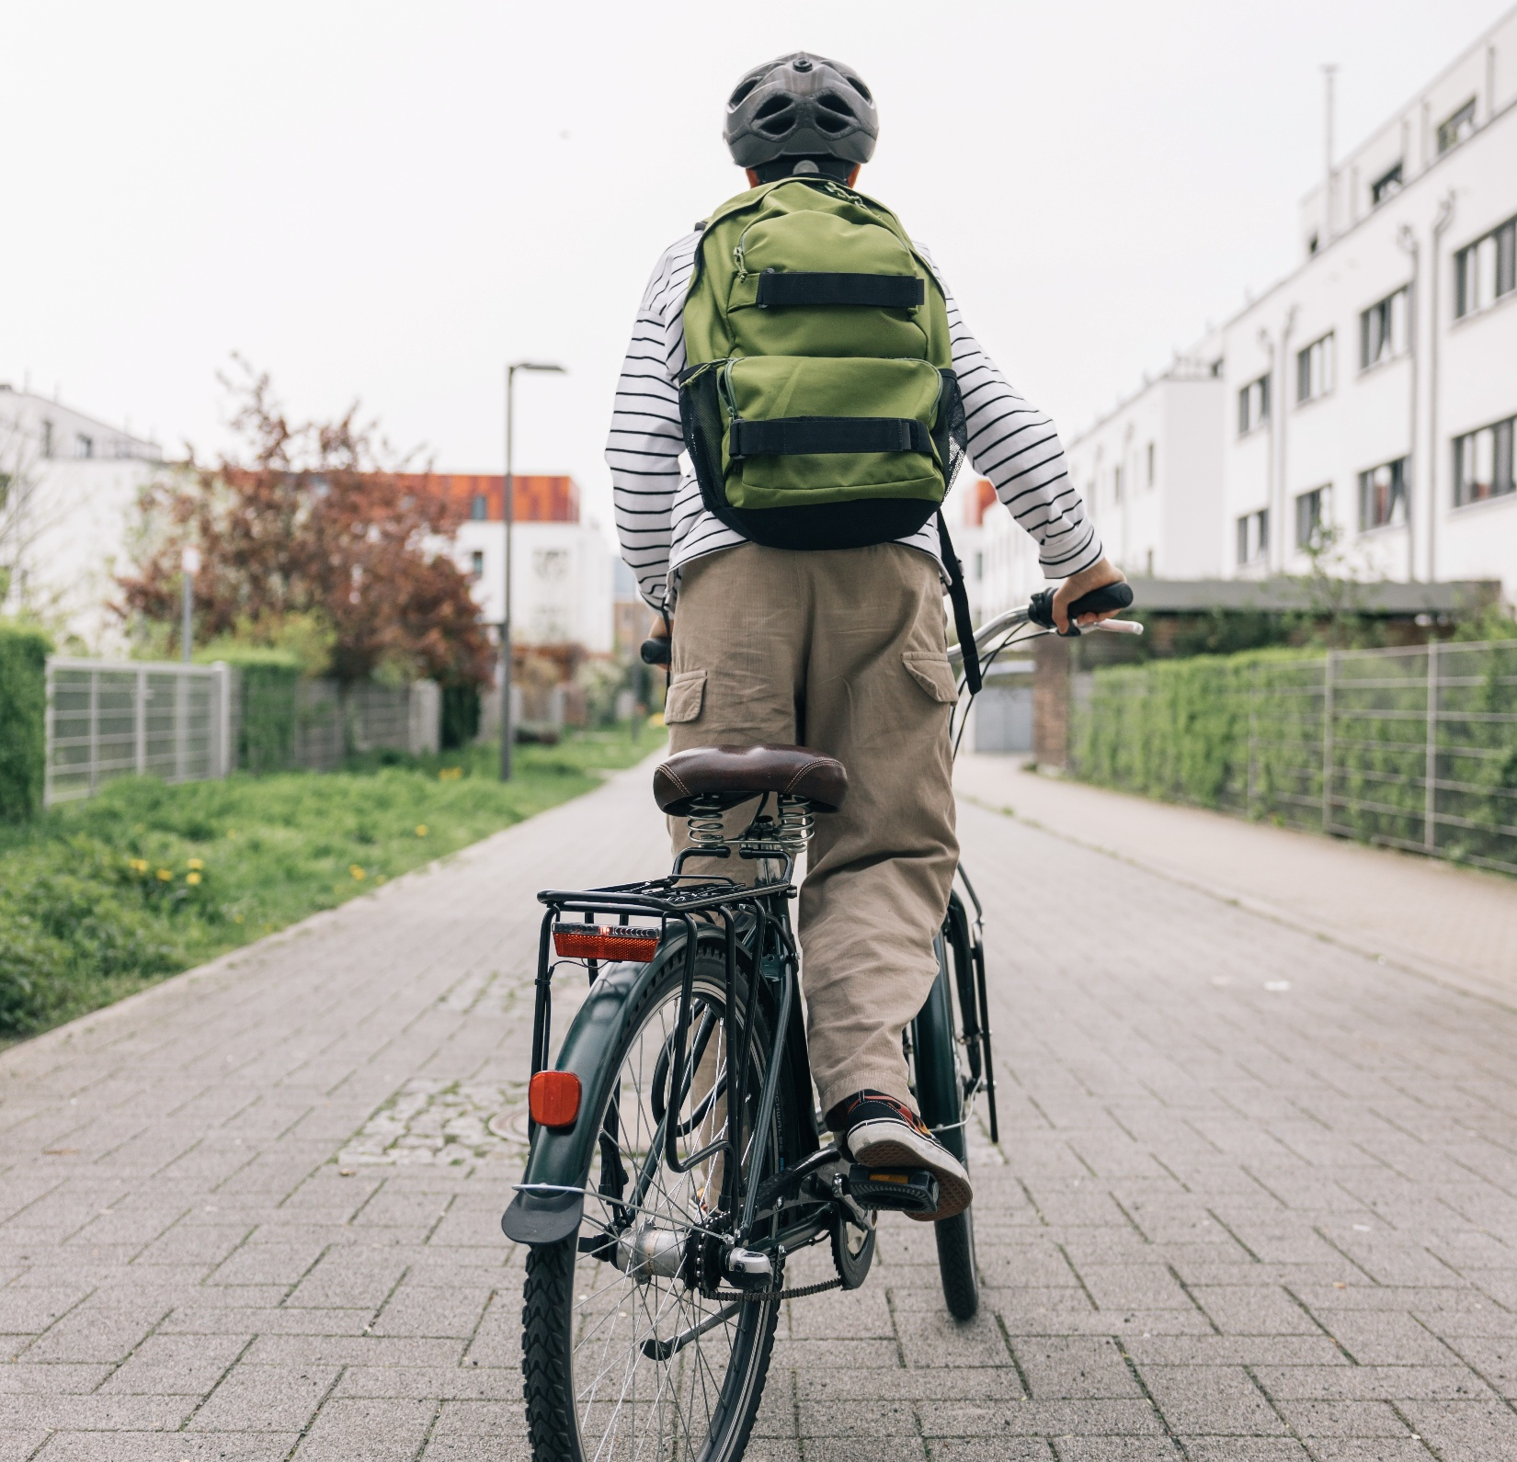
Activity: Climate café
Duration: 45–60 minutes.
Description: a participatory, dialogue-based method that creates an informal and inclusive space for open conversations about climate and sustainability. Through small-group discussions at themed tables, participants share perspectives, reflect on challenges and explore possible actions together.
Steps:
Set up “Climate Café” tables by theme.
(e.g. food, mobility, energy, waste, inclusion, etc.)
Use discussion cards with questions.
(e.g., “What’s one small change you could make?”)
Rotate tables every 10 minutes.
Close with shared insights: “What will we change together?”
Learning goal: Empathy, shared responsibility, connection, critical thinking and awareness.
Notes:
Introduce the "Climate café" as a peer-to-peer activity for discussing climate topics. Each table covers a theme (e.g. food, mobility, fashion, waste) with discussion cards guiding the conversation. Students rotate tables every 10 minutes, engaging with new peers and perspectives. Conclude with a plenary reflection: “What will we change together?”. Share the learning goals of this approach to build empathy, encourage shared responsibility and strengthen critical thinking and awareness.

Slide 4

Activity: Climate debate lab
Duration: 1 hour.
Description: a structured, participatory method that helps students explore complex climate issues through respectful debate and critical reflection. By engaging with contrasting viewpoints, participants develop a deeper understanding of the social, environmental and ethical dimensions of climate decisions.
Steps:
Divide into two groups: for and against a chosen topic.
(e.g., “Should we ban fossil-fuel cars by 2035?”)
Research 10 minutes (or before activity), debate 20 minutes
Reflect: What arguments were strongest?
How do values influence choices?
Summarise collective insights on a whiteboard or poster.
Learning goal: Argumentation, systems thinking, empathy.
Notes:
Debates are a powerful way to build critical thinking and empathy. Encourage students to explore different perspectives and reflect on how values shape decisions. Use the reflection moment to discuss how informed dialogue can lead to better climate solutions.

Slide 5
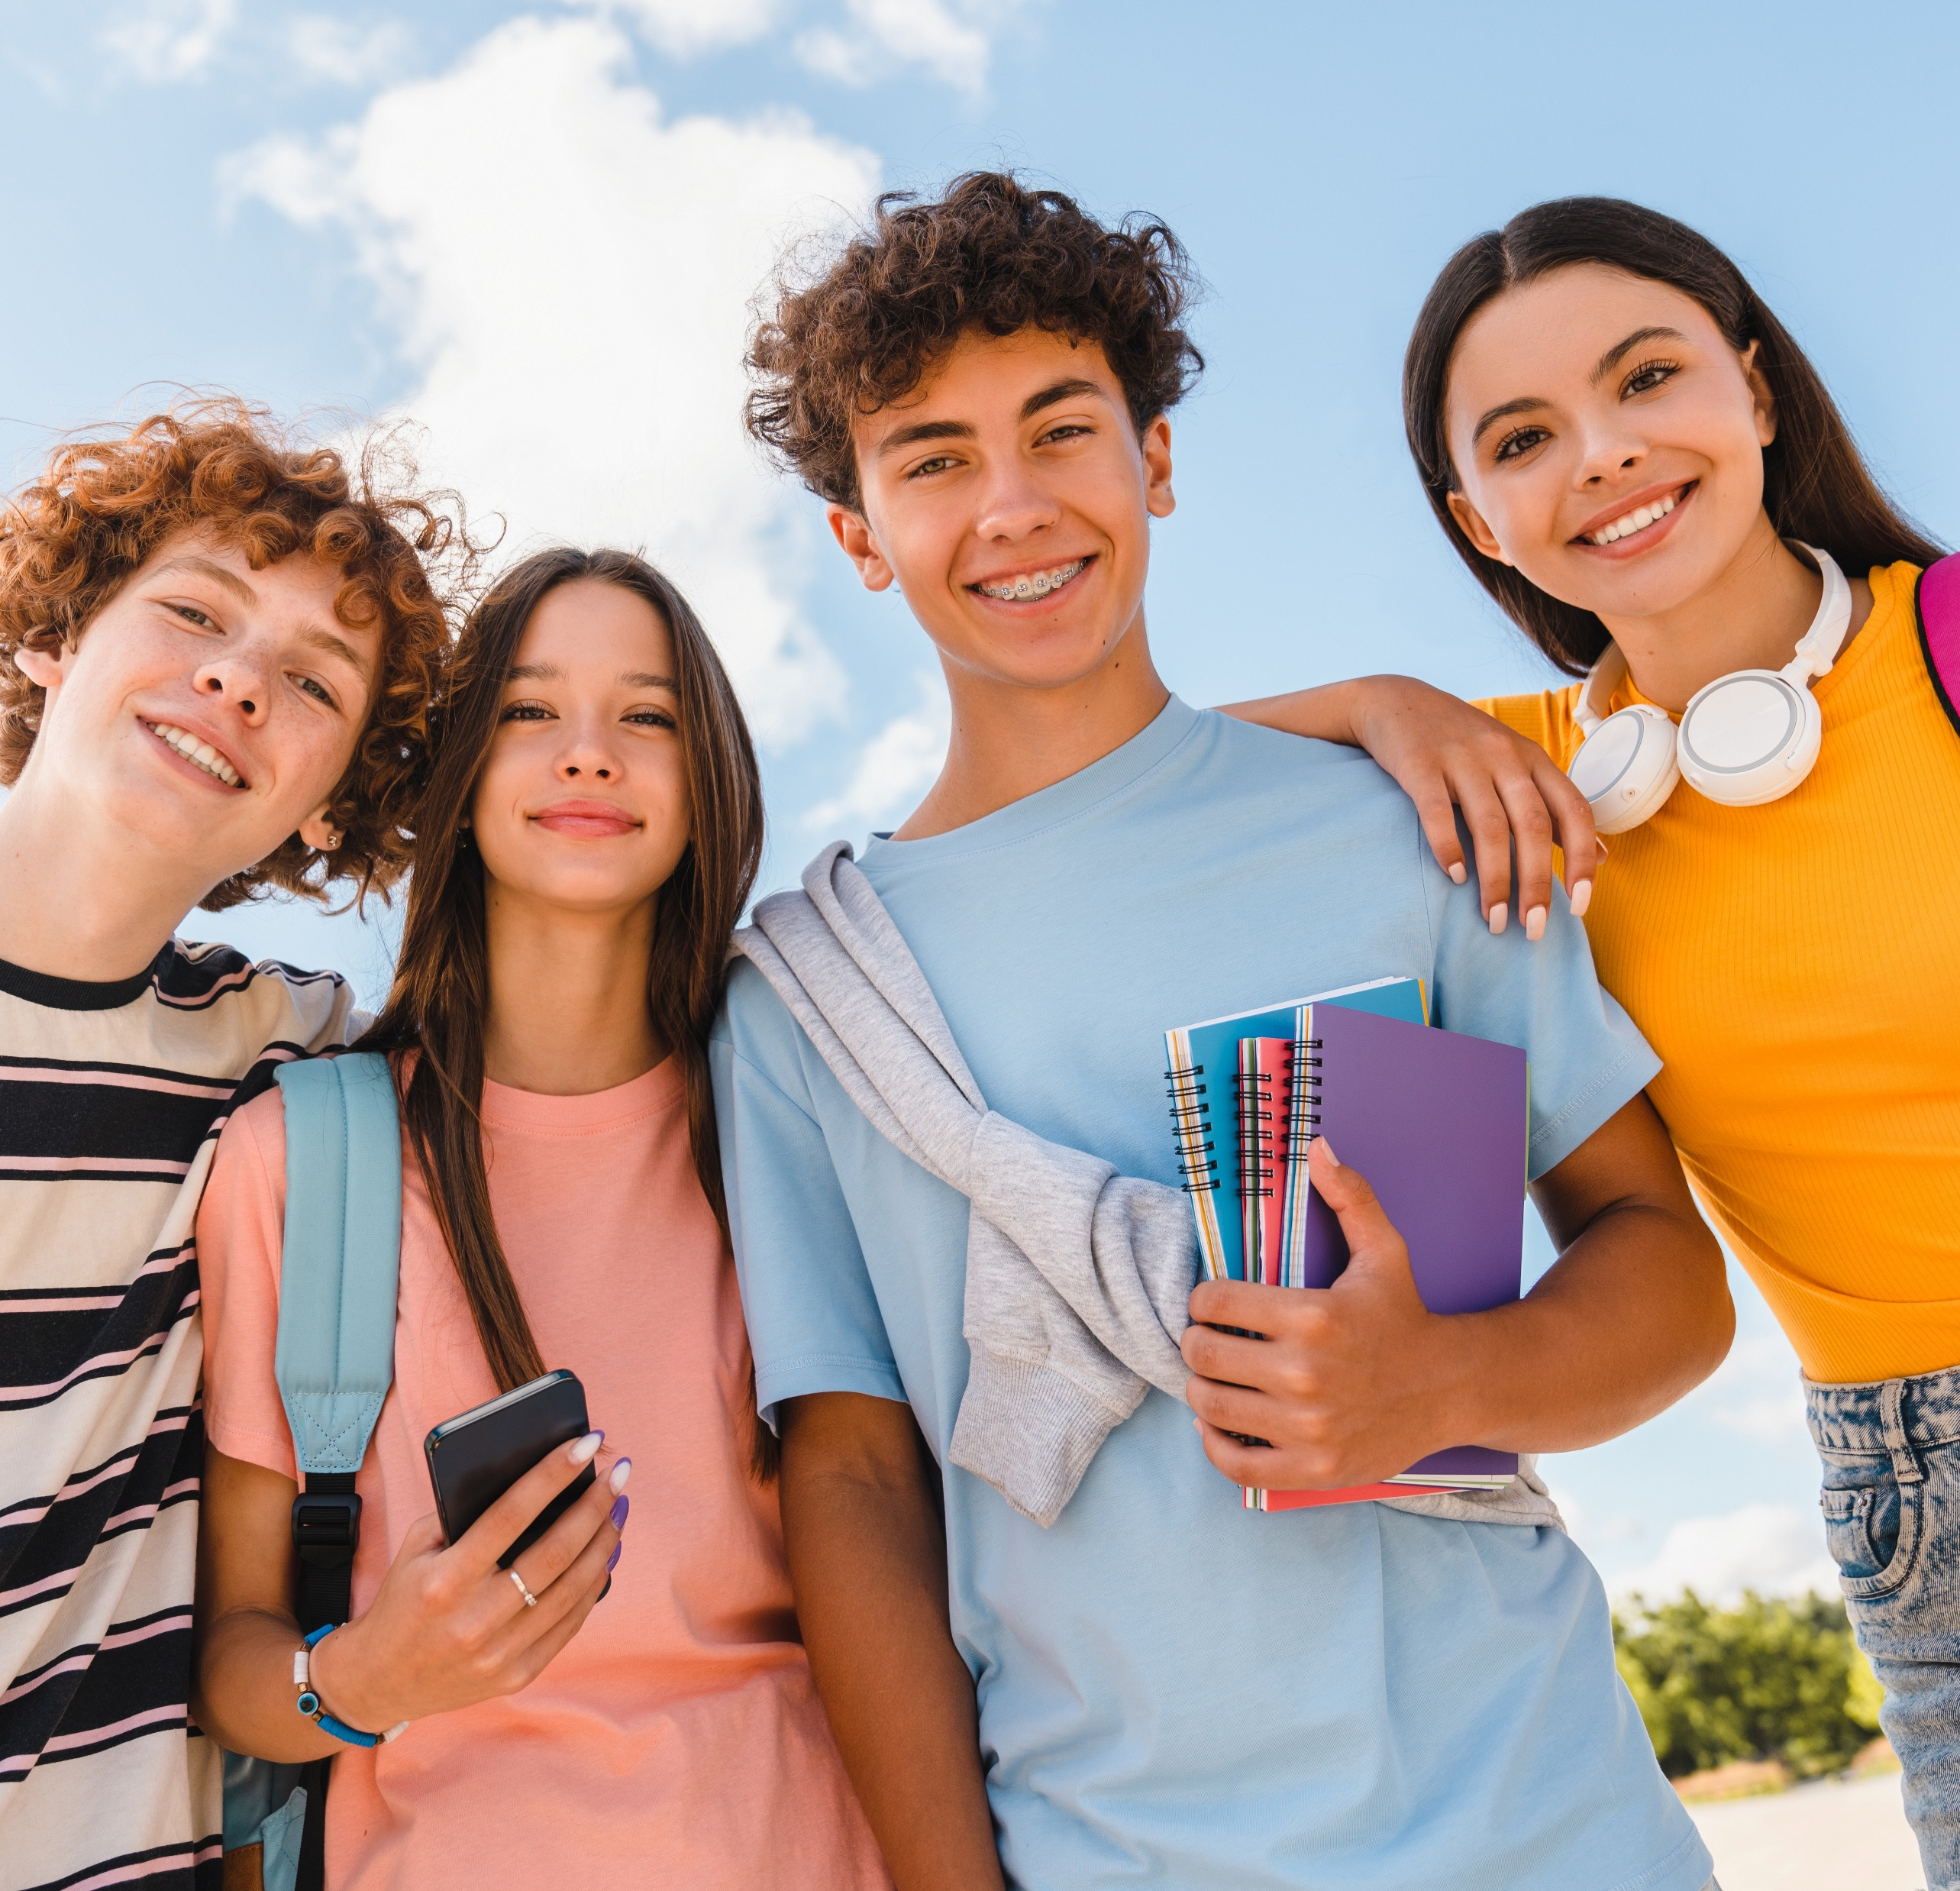
Activity: Draw the future
Duration: 1.5 hours.
Description: a creative, participatory foresight activity that invites participants to imagine and visualise a sustainable, climate-friendly and socially just future. Working in small teams, participants explore future scenarios and translate long-term visions into practical ideas for action.
Steps:
Start with a short intro: What does a climate-friendly and inclusive community look like in 2050?
In small teams, brainstorm future scenarios
Use creative tools (drawing, painting, etc.) or
digital tools (e.g. Miro) to visualise ideas.
Each group presents their “future vision” and
1–2 practical next steps.
Learning goal: Foresight, collaboration, creative thinking.
Notes:
This workshop encourages students to imagine a climate-friendly future and work backwards to identify actions they can take today. Use visual tools like drawings or digital boards to help students express their ideas. Highlight the importance of creativity and collaboration in shaping sustainable communities.

Slide 6

Activity: Energy detectives from data to action
Duration: 1 hour.
Description: a hands-on, inquiry-based activity where students analyse energy use in their everyday environments, identify saving opportunities, take simple actions, and reflect on the impact. It builds awareness by linking data, behaviour change and accountability.
Steps:
Encourage students to become energy detectives: Ask them to audit
energy use in their classroom, school, or home (lights, devices,
heating). You could divide them into small groups.
Spot the opportunities: Support students to discuss which
changes could save the most energy.
Take action: Ask students to pick simple actions (e.g., unplug
devices, turn off unused lights, adjust heating).
Measure the impact: Ask students to track what changes made
a difference and present the results
Reflect together: Help students to discuss what they learned.
Learning goal: Data literacy, behavioural change, accountability.
Notes:
This activity helps students understand their energy use and take responsibility for reducing it. Encourage them to track changes and celebrate improvements. Link the audit to broader climate goals and show how small actions can lead to measurable impact.
Resources:
CUBE.Schools energy challenge: What is it? – Energy Cube Challenge – Cubes énergie
European energy saving week resources: Resources - European Sustainable Energy Week - European Commission

Slide 7

Activity: Youth climate dialogue
Duration: 60–90 minutes
Description: a participatory method where young people co-create a dialogue with decision-makers on climate issues, share their perspectives and collaboratively develop actionable recommendations. It fosters empowerment, civic engagement and policy awareness.
Steps:
Define objectives and choose the appropriate political level.
Co-create agenda with youth participants: topics, questions, and discussion format.
Invite decision-makers (civil servants, regional authorities, representatives of other institutions, etc.).
Facilitate dialogue in-person or hybrid, ensuring all youth voices are heard.
Document outcomes and share recommendations publicly, e.g., via the Climate Pact platform or school/community channels.
Learning goal: To empower youth to engage in democratic processes through co-creation, structured dialogue and developing policy recommendations.
Notes:
Explain that the Youth Climate Pact Dialogue is a unique opportunity for young people to engage directly with policy makers. The format is flexible and adaptable to any political level: from local (mayor), regional, national (minister), to European (MEP or European Commission official). Share that the guidance document provides practical tips for organising dialogues, facilitating co-creation, and learning from previous Youth Climate Pact Dialogues, helping replicate or adapt this approach in each specific school, community or youth group.

Slide 8
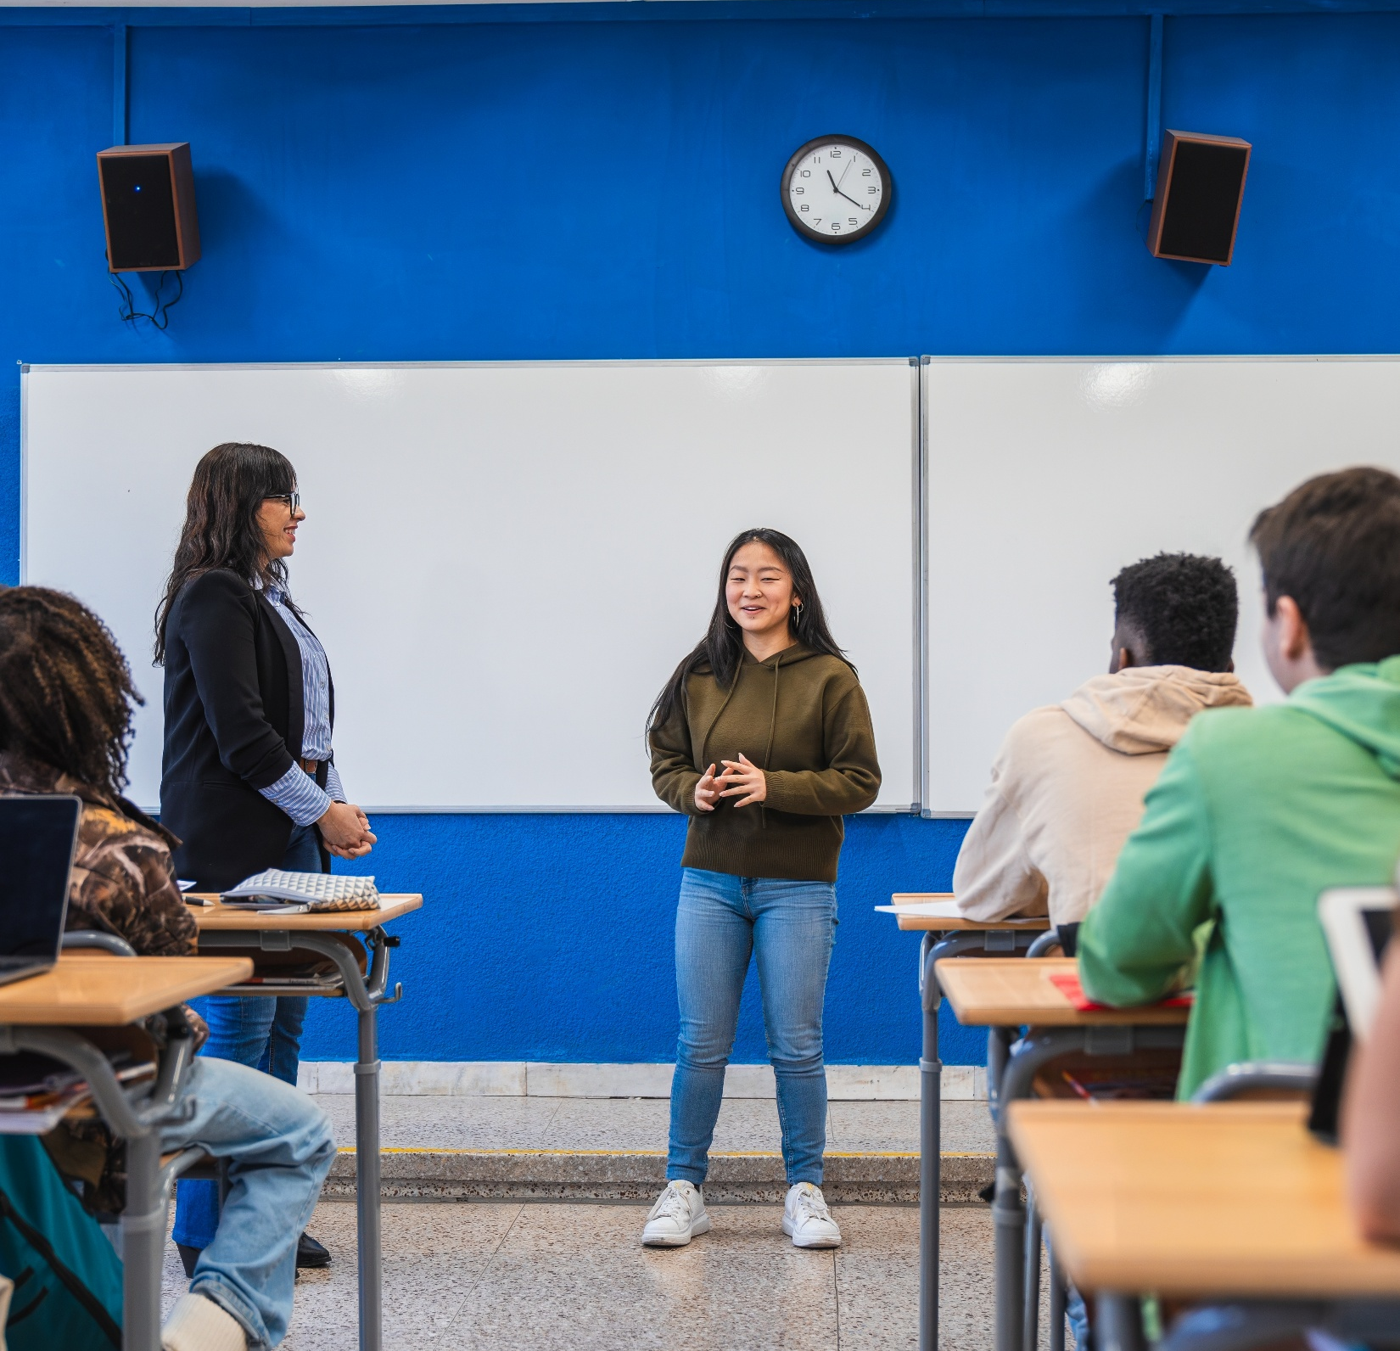
Activity: Peer parliament
Duration: 60–90 minutes.
Description: Peer Parliament, developed by the European Climate Pact with the support of the Pact community, is a participatory method where participants debate climate issues, propose solutions and make collective decisions by simulating a parliamentary process.
Steps:
Introduce the Parliament: Explain rules, roles and objectives (facilitator, speaker, note-taker).
Assign Topics: Climate-relevant themes such as energy, mobility, biodiversity, food Systems, etc.
Small-Group discussions: Students discuss issues and
generate proposals or solutions.
Plenary Debate: Each group presents recommendations;
peers ask questions or suggest changes.
Decision/Action voting: Students vote on top proposals to
take forward in school or community projects.
Optional follow-up: Present recommendations to school leadership, local authorities or other local actors.
Learning goals: Develop leadership, critical thinking, collaboration and advocacy skills
Notes:
Emphasize that Peer Parliaments allow students to experience democratic decision-making while learning about climate issues. Highlight the benefit of peer-to-peer learning: students learn from each other’s perspectives and co-create solutions. Suggest tailoring topics to local context: e.g., energy savings in the school, local mobility, biodiversity on campus. Encourage documenting proposals and sharing them via the Climate Pact to amplify student impact across schools and communities. Peer Parliament link: Peer Parliament - European Climate Pact - European Union

Slide 9

Activity: Local Climate action group
Duration: 1.5-2 hours
Description: This activity brings students together in small teams to collaborate on local climate action ideas
Steps:
Students form teams and choose a locally relevant climate topic (e.g. energy, waste, biodiversity).
Each team designs a simple awareness campaign, including a slogan, a visual element and a clear call to action.
Teams present their ideas and vote for the most inspiring or creative proposal.
Campaigns are shared within the school to amplify impact.
Learning Goal: To develop communication, teamwork and active citizenship skills and to encourage students to engage in collective climate action at the local level.
Notes:
This workshop empowers students to become climate communicators. Encourage bold ideas and teamwork. After presentations, discuss how campaigns can influence behaviour and policy. If possible, share the winning campaign on school or Climate Pact platforms.

Slide 10
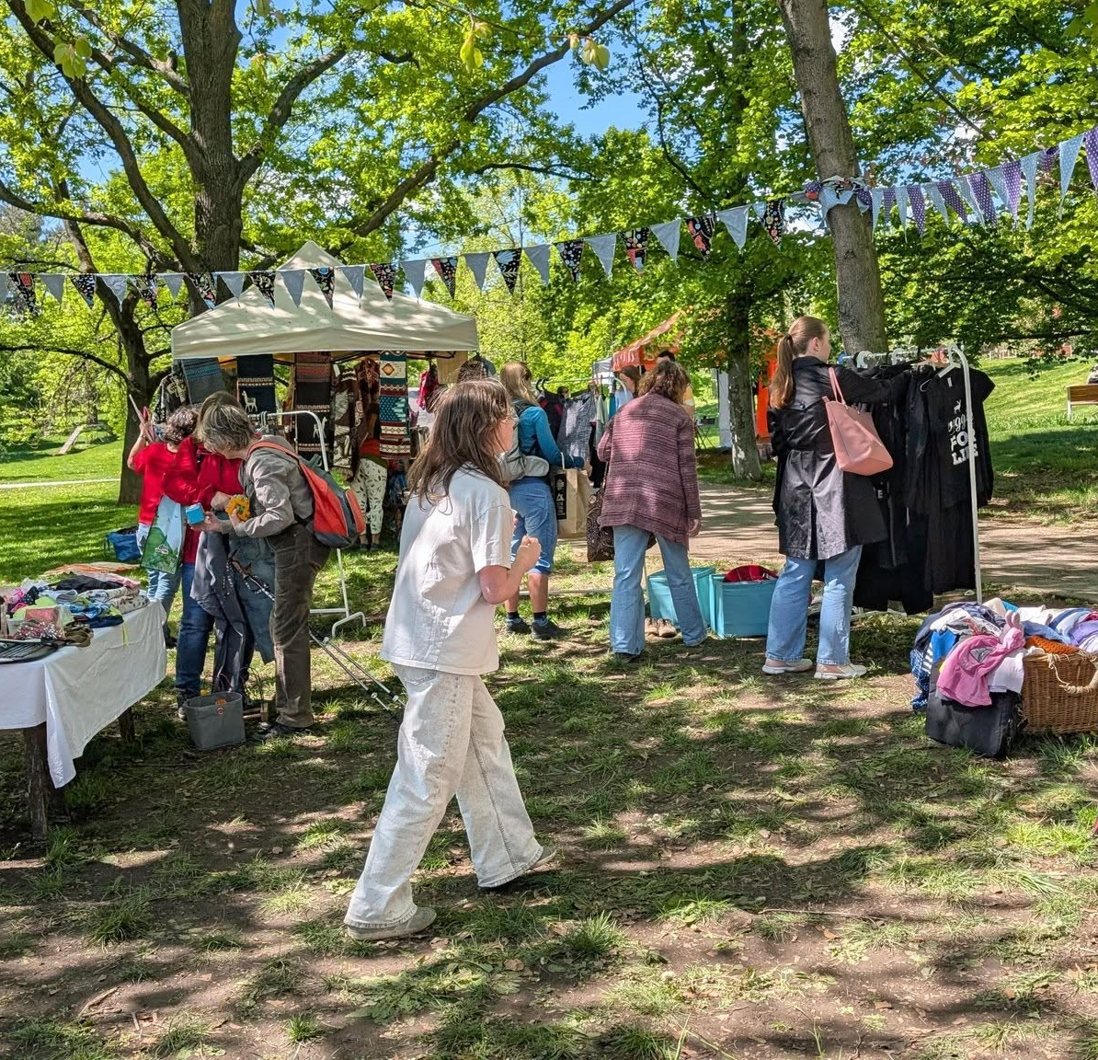
Activity: Circular fashion
Duration: 1 hour
Description: an interactive activity where students explore the environmental impact of clothing, calculate footprints and brainstorm circular solutions such as second-hand, repair or swaps.
Steps:
Encourage students to discuss how fashion affects the planet. Ask critical questions.
Calculate carbon/water footprint of an item.
Brainstorm alternatives: second-hand, swaps, repair.
Encourage students to present ideas for a “Sustainable Fashion Challenge.”
Learning Goal: Understanding circular economy and consumer choices.
Notes:
Encourage students to think critically about their clothes. Ask critical questions (e.g. where are our clothes produced and how? Do you know what are the negative impacts (social, environmental, economic) of fast fashion?
Related resources:
Let’s Fix Fashion Campaign – Ireland: Let’s Fix Fashion | Join | Green-Schools
Youth X Change – UNESCO: YouthXchange: towards sustainable lifestyles; training kit on responsible consumption, the guide - UNESCO Digital Library

Slide 11
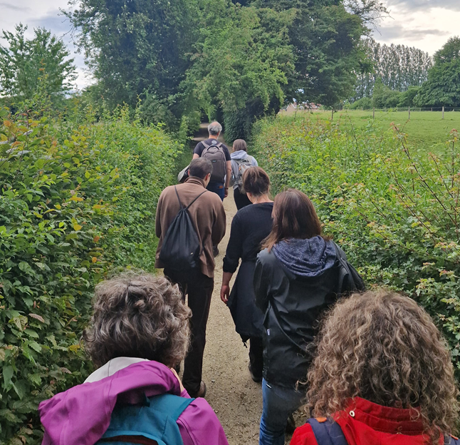
Activity: Climate Walk
Duration: 1 hour
Steps:
Introduce the Climate Walk and invite students to reflect on what they observe around them, using open questions to stimulate discussion.
Stop during the walk to estimate the carbon or water footprint of an everyday item or activity, making climate impacts tangible.
Brainstorm sustainable and circular alternatives, such as reuse, repair, sharing or other low-impact practices.
Conclude with students sharing ideas for a simple “Sustainable Challenge” they could implement at school or in their community.
Learning Goal: Understanding circular economy and consumer choices.
Notes:
Encourage students to think critically about their clothes. Ask critical questions (e.g. where are our clothes produced and how? Do you know what are the negative impacts (social, environmental, economic) of fast fashion?
Related resources:
Let’s Fix Fashion Campaign – Ireland: Let’s Fix Fashion | Join | Green-Schools
Youth X Change – UNESCO: YouthXchange: towards sustainable lifestyles; training kit on responsible consumption, the guide - UNESCO Digital Library

Slide 12

Activity: Photo story
Duration: 1 hour
Description: a creative and participatory method developed by the European Climate Pact that lets participants capture and share climate-related issues using photography. Students explore local climate challenges and solutions, build empathy, and communicate their
perspectives to the wider community.
Steps:
Explain the activity, goals and basic rules.
Photo capture: Participants take photos illustrating climate-related issues or solutions.
Selection and captioning: Students choose key images and write brief captions explaining their significance.
Students present photos in groups, discuss perspectives and build shared understanding.
Students compile images and captions into a photo story.
Sharing: Share the final story with school and local community.
Learning Goal: develop awareness, empathy, communication skills, and civic engagement
Notes:
Encourage students to think critically about their clothes. Ask critical questions (e.g. where are our clothes produced and how? Do you know what are the negative impacts (social, environmental, economic) of fast fashion?
Related resources:
Let’s Fix Fashion Campaign – Ireland: Let’s Fix Fashion | Join | Green-Schools
Youth X Change – UNESCO: YouthXchange: towards sustainable lifestyles; training kit on responsible consumption, the guide - UNESCO Digital Library

Slide 13
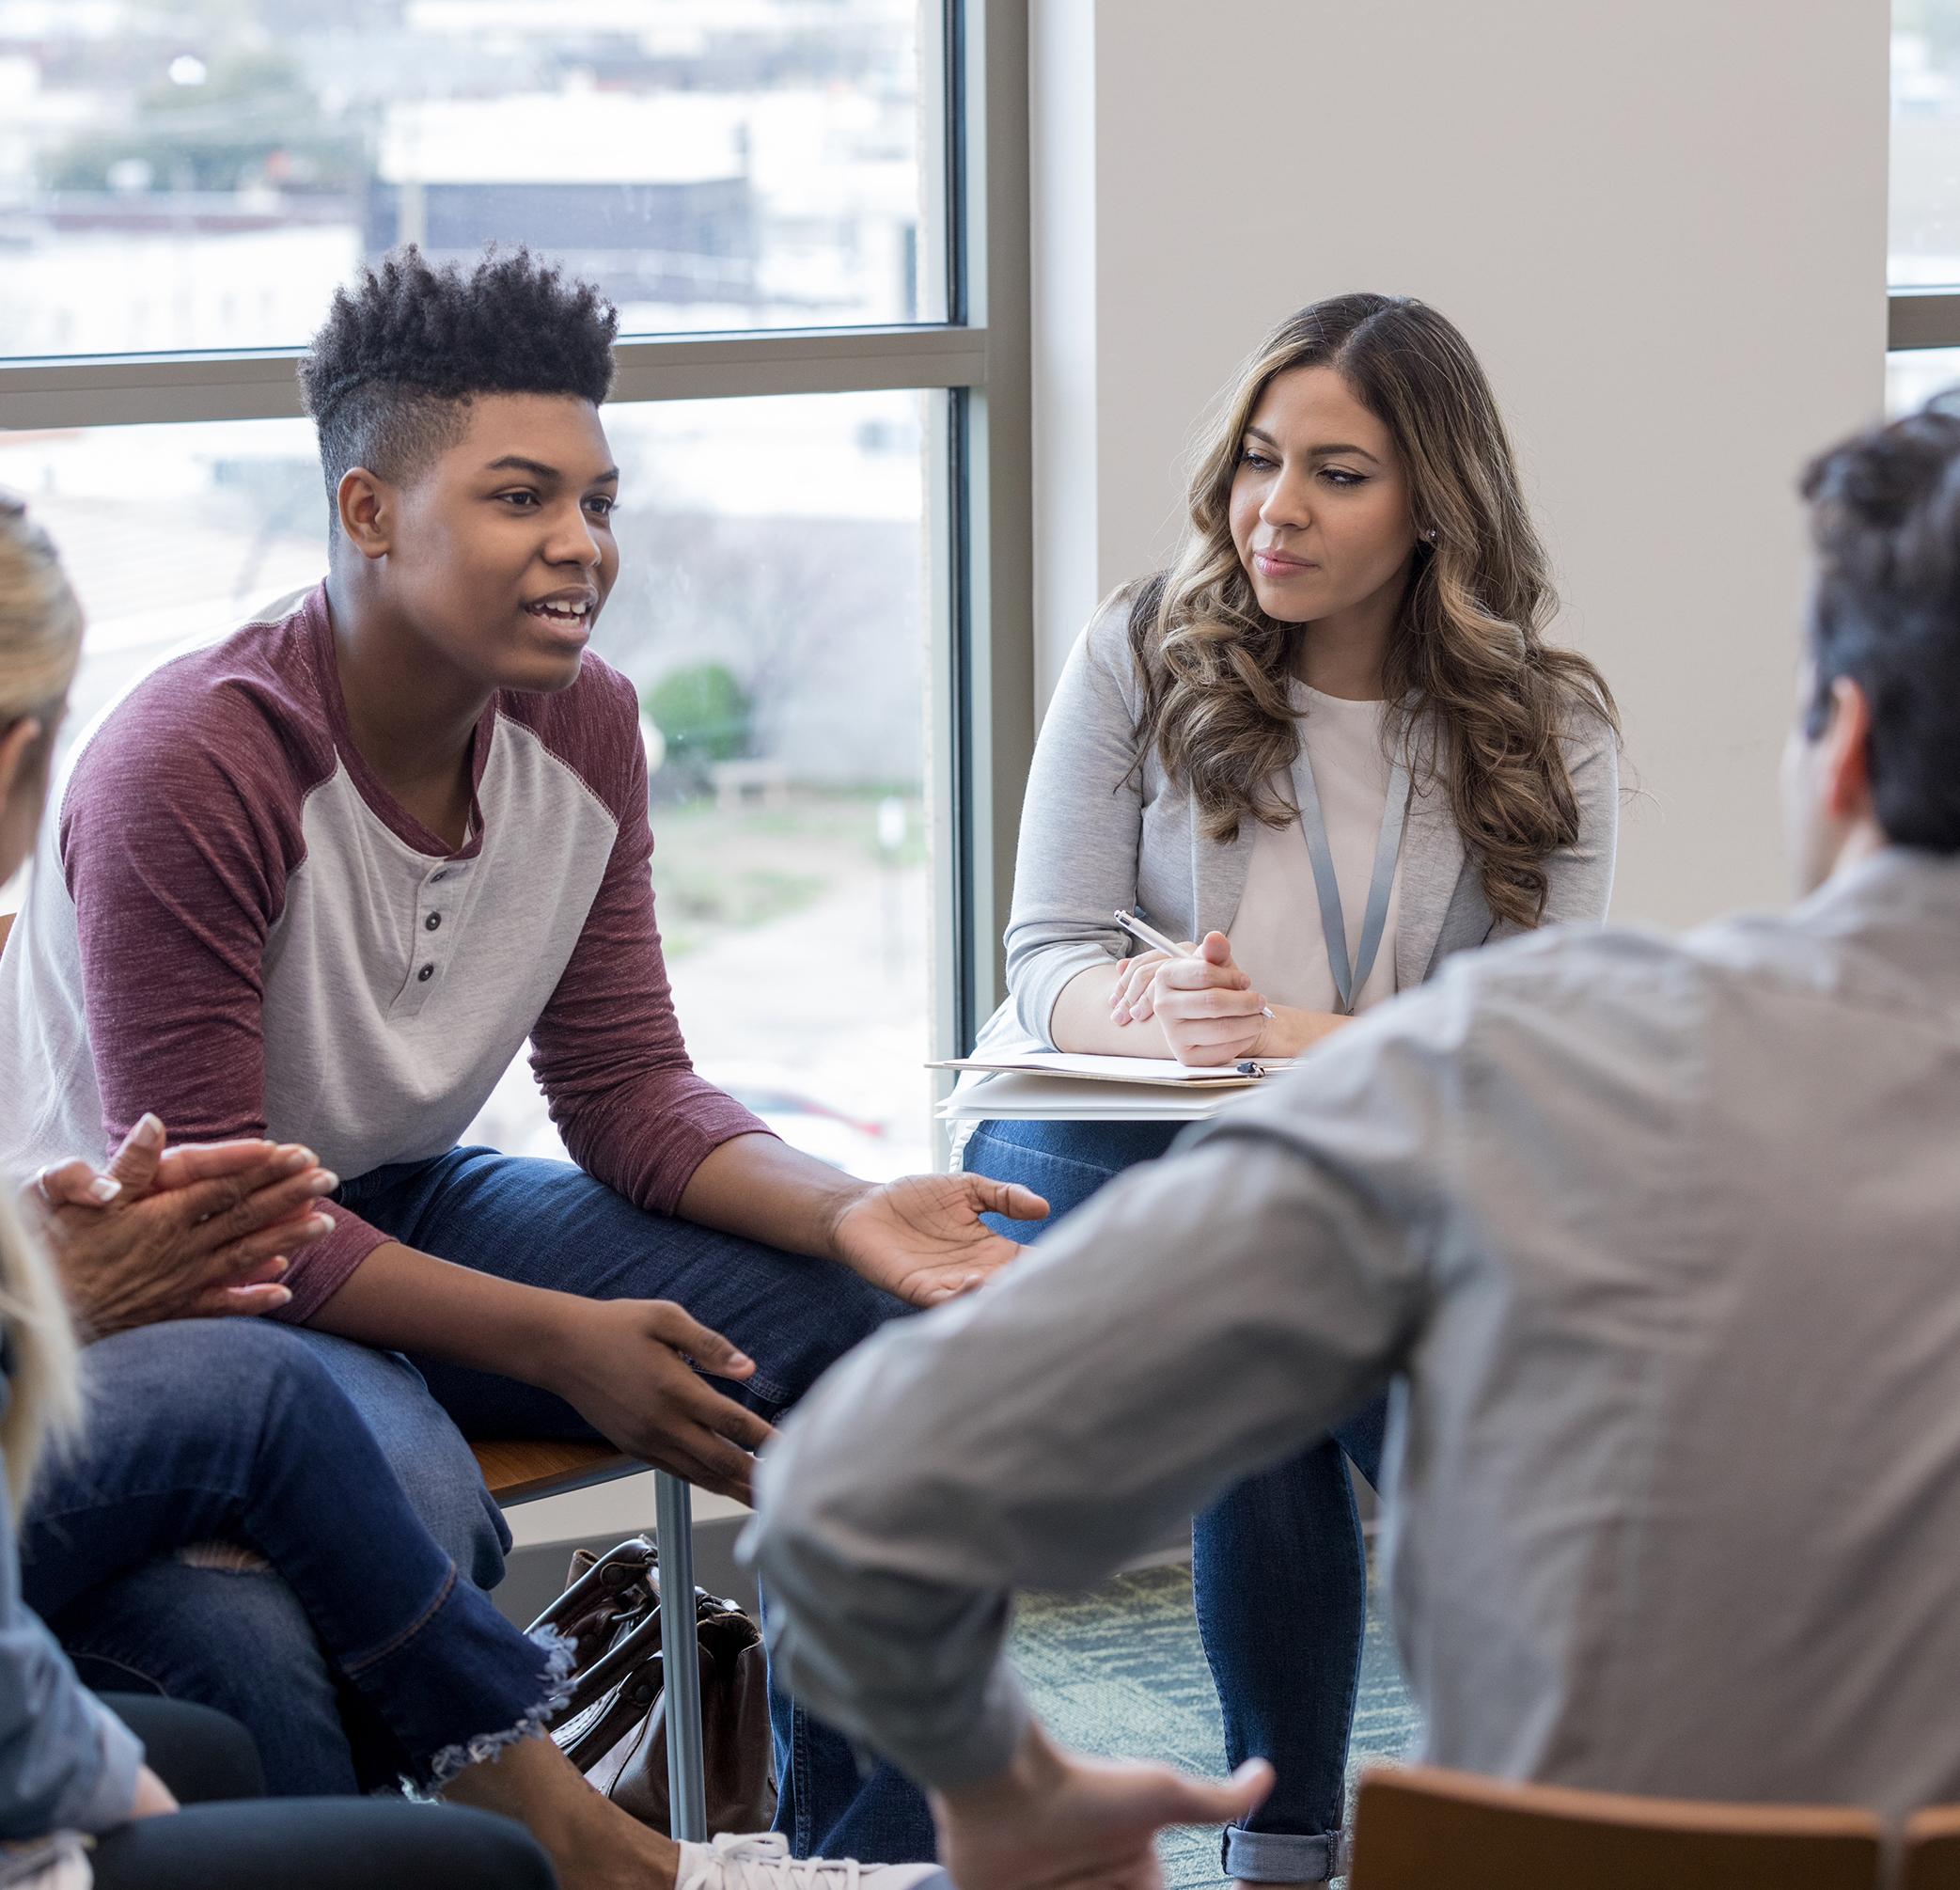
Activity: Climate games
Duration: 1 hour (flexible depending on chosen game)
Description: an interactive, playful method developed by the European Climate Pact that engages participants in climate topics through quizzes, bingo or movement-based challenges. It fosters awareness, curiosity, conversation, and positive climate action in a fun and social way.
Steps:
Select here a climate‑themed game that suits your group (e.g., bingo, quiz, relay, board game).
Explain the rules and the climate concept behind the chosen game.
Support students to play and engage, encouraging them discuss and reflect.
At the end, invite students to share what they learned or found surprising and support group discussions.
Optionally share results or photos within the school or community
Learning Goal: develop awareness, empathy, communication skills, and civic engagement
Notes:
Encourage students to think critically about their clothes. Ask critical questions (e.g. where are our clothes produced and how? Do you know what are the negative impacts (social, environmental, economic) of fast fashion?
Related resources:
Let’s Fix Fashion Campaign – Ireland: Let’s Fix Fashion | Join | Green-Schools
Youth X Change – UNESCO: YouthXchange: towards sustainable lifestyles; training kit on responsible consumption, the guide - UNESCO Digital Library

Slide 14

Join the Pact2School campaign
and the Pact2School Challenge!
Pact2School webpage: Join our new Pact2School campaign - European Union
Notes:
Conclude by encouraging teachers and other education community members to join the Pact2School campaign. The campaign aims to support children, youths, teachers and the rest of the education community to explore green action and sustainability topics, it also aims to develop meaningful partnerships between the Climate Pact community and schools and universities.
The campaign aims to inspire students and teachers by organising awareness raising sessions on the sustainability and climate action topics as well as to support schools to participate in the Pact2School challenge by submitting impactful student-led project ideas and get up to 1000 euros in project funding.
Webpage link: Join our new Pact2School campaign - European Union

Slide 15
Explore the EU Climate Action Academy
Learn through webinars and courses and download tools to support climate action
Notes:
Encourage students to explore the EU Climate Action Academy as part of the Climate Pact: a platform that supports learning and capacity building on climate action. It offers free webinars and courses on a wide range of climate topics, as well as practical resources that can be downloaded and used in schools, communities or local initiatives. It’s a useful place to deepen knowledge and get inspired by concrete climate action examples across Europe. EU Climate Action Academy

Slide 16

Thank you for
helping our planet!

Slide 17
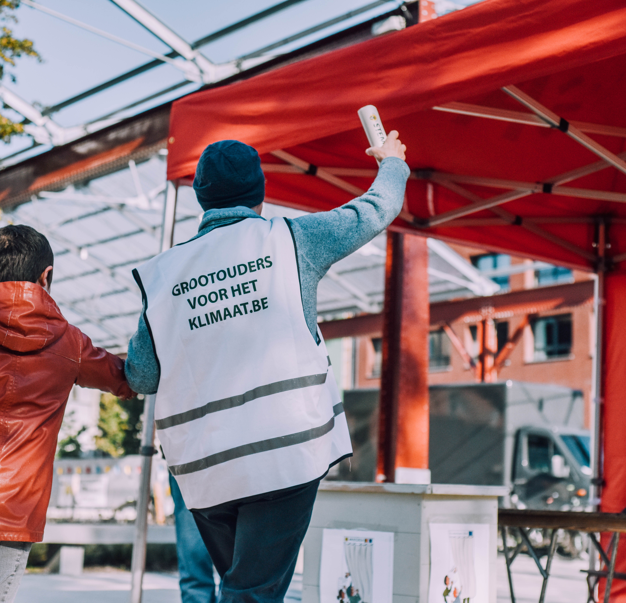
THEME:
Activity:
Duration: XX
Step-by-Step:
XX
XX
Learning goal:
Notes:
Feel free to add any activity that you might know and that you would like to share with teachers or other members of the education community.

