Slide 1
Mastering effective
Climate communication
Navigating difficult climate conversations
Tuesday 10 December 2024

Slide 2

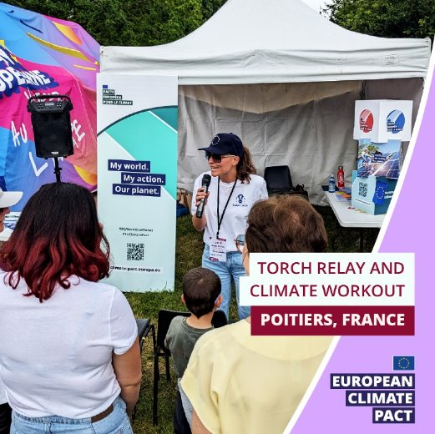

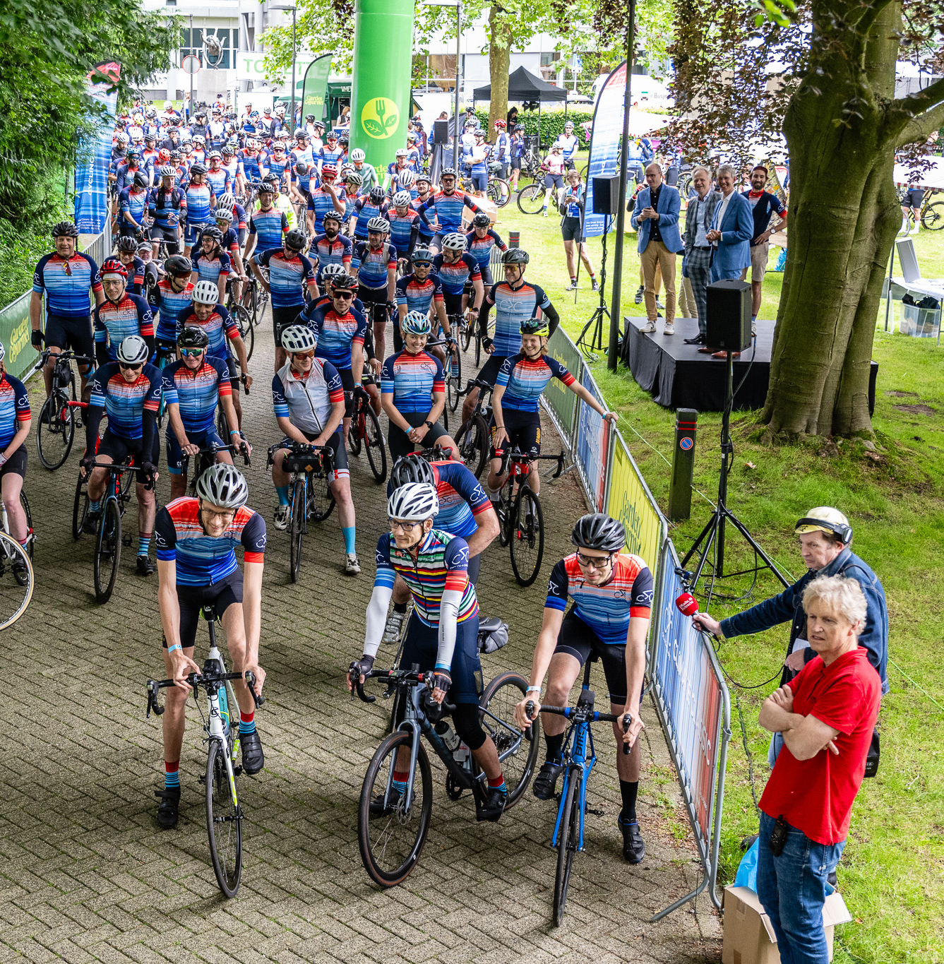


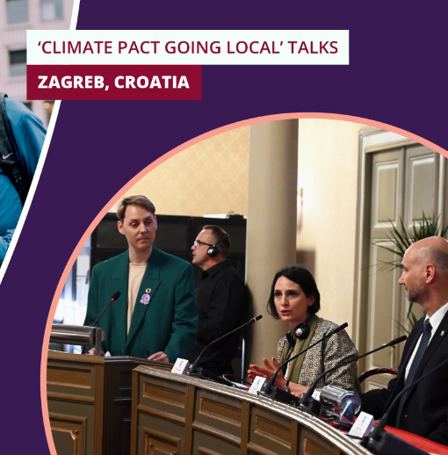


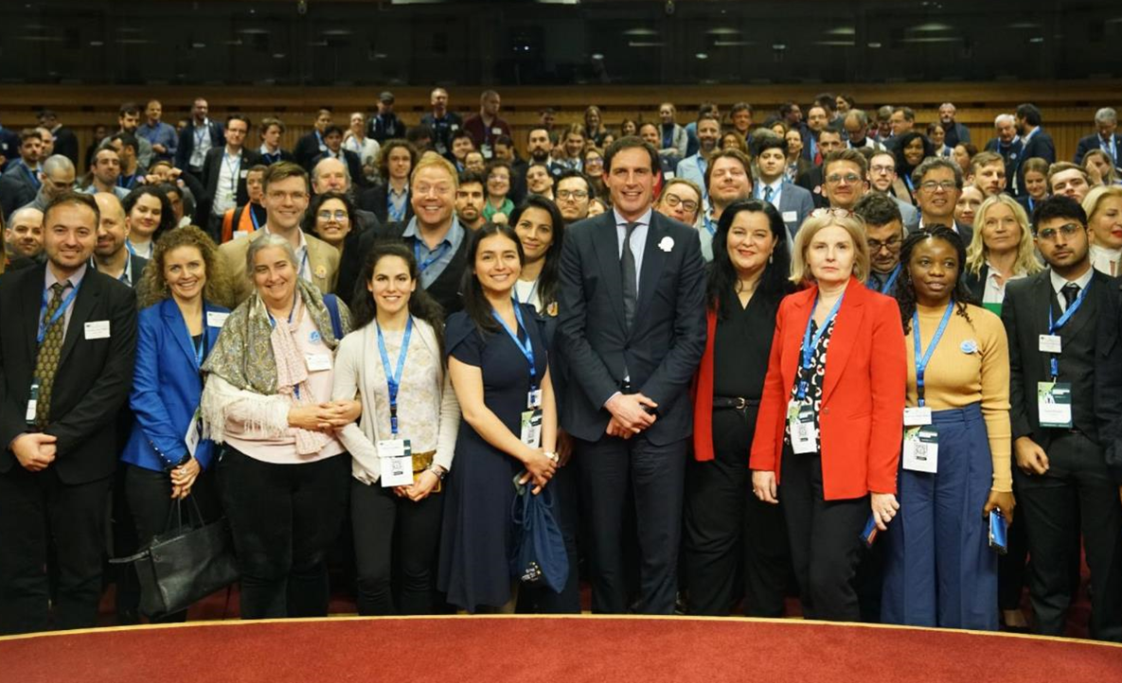
What's the EU CLIMATE Pact?
“My World. My Action. Our Planet.”
Initiative launched by the European Commission aiming to create a movement of people, communities and organisations united around climate action.
As part of the European Green Deal, it is helping the EU meet its goal to become climate-neutral by 2050.
6
group activity ideas for citizen engagement
200+
events in EU Member States
800+
Climate Pact Ambassadors
in all MS
52
Climate Pact Partners
142
Climate action resources on website
Notes:
The Climate Pact is an opportunity for people, communities and organisations to participate in climate action across Europe:
Learn about climate change
Develop and implement solutions
Connect with others and maximise the impact of these solutions
As part of the European Green Deal, the Pact aims to become a lively space to share information, debate and act on the climate crisis, and offer support for a European climate movement to grow and consolidate.
What are the Pact’s objectives?
Raise awareness of climate issues and EU actions
Encourage climate action & catalyse engagement
Build a community of individuals and organisations that act on climate and help them to learn from each other
As our community grows, so will the scope of the Pact’s activities. Be sure to check in regularly to find out about our latest developments.
Motto: “My World. My Action. Our Planet.”
In every Member State, Country Coordinators (CCs) and PR agencies organise and promote events and activities for the local Pact community and the public, such as: Citizen engagement activities, Capacity development workshops, Learn and share sessions
-> Climate Pact Ambassadors are leaders of organisations, communities, informal groups or movements, local authorities, representatives of cultural institutions, influencers (etc.). Currently more than 800 Ambassadors.
-> Climate Pact Partners are organisations committed to addressing climate change and contributing to a sustainable future.
Quick-start tools for citizen engagement:
•Get inspired by the 6 quick and easy-to-implement practical approaches published on the Pact website: Climate walk, Climate games, Sustainable Potluck Meal Photo story, Peer parliament, Local climate action group
•Share the results with the European Climate Pact
•Disseminate your activity and its results and invite others to host!

Slide 3

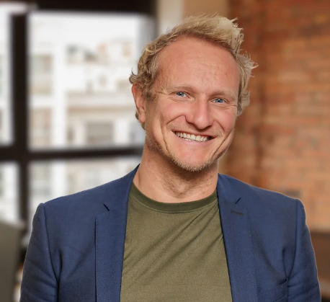
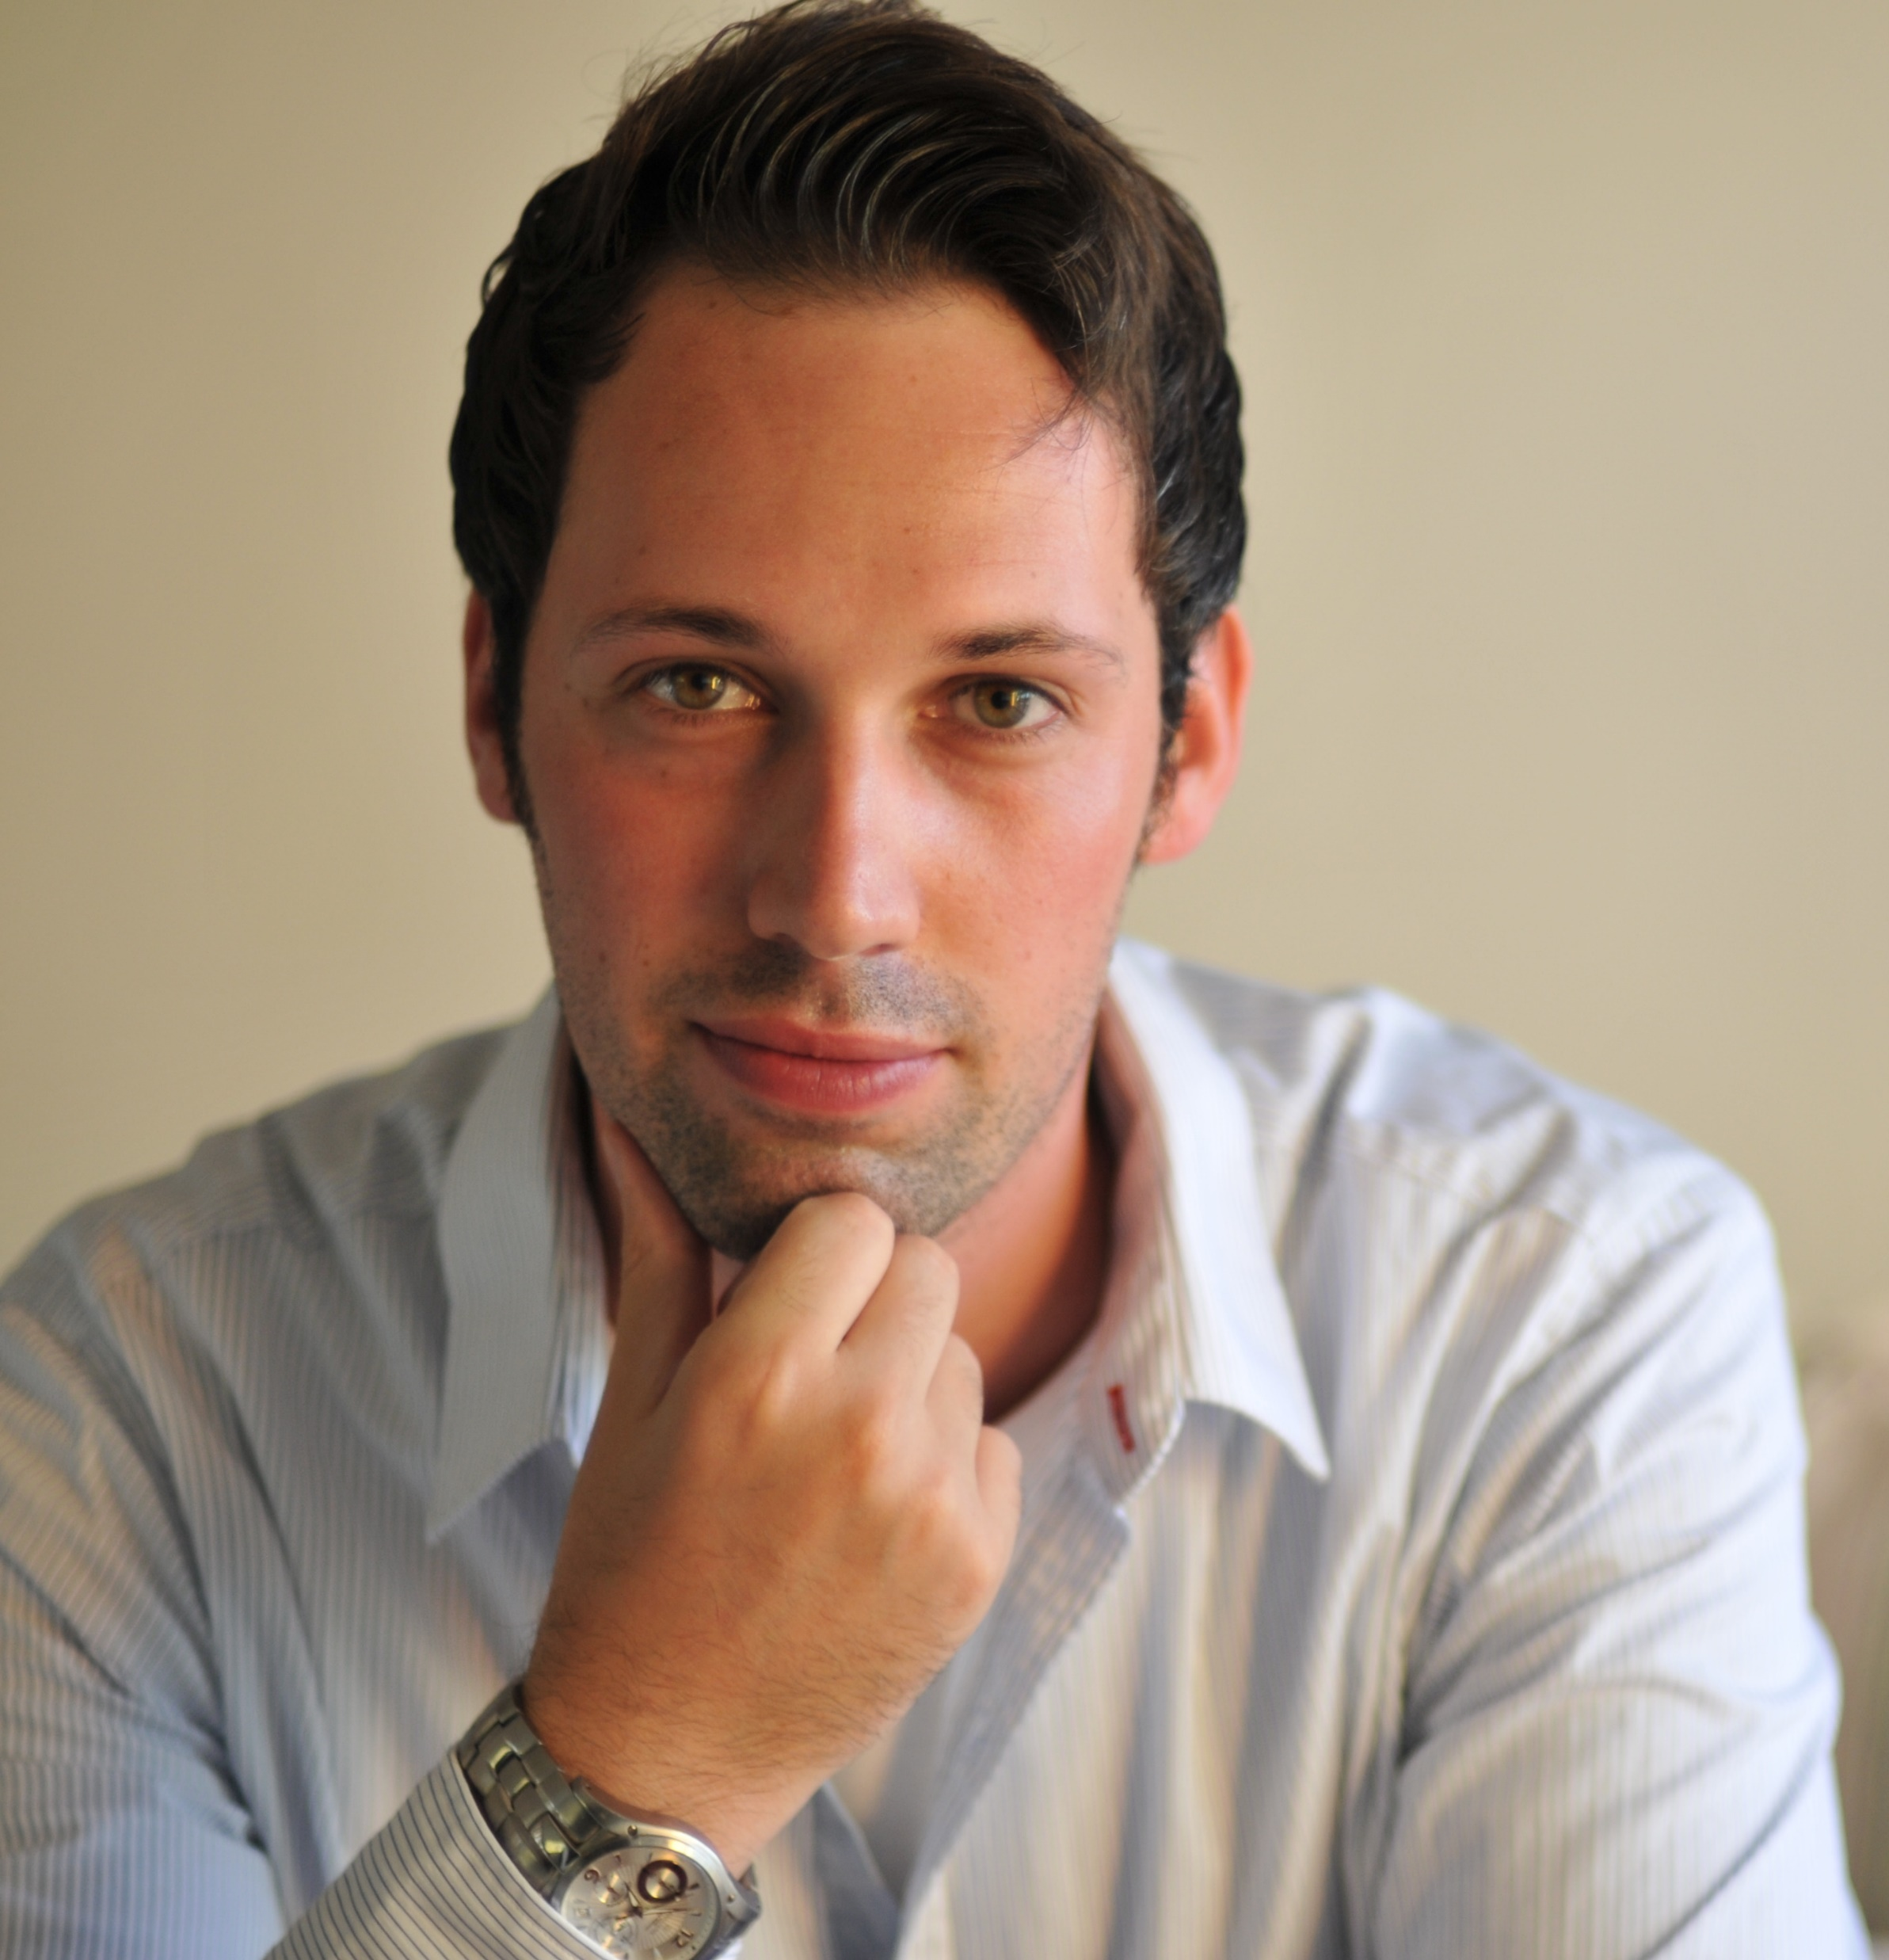



Introduction
Merel
Griepink
Research Consultant
@ PredictBy
Prof. Dr. Frans Folkvord
Co-founder and Director
@ PredictBy
Prof. Dr. Sander
v.d. Linden
Professor University of Cambridge
and author of FOOLPROOF
Dr. Marc Esteve
del Valle
Climate Pact Ambassador and Assistant Professor University of Groningen

Slide 4



TOPICS FOR TODAY
Difficult Climate Conversations
Social Media
Disinformation

Slide 5
WHAT ARE DIFFICULT CLIMATE CONVERSATIONS AND WHAT IS CAUSING THEM?

Slide 6
Difficult climate conversations
Difficult climate conversations refer to discussions about climate change and related actions that are emotionally, socially, or psychologically challenging for participants - involve complex, polarizing, or uncomfortable topics such as environmental responsibility, lifestyle changes, political ideologies, or collective inaction.

Slide 7
Difficult cLimate conversations
They can be difficult due to emotional barriers (e.g., guilt, fear, denial), cognitive challenges (e.g., conflicting beliefs or values), or social dynamics (e.g., fear of judgment, differing opinions, or cultural norms).

Slide 8
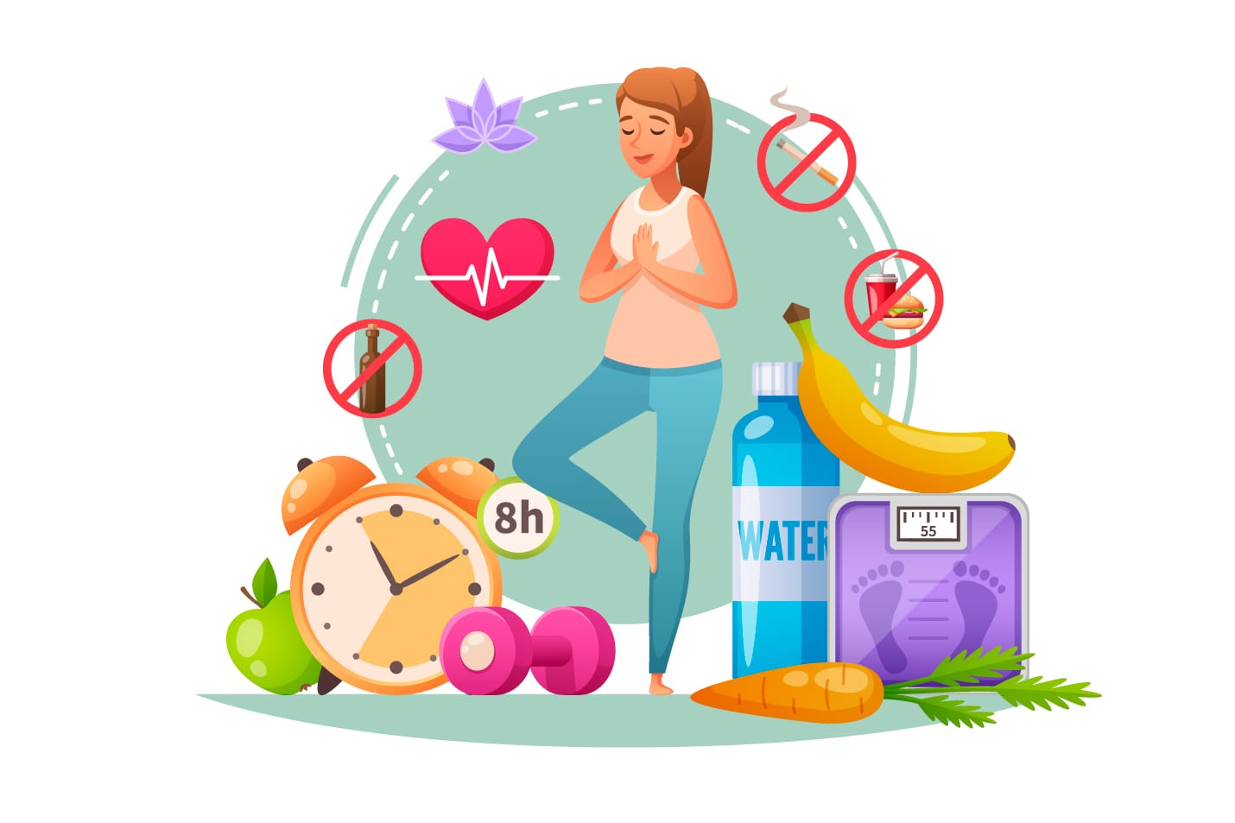
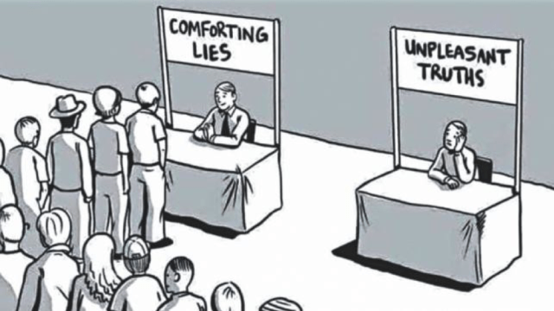

Intro & Background
Factors leading to
difficult climate conversations
Threat to identity and Values
Cognitive Dissonance
Psychological distance

Slide 9
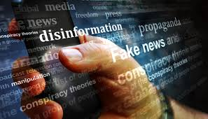


Intro & Background
Factors leading to
difficult climate conversations
Disinformation
Echo chambers
Polarization

Slide 10
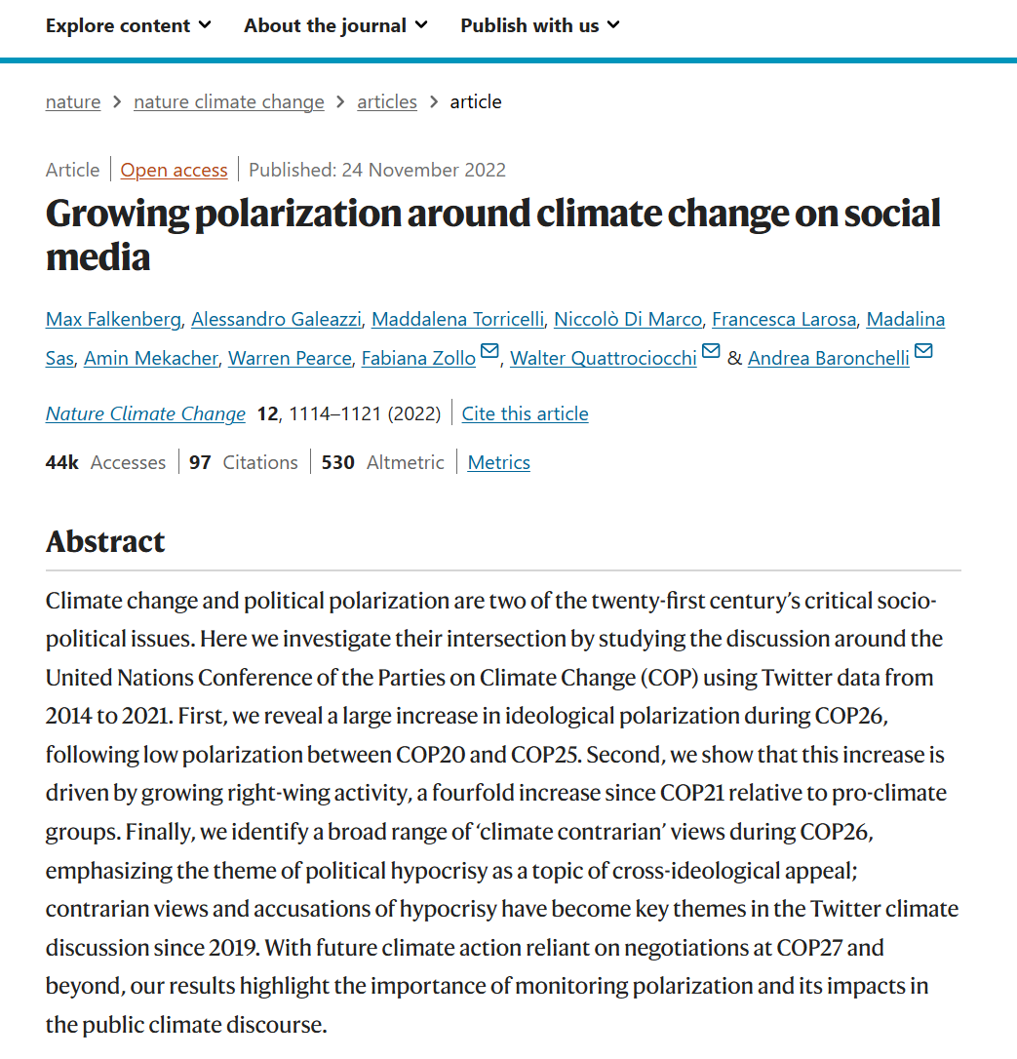
Intro & Background
climate conversations
On social media
General polarization in society and politics
Homophily in communication - echo chambers
The use of algorithm of online platforms to boost advertising revenues
Accusations of hypocrisy

Slide 11
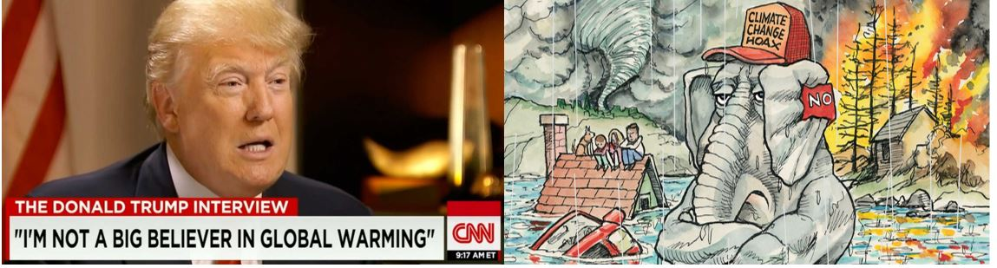
Trend towards more difficult
Climate conversations
CNN – Interview with Donald Trump
The Economist - Sep 4th 2021

Slide 12
HOW TO MANAGE DIFFICULT CLIMATE CONVERSATIONS

Slide 13
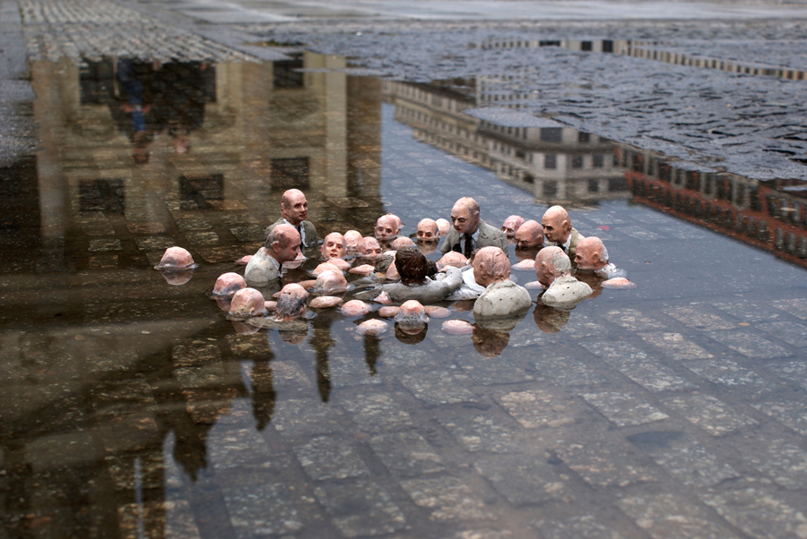
Intro & Background
Difficult climate conversations
Current state
Isaac Cordal – ‘Follow the leaders’ or ‘Politicians discussing global warming’, Berlin, Germany

Slide 14
Climate psychology therapy
Strategies for Overcoming Barriers
Start with shared values: Focusing on common ground - health, community well-being, or economic benefits
Empower action: Highlighting achievable solutions and impact of small steps can counter feelings of helplessness.
Use narratives and emotions (Webinar #1): Stories and personal experiences can create emotional connections that overcome psychological distance.
Normalize the discussion: Demonstrating that climate conversations are common and socially acceptable can reduce the stigma and fear of judgment.

Slide 15
Inoculating against
climate disinformation
Sander van der Linden
10 December 2024
Professor of Social Psychology in Society - Department of Psychology, University of Cambridge
@Sander_vdLinden

Slide 16
Misinformation
Disinformation
Propaganda
“Fake
news”
What is
“fake news”?
Misinformation
  “False, misleading, or incorrect information” (including human error).
Disinformation (misinformation + intent)
  “The purposeful spread of false or misleading information with the explicit intent to cause harm or to confuse and deceive others”.
Political Propaganda (disinformation + political agenda)
  “Institutionalized or state-run public indoctrination campaigns”.
van der Linden, 2023

Slide 17
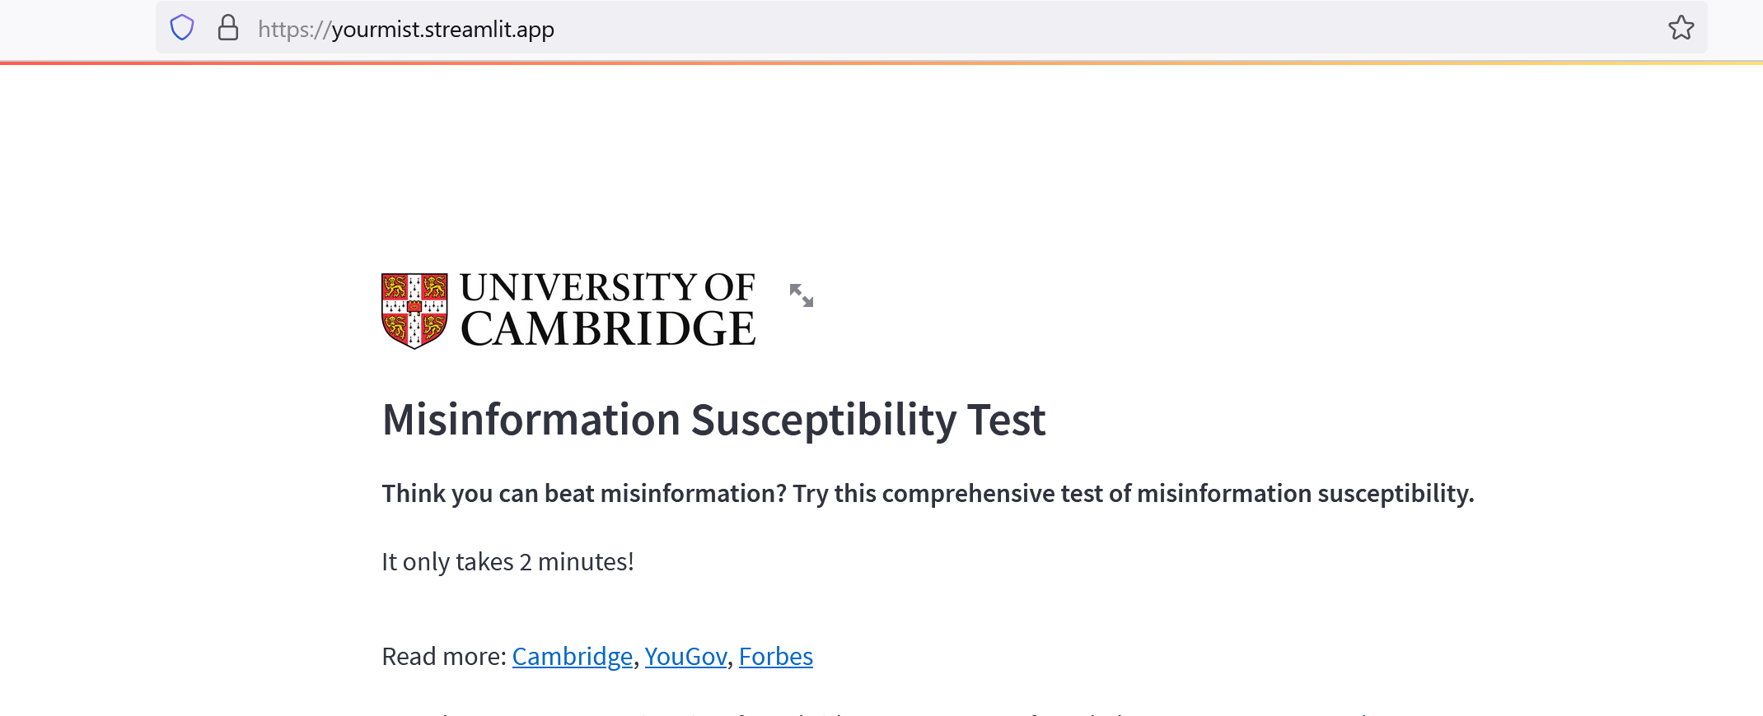
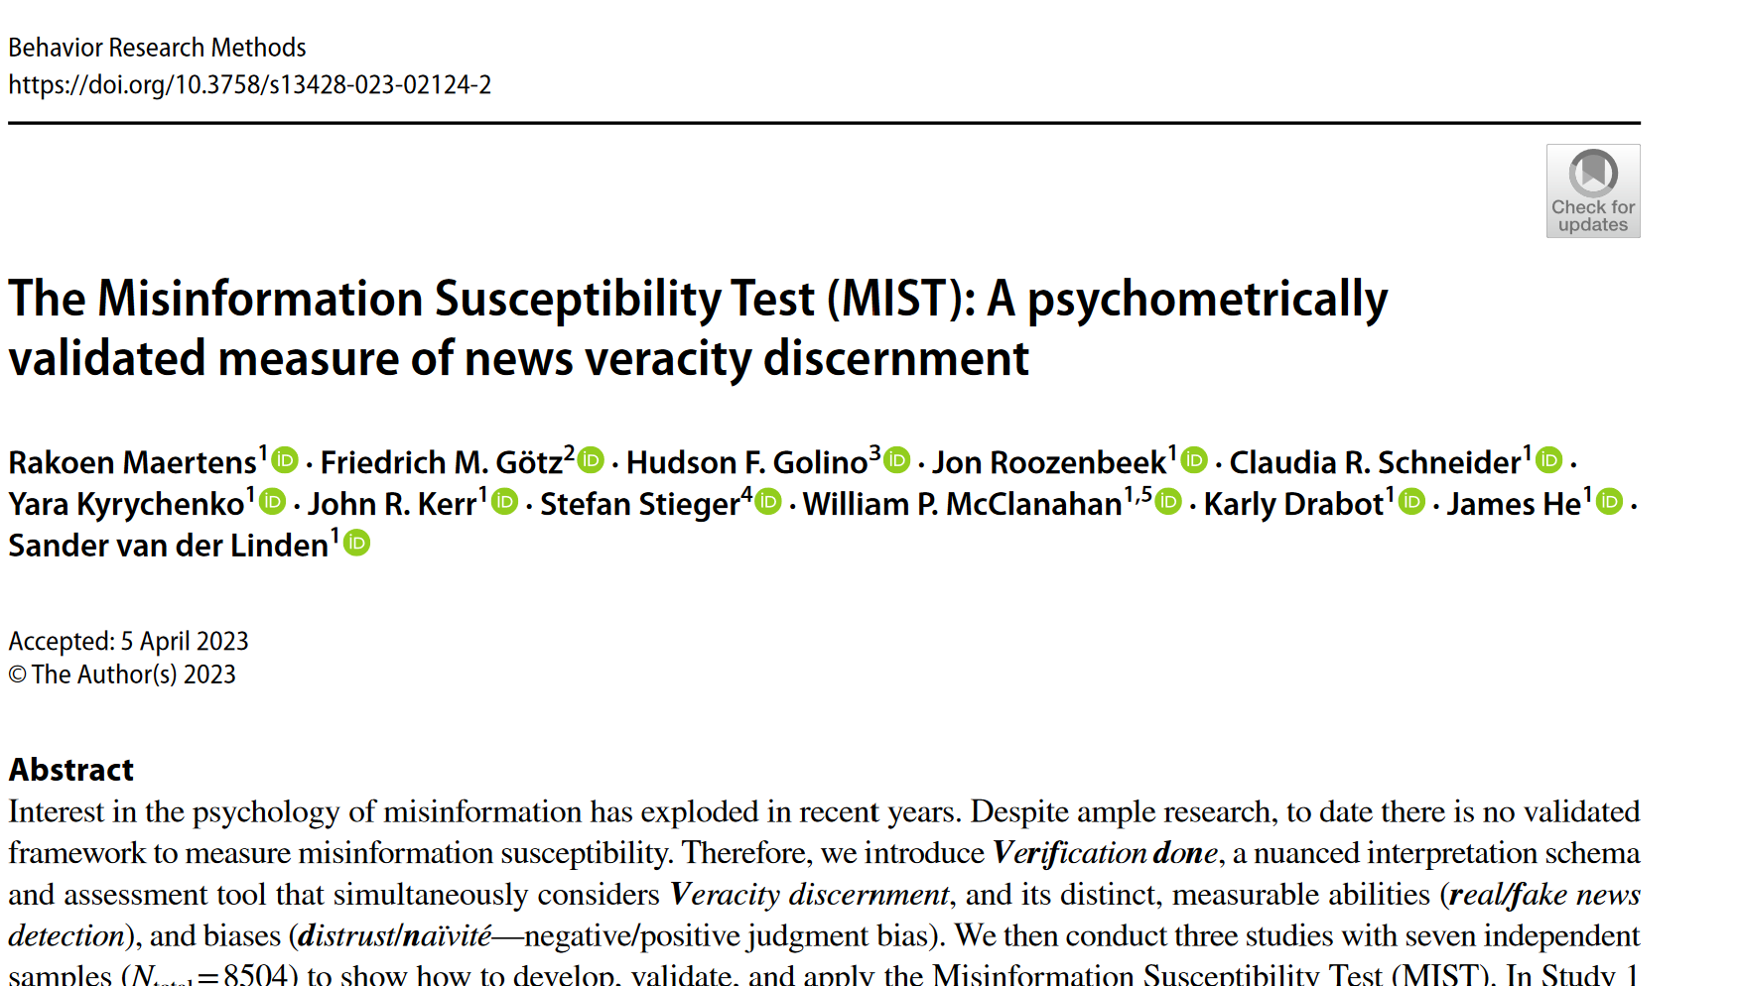
Fake news quiz

Slide 18
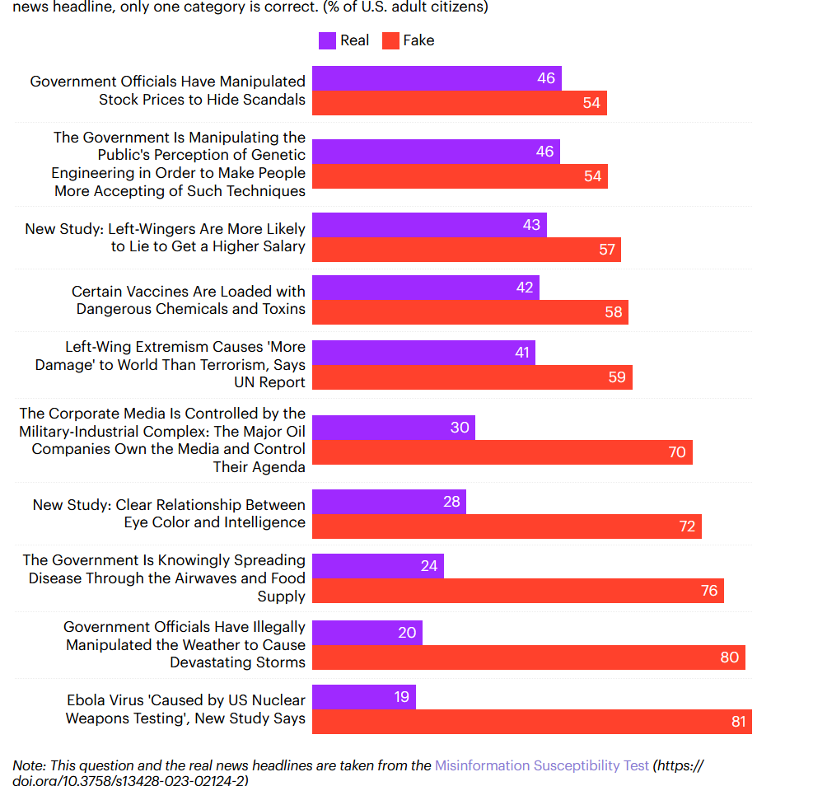
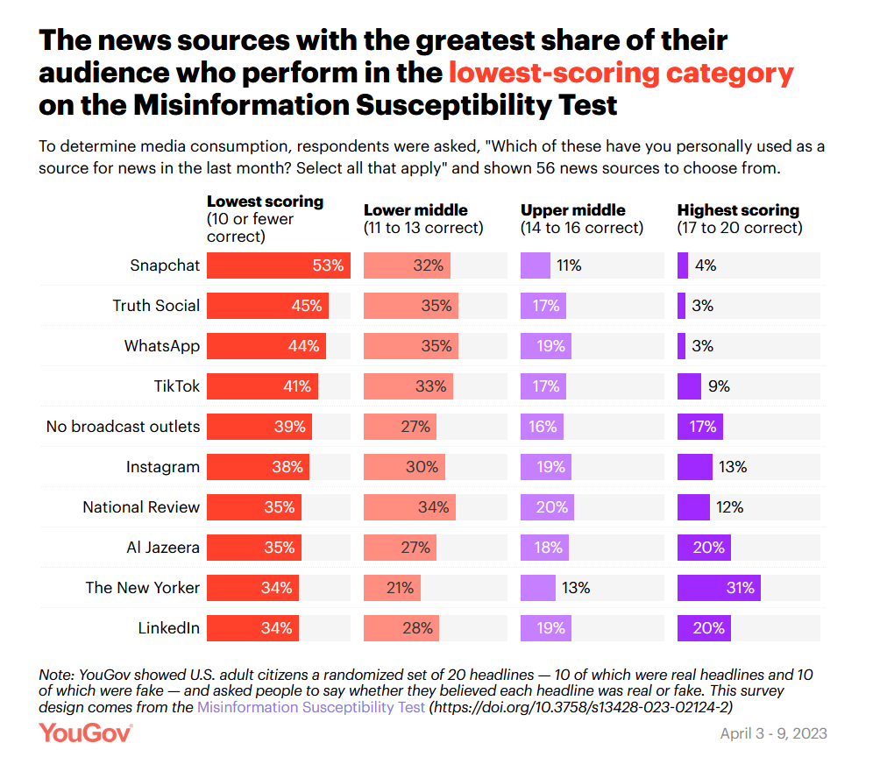
Fake news quiz

Slide 19
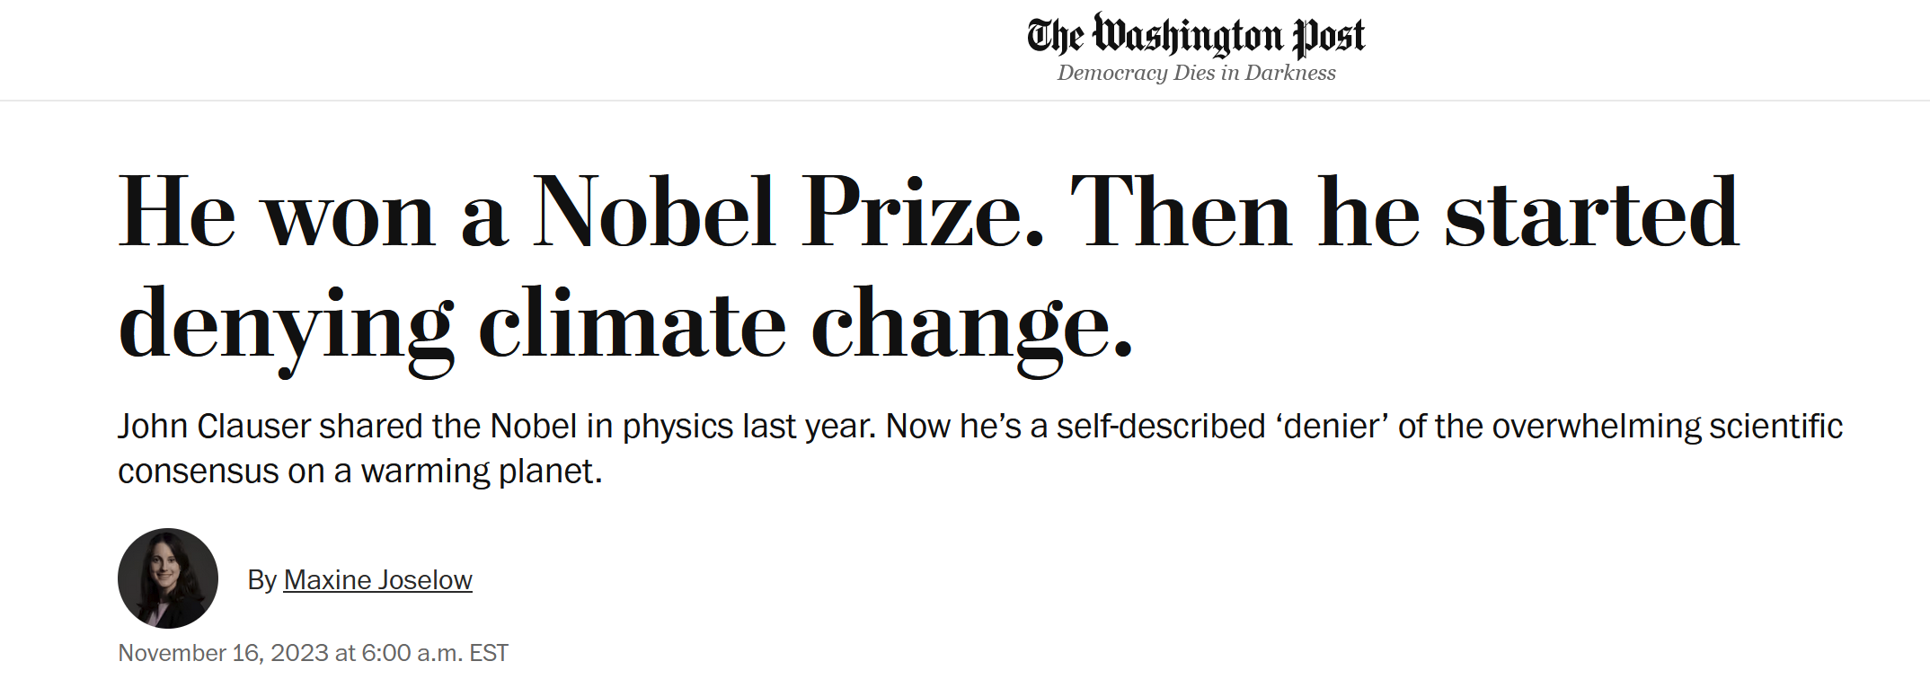
Climate misinformation – alive and well
“In my opinion, there is no real climate crisis”

Slide 20
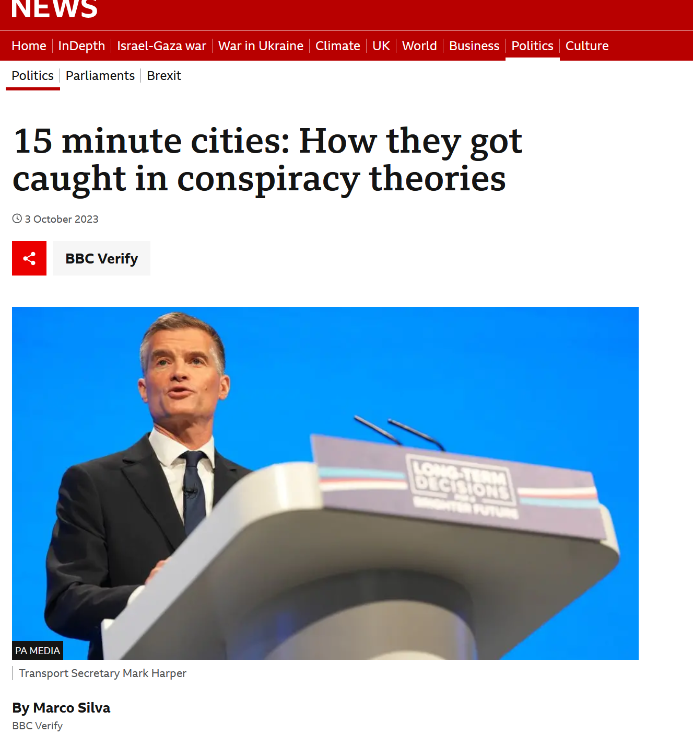
Climate misinformation – alive and well

Slide 21
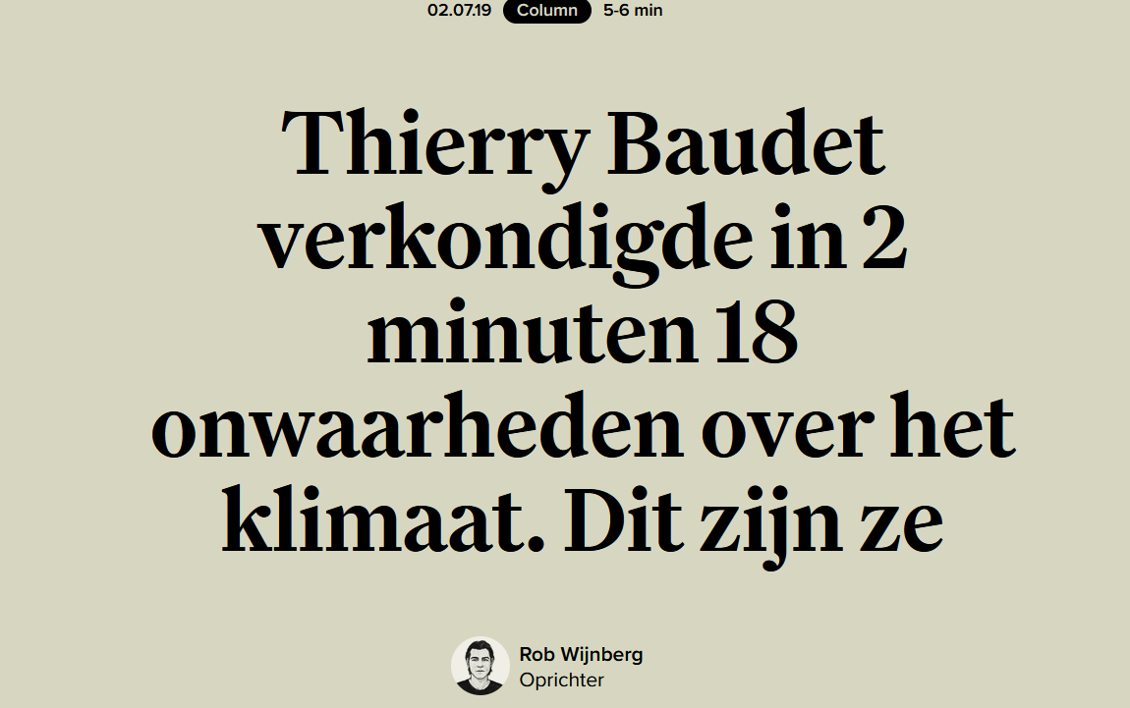
Climate misinformation – alive and well

Slide 22
Fact checking
And verification

Slide 23
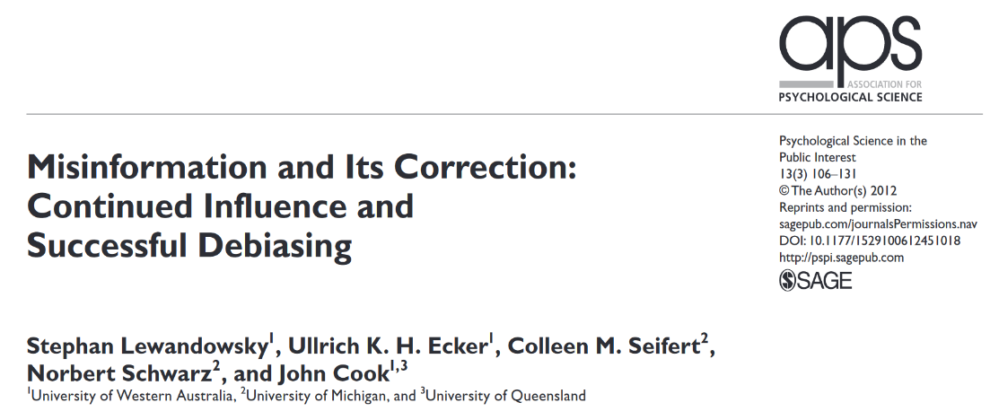
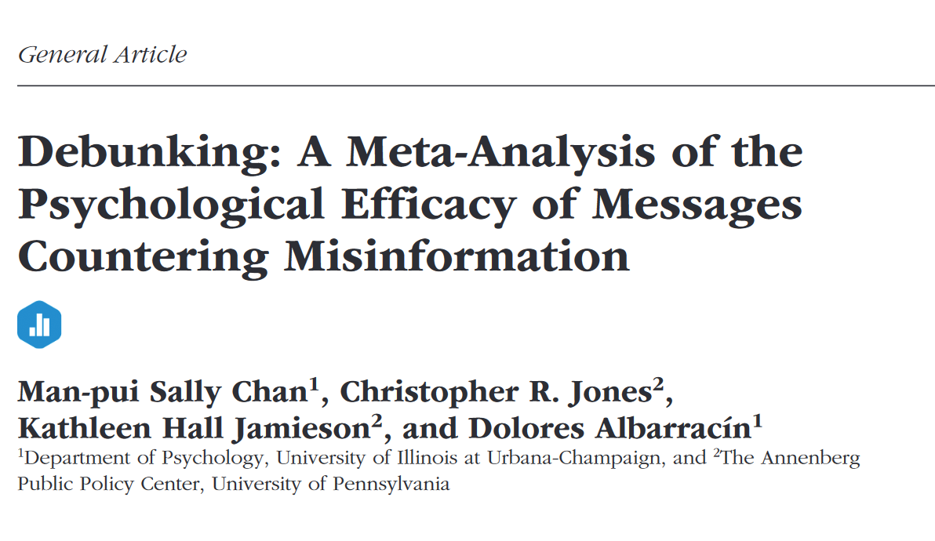
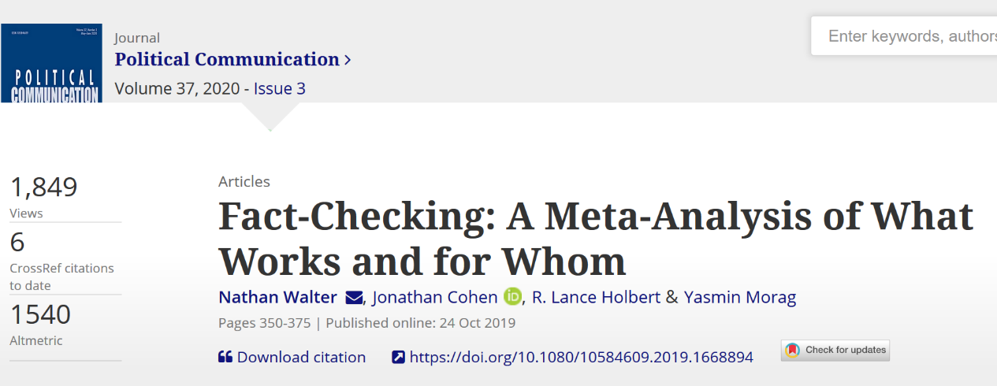
Countering Disinformation:
Counter disinformation:
Pre-bunking vs debunking

Slide 24
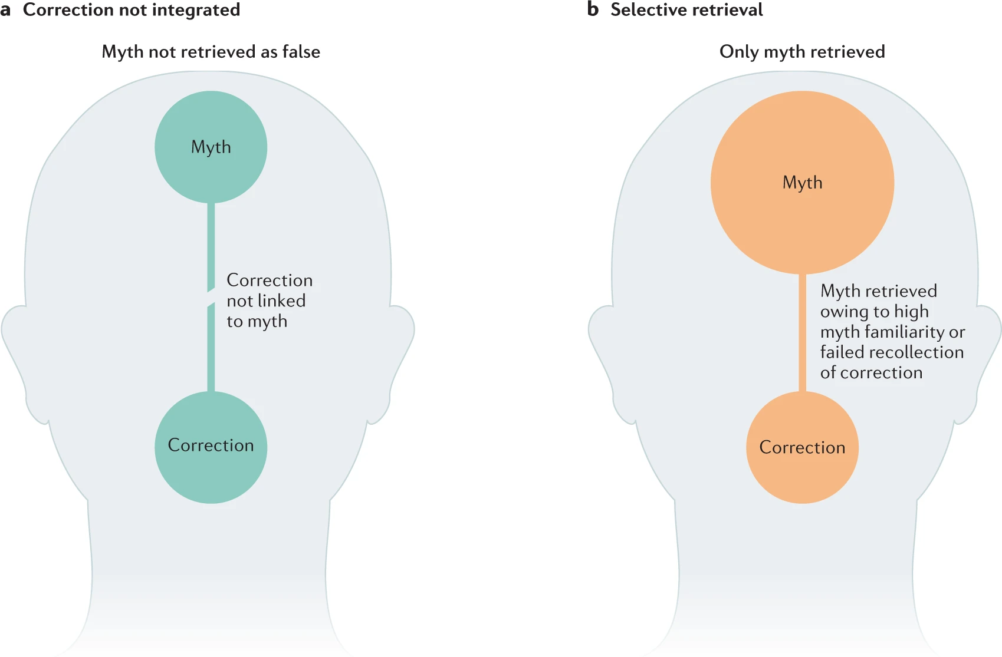
Ecker et al. (2022)

Slide 25
Exposure to
Pre-bunking
misinformation
de-bunking
e.g. inoculation
e.g. fact-check
Time

Slide 26
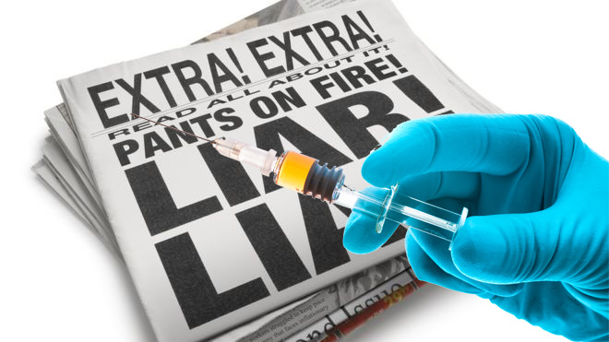

Slide 27
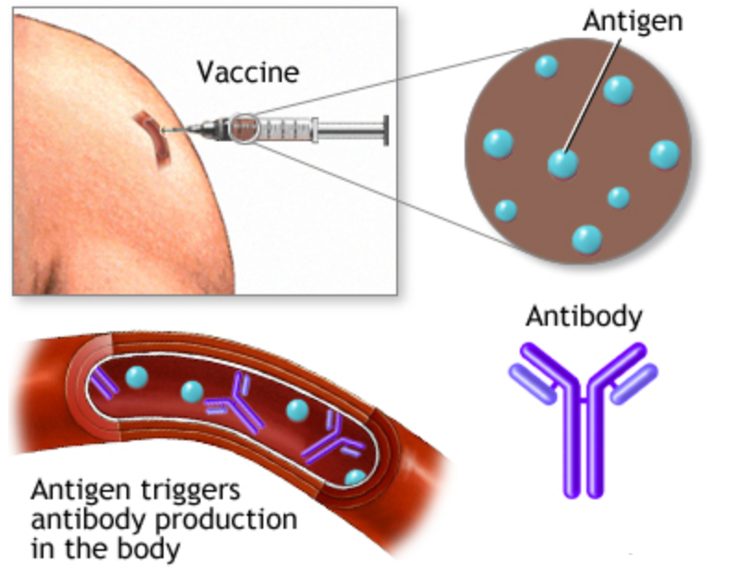
v

Slide 28
The process of psychological “inoculation”
The vaccine
A) Affective basis:
“Warning of impending threat”
B) Cognitive basis:
“Refutational preemption”
Psychological
Inoculation
Increased resistance to future exposure and persuasion attempts
Triggers production of mental “antibodies”
Through internal rehearsal

Slide 29


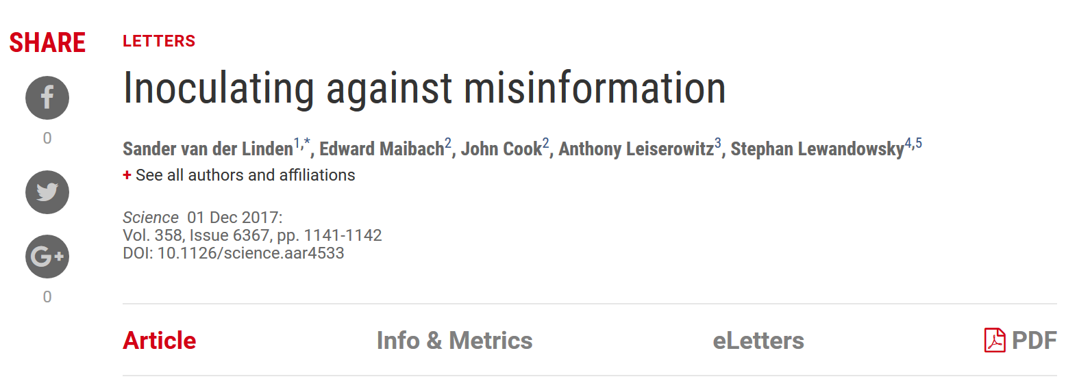
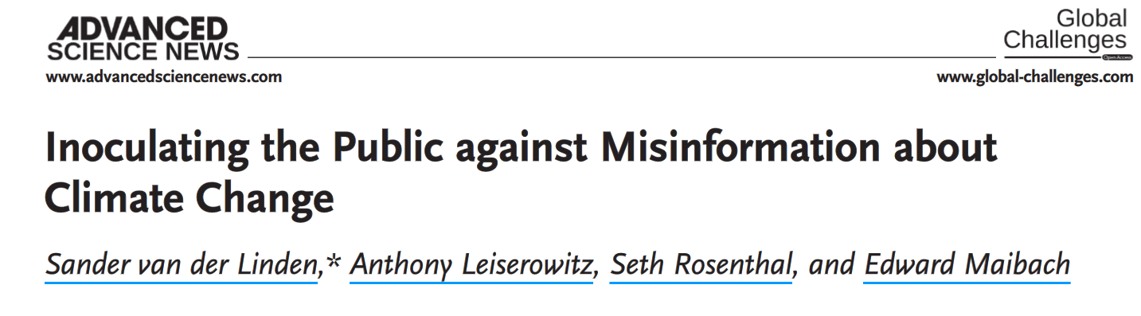
Inoculating against misinformation

Slide 30
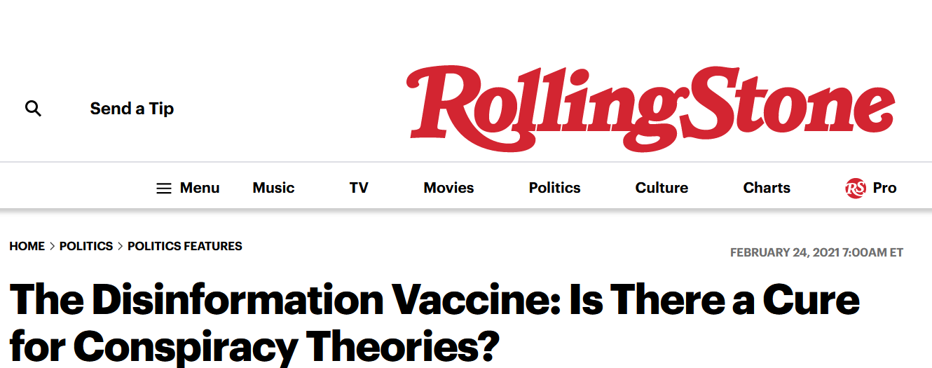
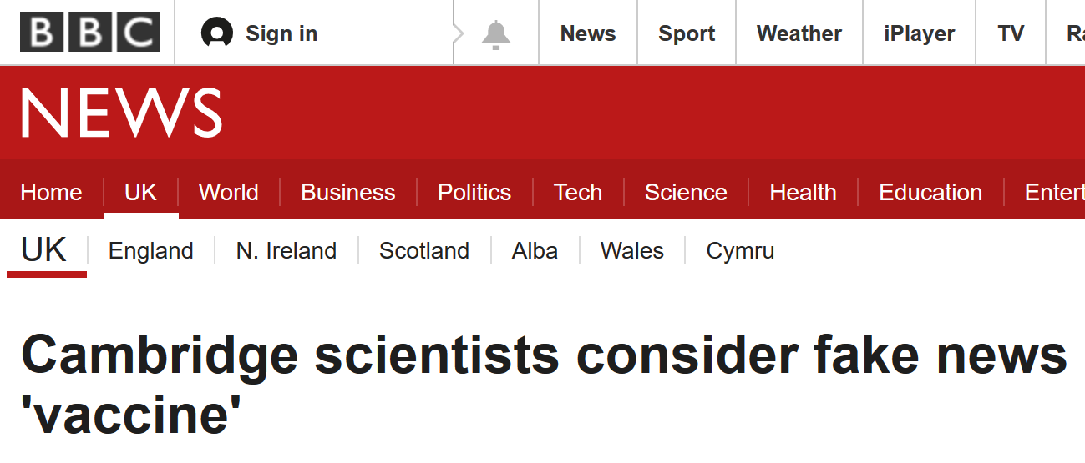
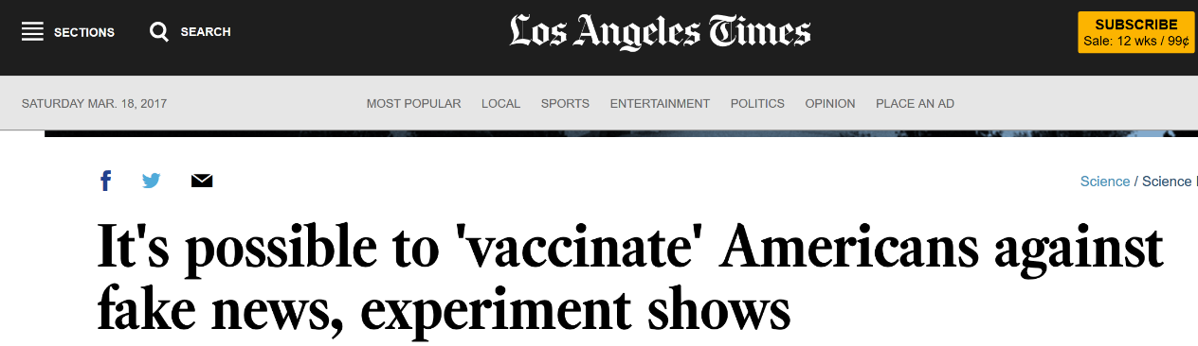
A psychological vaccine against fake news

Slide 31

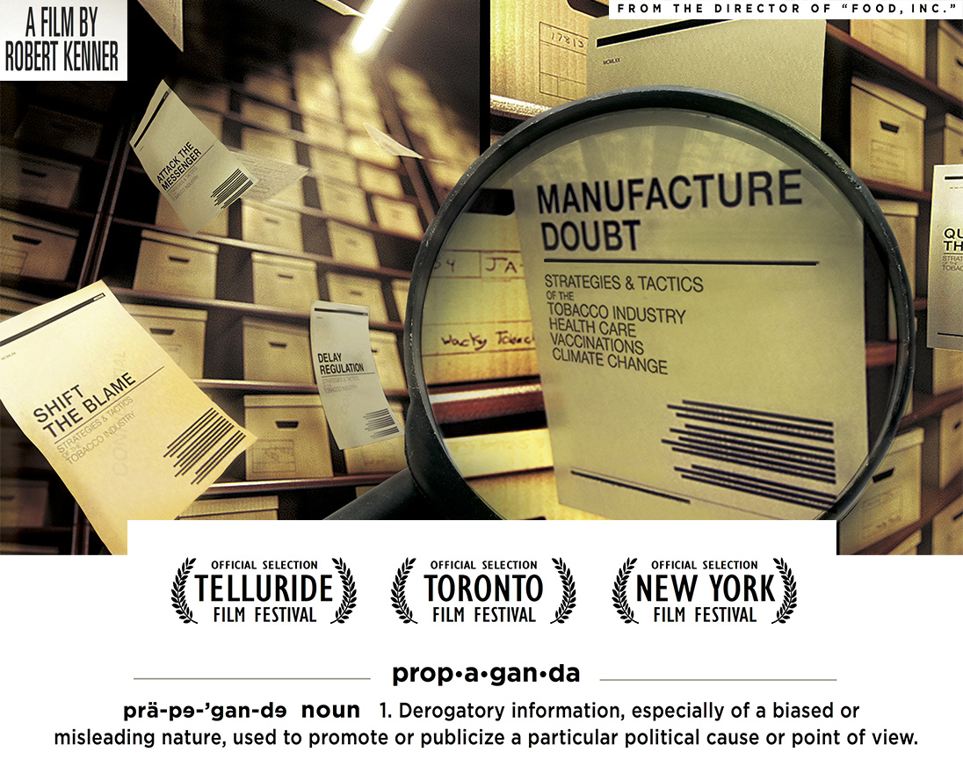
Concerted disinformation campaigns

Slide 32
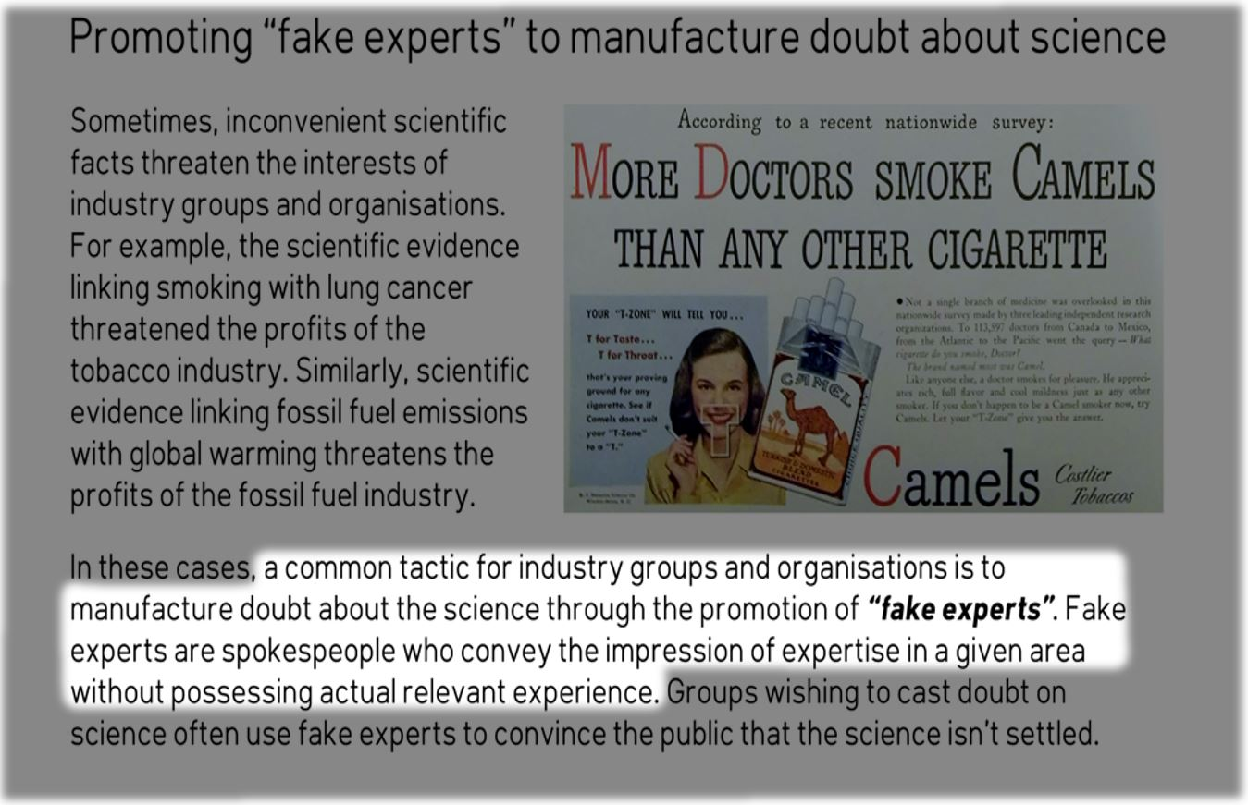

Slide 33


Slide 34
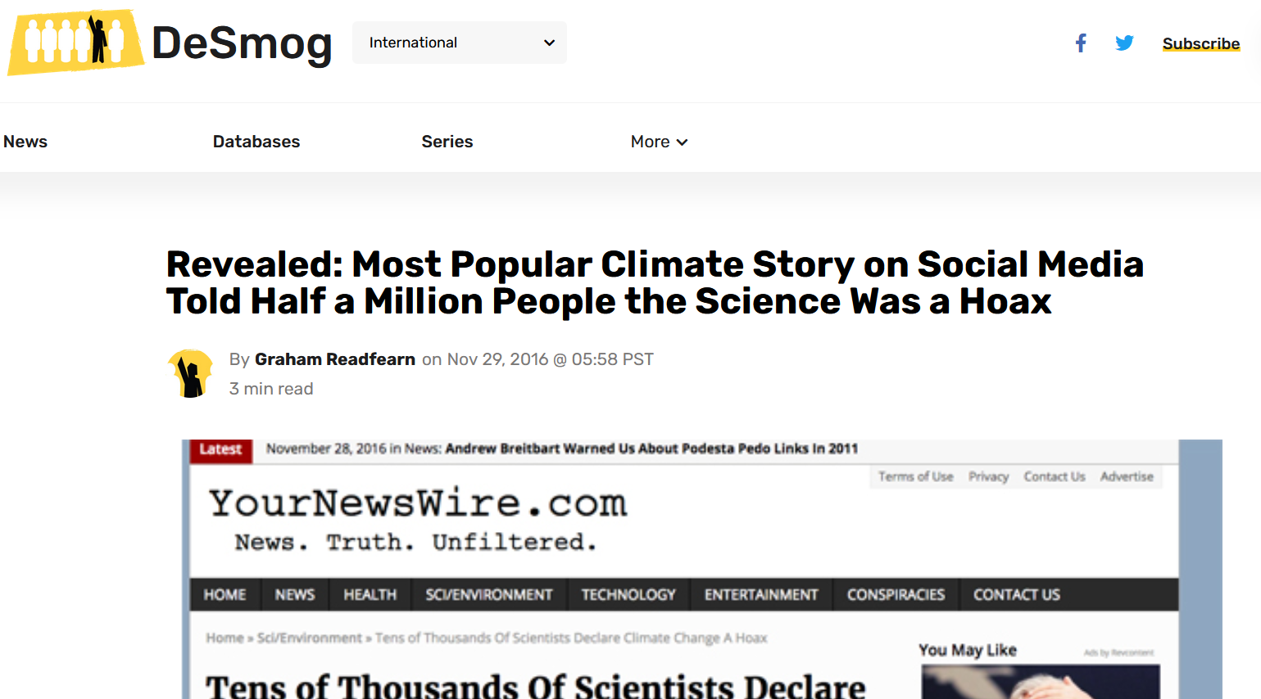
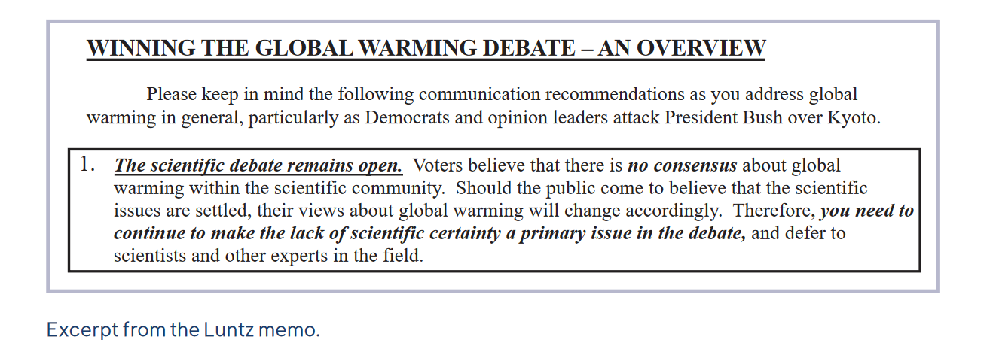
Concerted disinformation campaigns

Slide 35
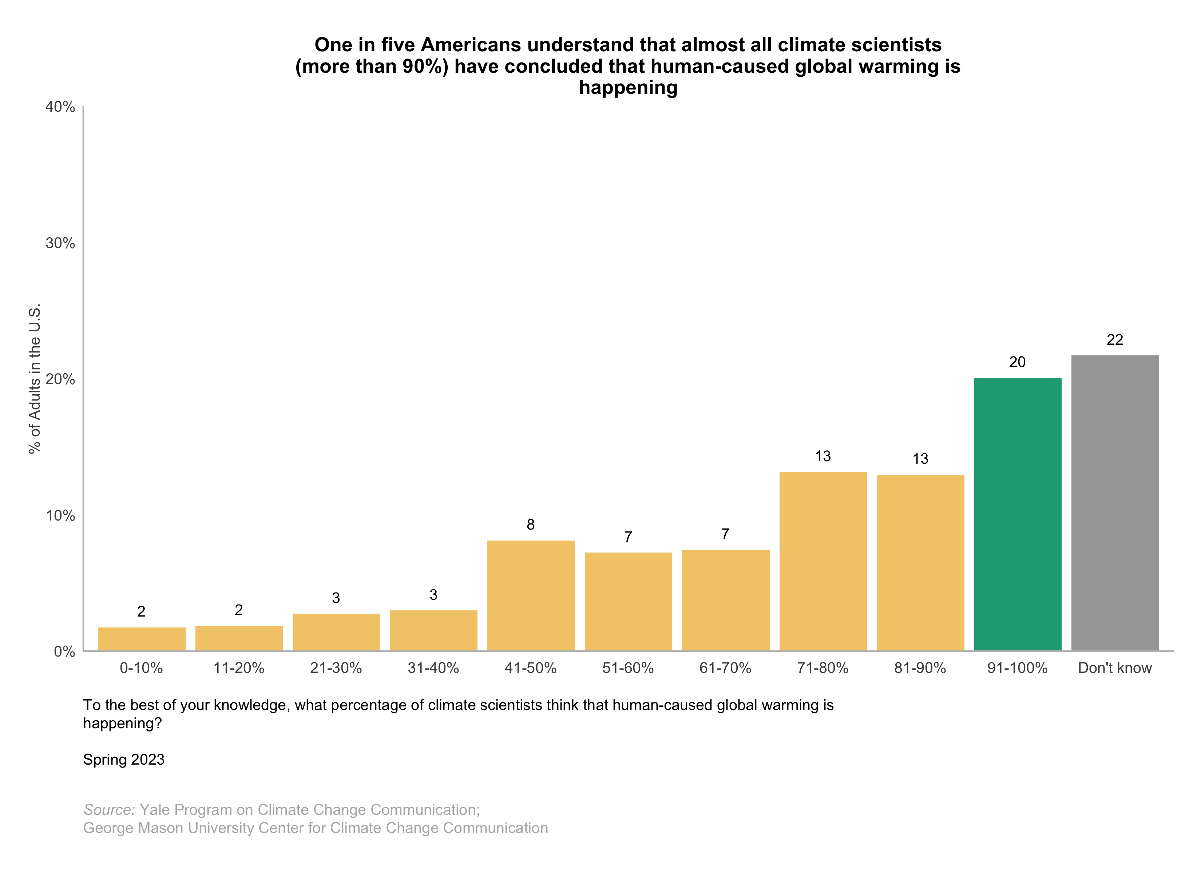
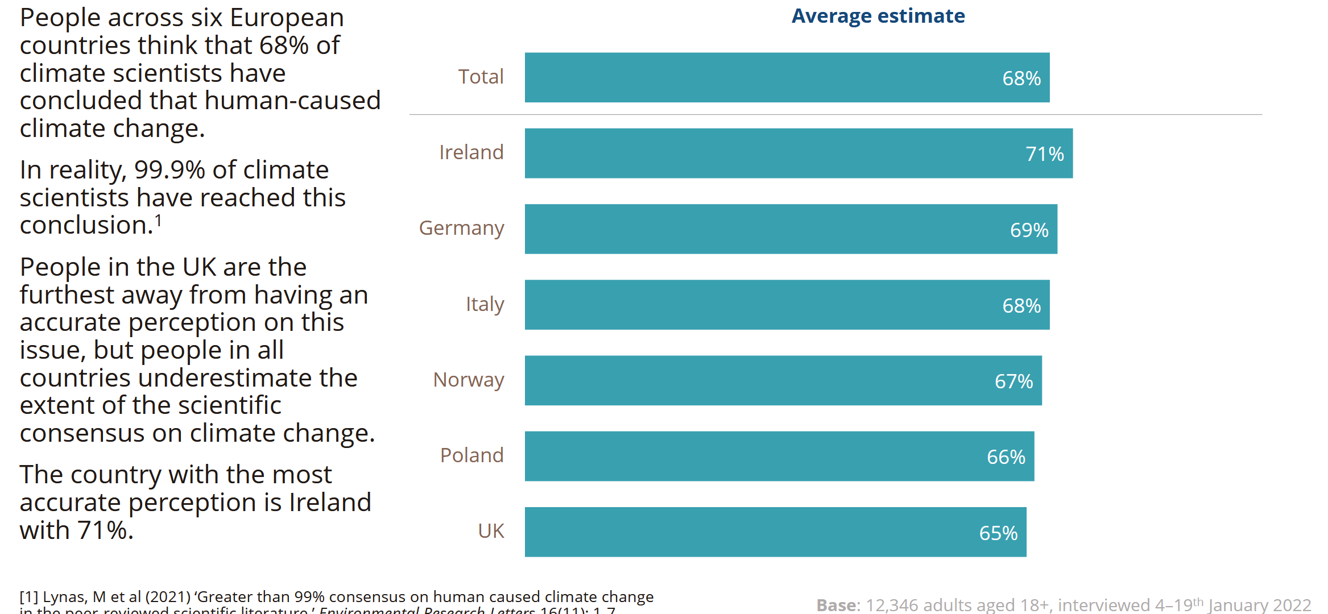
The Gateway Belief Model (GBM) – (van der Linden et al., 2015, 2019)

Slide 36
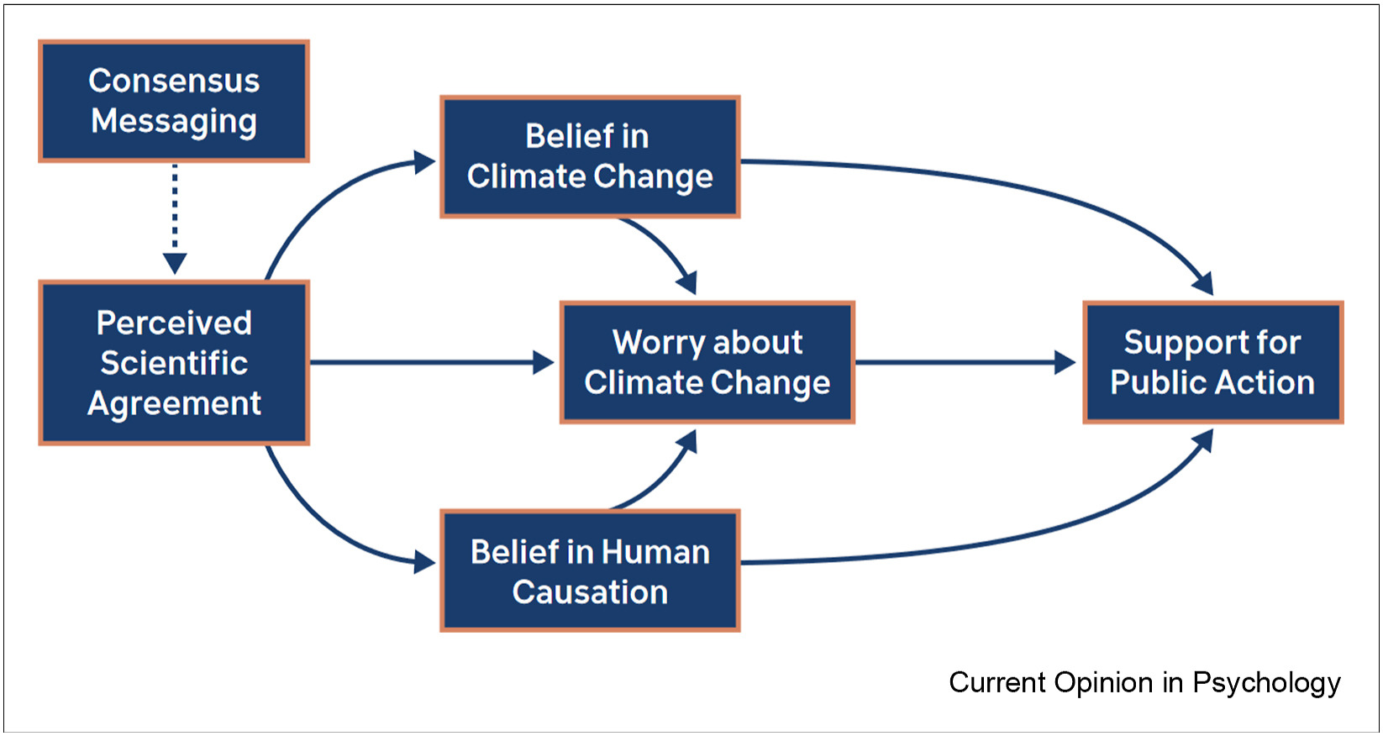
The Gateway
Belief model
(GBM)
van der Linden (2022)
van der Linden et al., 2015, 2019

Slide 37
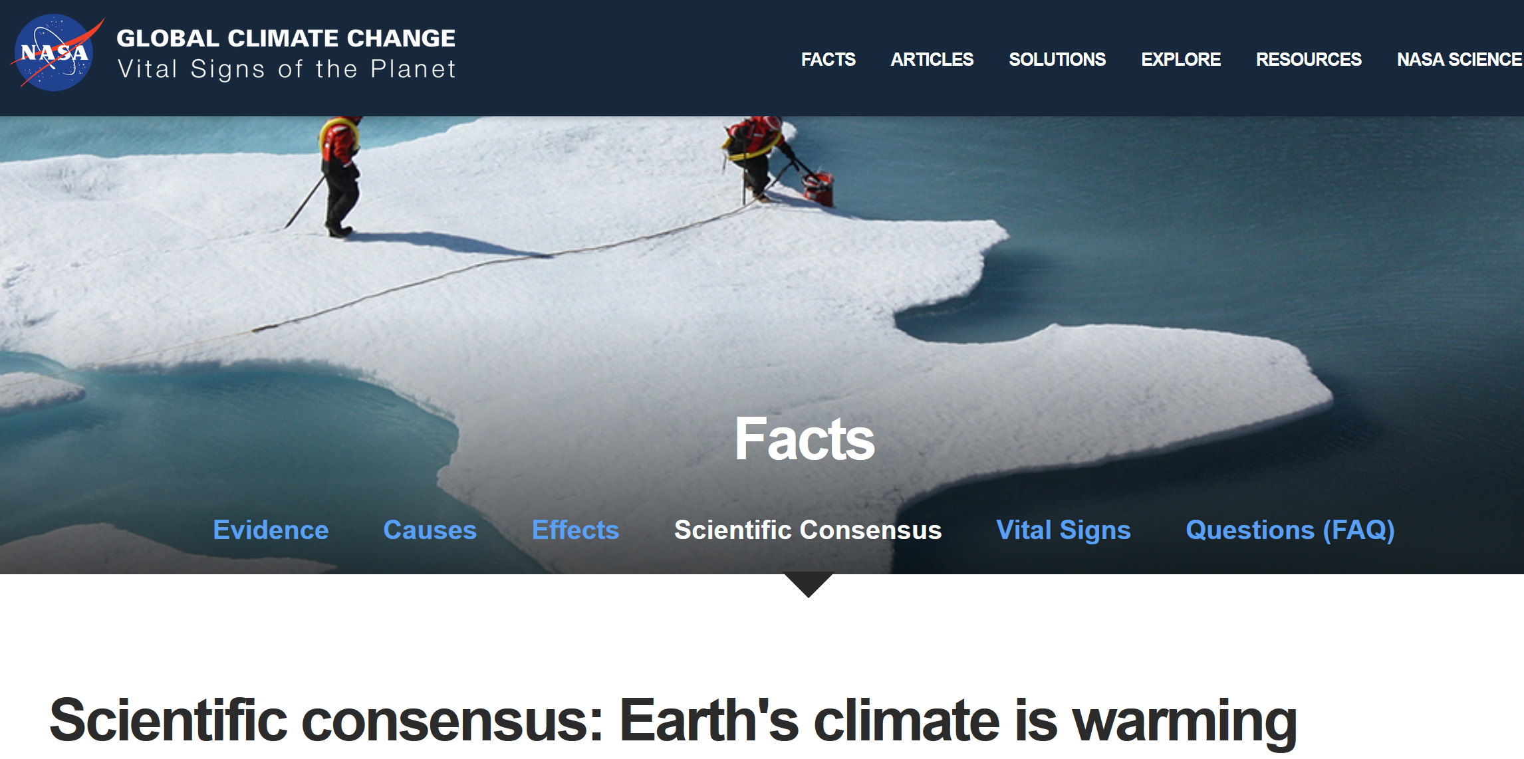
A “psychological vaccine” against fake news

Slide 38
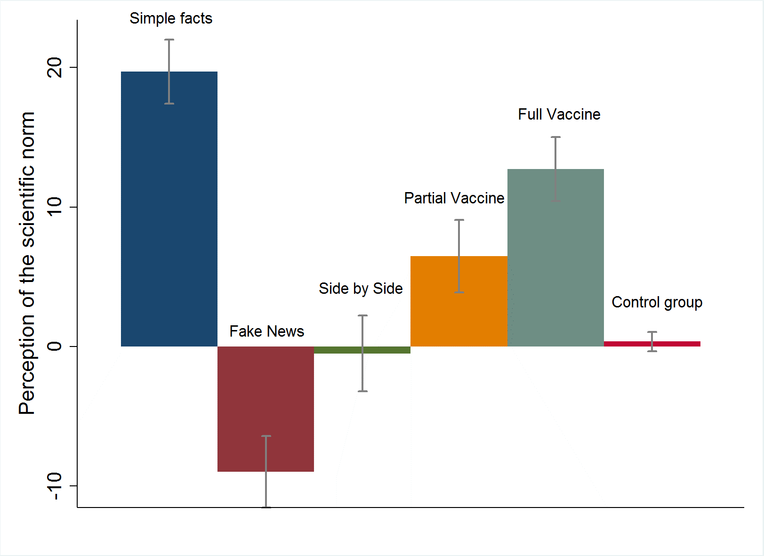
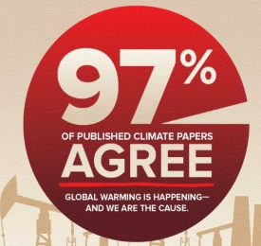
+
+
Shift in Perception

Slide 39
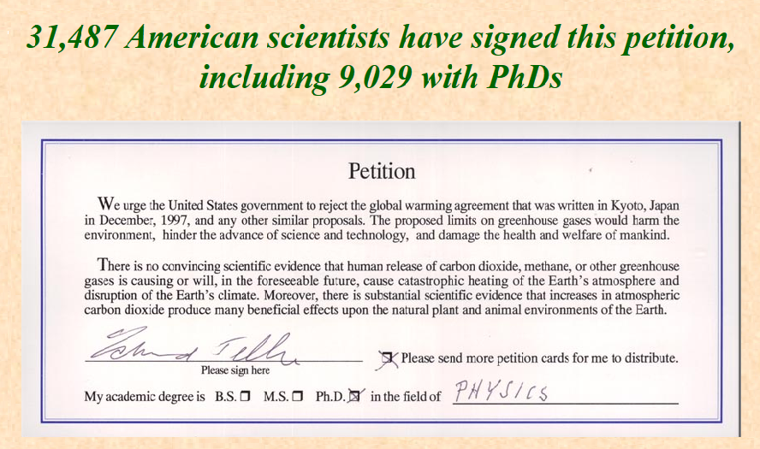
WE SHOWED PARTICIPANTS…

Slide 40
+
+
Shift in Perception

Slide 41
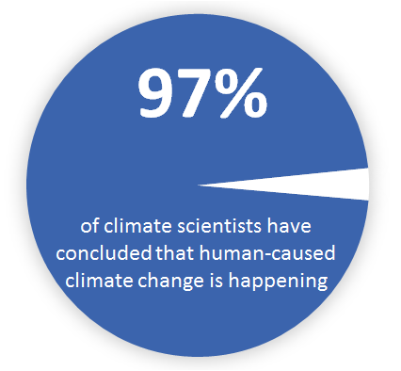
WE SHOWED PARTICIPANTS…

Slide 42
+
+
Shift in Perception

Slide 43
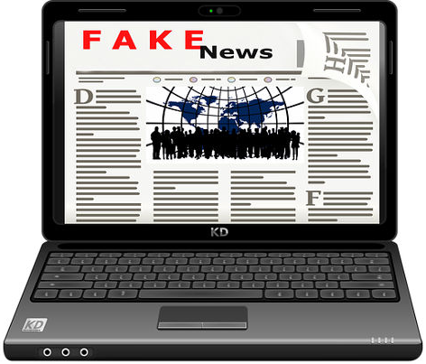
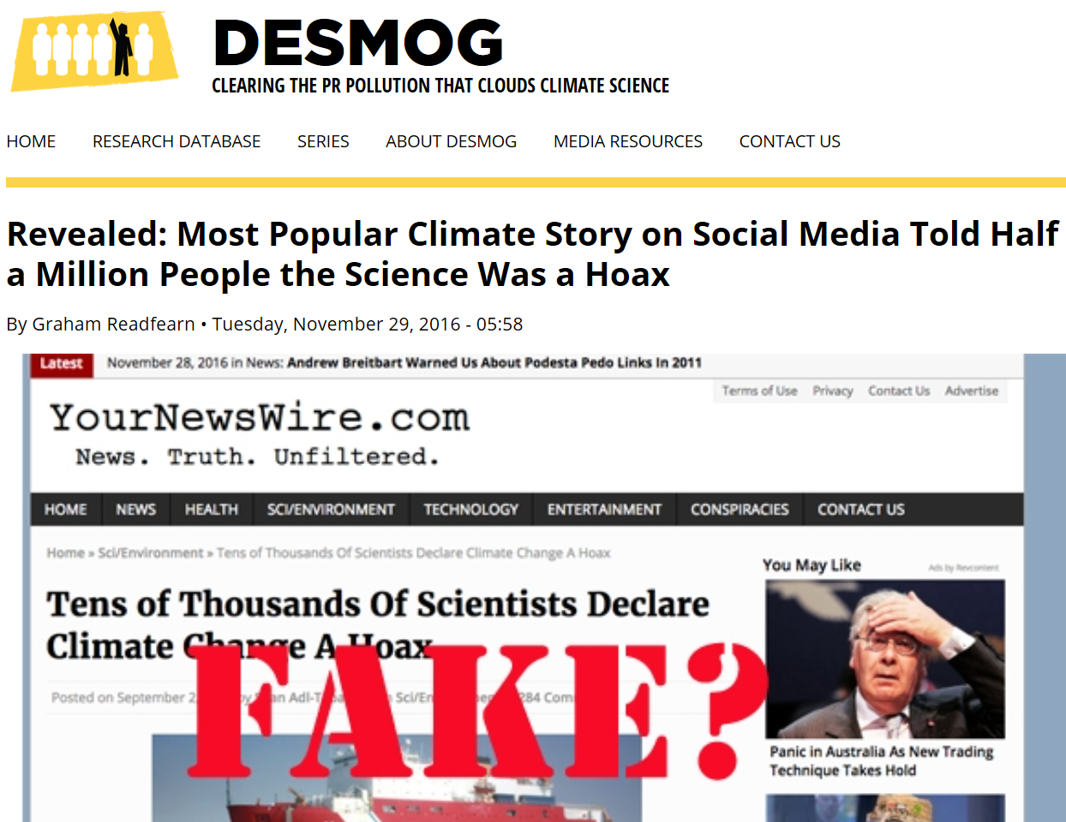
A psychological vaccine against fake news
‘Partial Vaccine’
‘Full Vaccine’

Slide 44
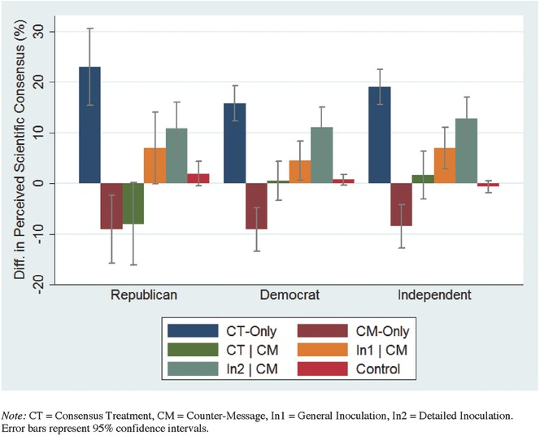
d = 0.33
d = 0.75
+
+
Shift in Perception

Slide 45
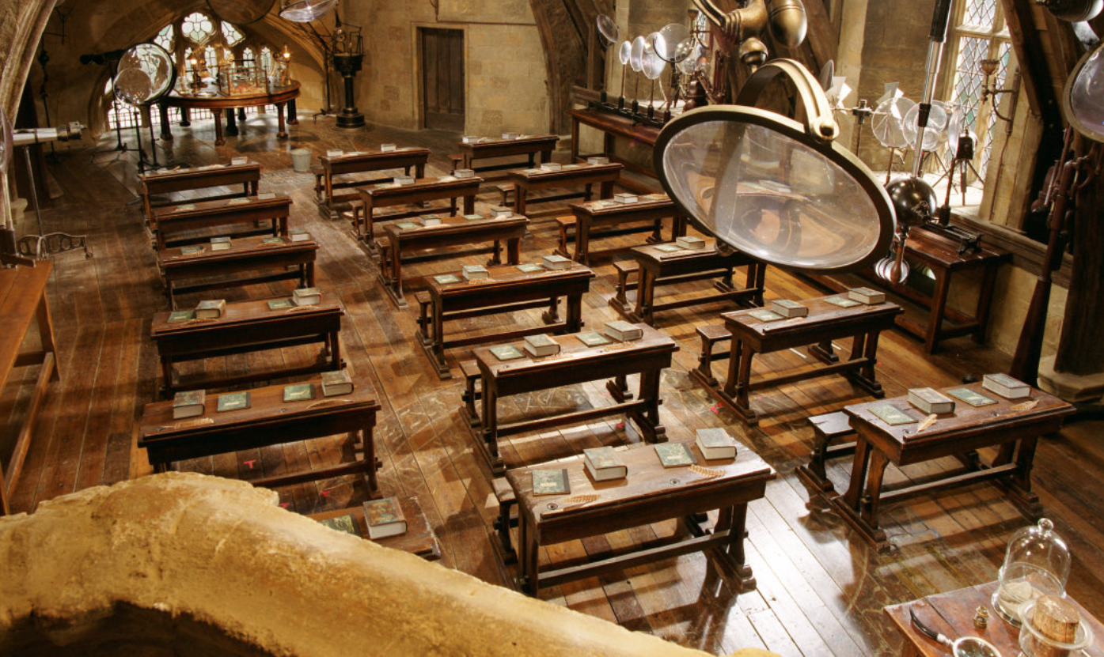

Defence Against
The dark arts?
"Your defences must therefore be as flexible and inventive as the arts you seek to undo"
  —Professor Snape

Slide 46
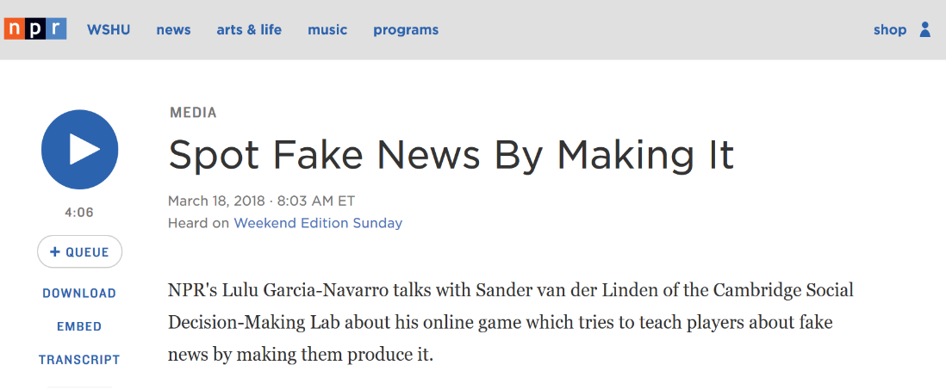
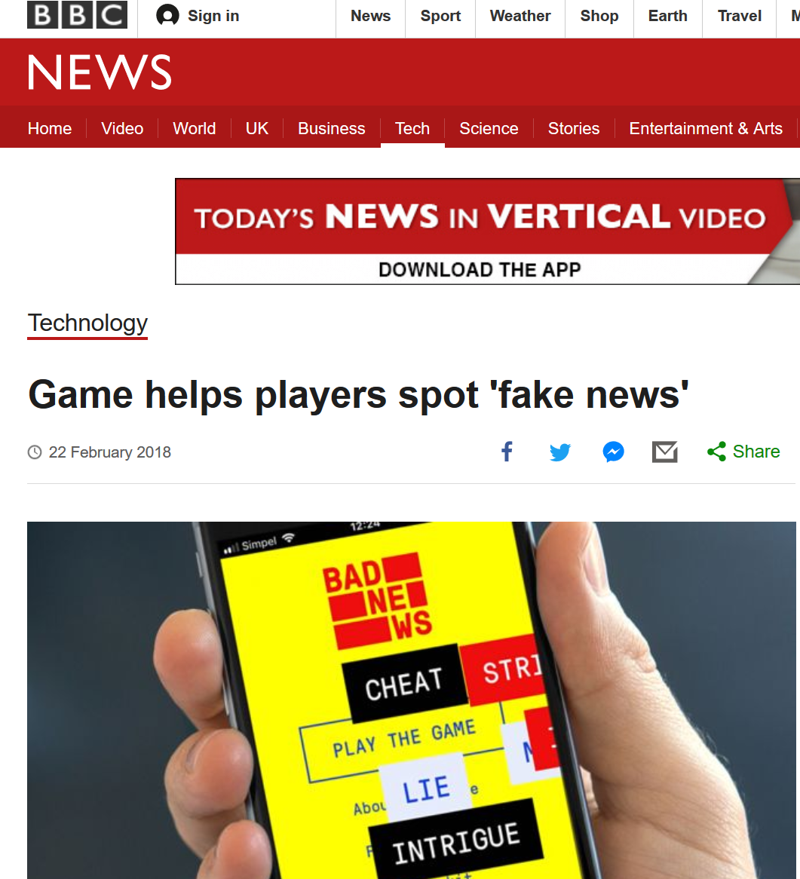
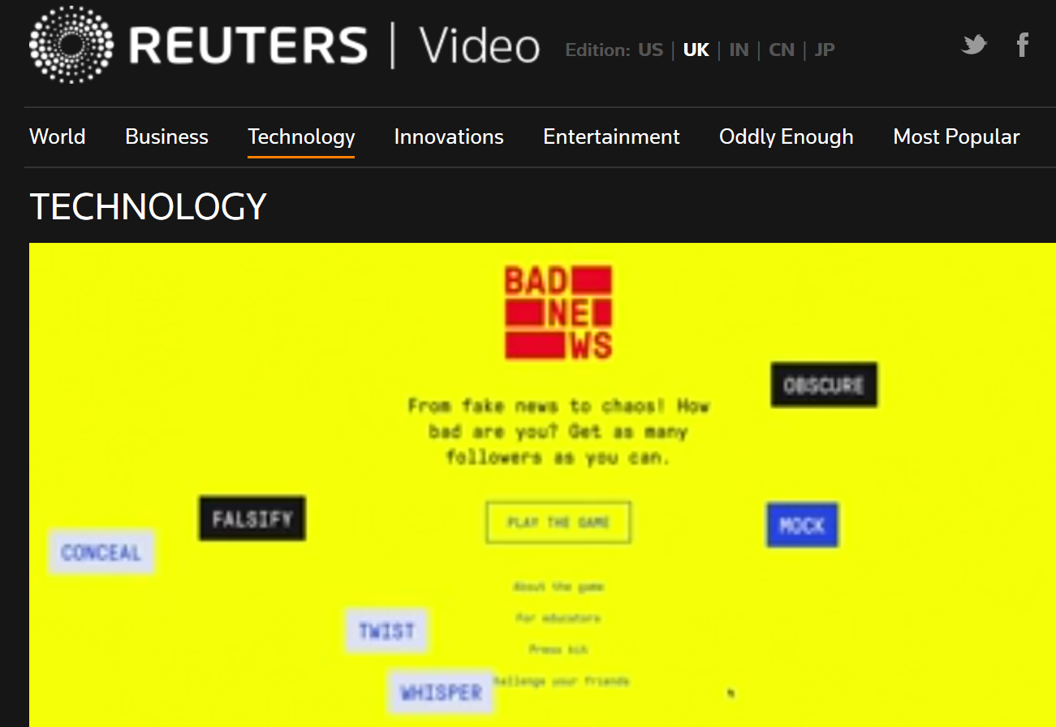
A psychological vaccine against fake news

Slide 47
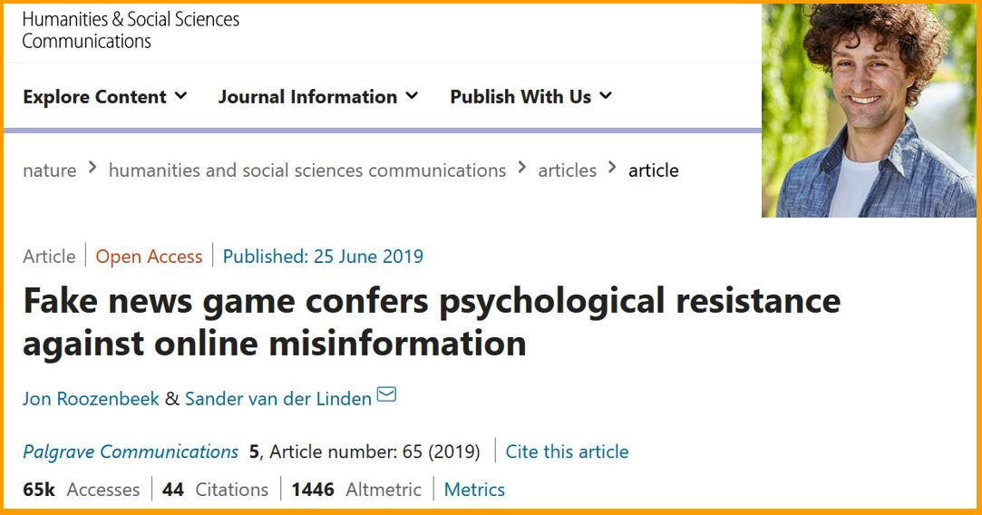
Inoculating against misinformation
https://www.nature.com/articles/s41599-019-0279-9
(Roozenbeek & van der Linden, 2019)

Slide 48

Results so far (N = 30,000, n = 15,000)

Slide 49


Slide 50



Preregistered randomized replication

Slide 51

Available on OSF
Preregistration
Items
Raw Datasets
R Scripts
Experiment 1 (Maertens et al., 2020)
Reliability Rating of Fake News
N = 118 | Error Bars = 95% CI
T1 = PRE
T2 = POST - 0 weeks
T3 = POST - 1 week
T4 = POST - 5 weeks
T5 = POST - 13 weeks

Slide 52
Available on OSF
Preregistration
Items
Raw Datasets
R Scripts
Experiment 1 (Maertens et al., 2020)
Reliability Rating of Fake News
N = 118 | Error Bars = 95% CI
T1 = PRE
T2 = POST - 0 weeks
T3 = POST - 1 week
T4 = POST - 5 weeks
T5 = POST - 13 weeks
Cohen’s d = 1.00

Slide 53
Available on OSF
Preregistration
Items
Raw Datasets
R Scripts
Experiment 1 (Maertens et al., 2020)
Reliability Rating of Fake News
N = 118 | Error Bars = 95% CI
T1 = PRE
T2 = POST - 0 weeks
T3 = POST - 1 week
T4 = POST - 5 weeks
T5 = POST - 13 weeks

Slide 54
Available on OSF
Preregistration
Items
Raw Datasets
R Scripts
Experiment 1 (Maertens et al., 2020)
Reliability Rating of Fake News
N = 118 | Error Bars = 95% CI
T1 = PRE
T2 = POST - 0 weeks
T3 = POST - 1 week
T4 = POST - 5 weeks
T5 = POST - 13 weeks

Slide 55

Available on OSF
Items
Raw Datasets
R Scripts
Experiment 2 (Maertens et al., 2020)
Reliability Rating of Fake News
N = 110 | Error Bars = 95% CI
T1 = PRE
T2 = POST - 0 weeks
T3 = POST - 1 week
T4 = POST - 5 weeks
T5 = POST - 13 weeks
T1 = PRE
T2 = POST - 0 weeks
T3 = POST - 9 weeks

Slide 56
Available on OSF
Items
Raw Datasets
R Scripts
Experiment 2 (Maertens et al., 2020)
Reliability Rating of Fake News
N = 110 | Error Bars = 95% CI
T1 = PRE
T2 = POST - 0 weeks
T3 = POST - 1 week
T4 = POST - 5 weeks
T5 = POST - 13 weeks
T1 = PRE
T2 = POST - 0 weeks
T3 = POST - 9 weeks

Slide 57
Available on OSF
Items
Raw Datasets
R Scripts
Experiment 2 (Maertens et al., 2020)
Reliability Rating of Fake News
N = 110 | Error Bars = 95% CI
T1 = PRE
T2 = POST - 0 weeks
T3 = POST - 1 week
T4 = POST - 5 weeks
T5 = POST - 13 weeks
T1 = PRE
T2 = POST - 0 weeks
T3 = POST - 9 weeks

Slide 58
Available on OSF
Items
Raw Datasets
R Scripts
Experiment 2 (Maertens et al., 2020)
Reliability Rating of Fake News
N = 110 | Error Bars = 95% CI
T1 = PRE
T2 = POST - 0 weeks
T3 = POST - 1 week
T4 = POST - 5 weeks
T5 = POST - 13 weeks
T1 = PRE
T2 = POST - 0 weeks
T3 = POST - 9 weeks

Slide 59



Slide 60

inoculation.science

Slide 61


Slide 62


inoculation.science

Slide 63
inoculation.science

Slide 64


inoculation.science

Slide 65

inoculation.science

Slide 66


Pre-registered field
experiment on YouTube
~1 million views.
30% randomly selected for 1 survey question on the YouTube platform within 24 hours of being exposed to the video.

Slide 67

Pre-registered field
experiment on YouTube
~5-10% boost

Slide 68

inoculation.science

Slide 69


Slide 70


Slide 71


Slide 72


Slide 73



Slide 74


Information Treatments

Slide 75

The New
Climate Denial

Slide 76


Computer-Assisted Recognition
of climate change Denial and Skepticism
(CARDS)
Coan et al., 2023.

Slide 77


Slide 78

















Thank you

Slide 79
Difficult climate
Conversations
In person challenges
Marc Esteve del Valle
Climate Pact Ambassador and Assistant Professor University of Groningen

Slide 80

Social networks &​
climate conversations​
3
2
1
5
4
5
3
4
1
2

Slide 81


With whom
Do we connect?
1. Propinquity
2. Homophily
Individuals are more likely to relate to one another when geographically close
Tendency of individuals to be connected with similar others (“Birds of a feather flock together”)
Esteve Del Valle, M., & Donker, S. (2024). Special Theme: Homophily in Social Networks. Connections, 44(1), 2–3. https://doi.org/10.21307/connections-2019.039
Source: https://istockphoto.com

Slide 82


With whom do we relate?
Strong ties (family members or close friends)
Frequent interactions
Emotional support
Instrumental exchanges
Weak ties (colleagues or neighbours)
Provide new information
Allow access to different resources and contacts
Granovetter, M. S. (1973). The Strength of Weak Ties. American Journal of Sociology, 78(6), 1360–1380. http://www.jstor.org/stable/2776392

Slide 83

With whom do we converse about the
Climate, and on what topics?

Slide 84
Context, Research
goal, and questions
Context
Questions
Conversations about energy and climate change are not commonplace (“socially constructed silence”)
Who do people talk to about their everyday energy practices?
Will a low and zero carbon (LZC) intervention make a difference to an individual’s propensity to discuss low-and-zero carbon practices?
Goal
Explore people’s everyday conversations about energy practices and climate change in the United Kingdom (UK)

Slide 85
Case study
Low Carbon Community (LCC) location | Demography | LCC behavioral interventions/ communication messages
1. Rural South Wales | 13,500 residents in 14 villages in the upper Amman Valley | Projects included energy audits and upgrades, solar thermal installation, launching solar PV and arts and climate change programs / Mainly intrinsic: addressing climate change
Source: Hamilton et al, 2019, p.184

Slide 86

Data and methods
Participants
Methods
85 individuals from 6 LCC locations in UK
  Social networks (ego network): name generator approach (e.g., who are you most emotionally close to?; what is your relationship with this person?)
  Energy conversations (semi-structured interviews)
      Sociodemographic characteristics;
      Household characteristics;
      Attitudes to the environment and climate change;
      Whether or not they had participated in a conversation about energy with someone in the last month
Source: Arnaboldi et al., 2016, p.185

Slide 87
Results
Who do people talk to about their everyday energy practices?
 | Nominated Alters (%) | Discuss Energy (%)
Family | 42 | 62
Friends | 33 | 24
Colleagues | 6 | 4
Neighbors | 6 | 4
In LCC | 3 | 4
Other | 10 | 2
Source: Hamilton et al., 2019, p. 185

Slide 88

Results
What do these people talk about?
Topics | Respondents (N)
General energy efficiency | 47
Energy prices and bills | 37
LZC technology and insulation | 36
Energy information sharing | 17
Energy display monitors | 10
Climate change and general environmental issues | 9
“Collin and Helen, yes because they’re a bit like us, they grow all their veg and they’re interested in such matters” (p. 188)
Self-censorship

Slide 89

Results
2. Will a low and zero carbon (LZC) intervention make a difference to an individual’s propensity to discuss low-and-zero carbon practices?
The authors’ Nested Multilevel logistic regression modal suggests that interventions, particularly the major ones (e.g. installation of wind turbines), increase individual’s propensity to discuss low-and-zero carbon practices

Slide 90
recommendations
Conversations need to be expanded beyond close, strong ties:
  New contexts: town fairs, cafes or civic centres
  Involve new parties: community organizations or NGOs
  Different activities: participatory artistic productions
  “Action on carbon and energy reduction needs to be properly resourced, supported and integrated at a local level, and through consistent long-term policy action at the national and international level” (p.190)

Slide 91

Case study: Talk climate
change project
Ettinger, J., McGivern, A., Spiegel, M. P., King, B., Shawoo, Z., Chapin, A., & Finnegan, W. (2023). Breaking the climate spiral of silence: lessons from a COP26 climate conversations campaign. Climatic Change : An Interdisciplinary, International Journal Devoted to the Description, Causes and Implications of Climatic Change, 176(3). https://doi.org/10.1007/s10584-023-03493-5
Source: https://talkclimatechange.org/map

Slide 92

The project
Oxford student-led climate conversation campaign associated with the 2021 United Nations COP26 meeting
Problems
Limited conversations about climate change: 2/3 of Americans said they rarely or never talk about climate change (Leiserowitz et al., 2021)
Psychosocial barriers to having climate conversations:
  Spiral of silence (Maibach et al, 2016)
  Pluralistic ignorance (Sparkman et al., 2022)
  Entrenched climate change beliefs
Goals
  Offer a space for individuals to converse about climate-related topics, making them more aware and engaged with climate action
  Collect 26,000 climate conversations worldwide (June-November 2024)
Source: https://yaleclimateconnections.org/

Slide 93
BUT ARE CLIMATE CONVERSATIONS IMPORTANT?

Slide 94

Yes, they are crucial for climate action
because…
Provide opportunities for reflection on climate change’s impacts, meanings, and emotional responses
Help improve the understanding that climate change is occurring and driven by human activities
Can help reach individuals less exposed to climate information (e.g. rural communities with limited internet access)
Source: https://science.nasa.gov/

Slide 95

The campaign
Conversation tag | Frequency
1. Education | 90
2. Politics/policies | 59
3. Activism | 58
4. Community | 57
5. Individual carbon footprint | 55
6. Solutions | 54
7. Energy | 51
8. Recycling | 50
9. Animals/biodiversity | 46
10. Weather | 40
Source: Ettinger et al., 2023, p. 22

Slide 96
Lessons for climate change communication
Affirm the importance of climate conversations
Build conversational skills
Tailor the conversation
Give space for diverse emotional responses
Provide resources for distinct conversational settings
500
To inspire individuals’ behavioral change and climate activism
E.g., organize climate conversation workshops
In line with the beliefs, interests, and values of the conversation partner
Affirm the validity of different emotional responses to climate change
Consider the resources required for the venue where climate conversations are held

Slide 97
The fake news
game
www.getbadnews.com

Slide 98





The fake news game
www.getbadnews.com

Slide 99



The fake news game
www.getbadnews.com

Slide 100

The Fake News Game:
Six Badges (DEPICT SCALE)

Slide 101

RESULTS

Slide 102

climate pact activities
Visit the Climate Pact website to:
Build your climate knowledge with the EU Climate Action Academy’s
resources and online courses
🤝 Connect with Climate Pact Ambassadors, Partners and
Country Coordinators
🔦 Get inspired by our photo competition winners
🛠️ Check out our tools for citizen engagement or track your
own actions via the AWorld app
🗓️ Discover Climate Pact satellite events near you
📰 Subscribe to the newsletter!
Follow the QR code
to visit the website

Slide 103
Save the date
European Climate Pact: Together in Action
19 March 2025 | Brussels and online
A special two-day celebration of our community’s commitment to climate action, co-designed with our inspiring Climate Pact Ambassadors and partners but accessible and open to everyone.
Join to connect, share ideas and take part
Community registration open. Public registration to begin January 2025

Slide 104
Thank you very much for attending the webinar today!
An evaluation survey will pop up when you leave the webinar, we would appreciate your feedback! Thank you!

Slide 105
Additional
resources
Additional Climate Pact resources
& tools for constructive climate conversations

Slide 106


Play the Inoculation game &
Do the susceptibility test
The inoculation game
The susceptibility test
Click on the picture or play this game via
https://yourmist.streamlit.app/
Click on the picture or play this game via
https://www.getbadnews.com/en

Slide 107

More information on Inoculation science
Visit the inoculation science website, which brings together research and resources on inoculation theory applied to misinformation
The website explains what inoculation means, offers various short videos that inoculate against misinformation online as well as different inoculation games to “prebunk” conspiratorial, electoral and medical information.
Visit the website here: www.inoculation.science
Author: University of Cambridge and University of Bristol

Slide 108


The #talkingclimate handbook
The Climate Outreach Talking Climate Handbook provides evidence-based guidance for having constructive, meaningful conversations about climate change in everyday life.
It focuses on fostering understanding, finding common ground, and inspiring action by building connection and respect and offers tools for engaging diverse audiences, overcoming conversational challenges, and amplifying climate advocacy through dialogue. Designed for individuals passionate about addressing climate issues, the handbook promotes inclusivity and effective communication strategies
Author: EIT Climate-KIC and Climate Outreach
Download

Slide 109

Six principles for climate conversations
This document presents six guidelines to have constructive climate conversations.
This is an easy-to-read hand-out that teaches how to avoid common pitfalls when conducting climate conversations while offering practical solutions, suitable both for experts and those embarking on a climate journey.
The guide is available in English, French and Dutch.
Author: KlimaatContact
Download

