Slide 1

Empowering youth to lead the change
for a sustainable future
Inspirational actions and case studies for climate action
for middle, high school and university students
Notes:
Welcome the audience and introduce the Climate Pact’s vision of creating a movement of people (including youth) united around a common cause, each taking steps in their own context to build a more sustainable Europe. Emphasize that this presentation showcases real-life examples of how middle school, high school and university students are already shaping climate action through creativity, innovation, and collaboration. Highlight the central message: youth are not only learning about climate change, but they are also key players in the transition towards a more sustainable and just society. Invite educators and ambassadors to view these stories as inspiration for adaptation in their own schools and communities, of course considering the specific needs and interests at their local level.

Slide 2
Why engage students
in climate action?
Students are agents of change: capable of leading initiatives,
empowering peers and shaping school and community policies.
Engaging youth fosters critical thinking, innovation and civic responsibility.
The Climate Pact aims to empower students to design, implement, and scale climate action across schools, campuses and communities in Europe.
Notes:
Emphasize that middle, high school, and university students can lead projects, co-design solutions and influence policy at school or local levels. Highlight how climate action at this age leverages their growing independence, social networks and problem-solving skills. Link to the Climate Pact vision: students as leaders of the transition, not just learners: engaging in projects like biodiversity mapping, sustainable mobility campaigns, energy audits, and citizen-science activities. Note the multiplier effect: students influence peers, families, local communities and can participate in Europe-wide networks.

Slide 3
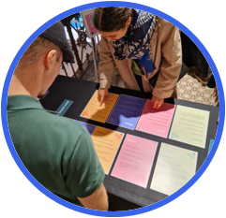
Six key action areas
for students’ engagement
Climate awareness
Sustainable mobility
Clean energy
Waste management and circular economy
Biodiversity and Nature-Based Solutions (NBS)
Sustainable and local food systems
Notes:
Introduce the six themes as practical entry points for schools to engage students. Each theme connects global challenges with everyday school life and learning opportunities.

Slide 4
THEME: CLIMATE AWARENESS
Inspiring examples
Peer Parliament Toolkit on different topics (i.e. mobility, energy and consumption): Small-group dialogues where students discuss climate challenges and propose local solutions.
Youth Leadership in Climate Policy Workbook (Plan International): Exercises for leadership, advocacy and collaborative problem-solving.
Toolkit for Youth on Adaptation and Leadership (Global Center on Adaptation): empowers young people, especially in local and regional settings, to engage actively in climate adaptation, resilience and preparedness.
Notes:
Emphasize that tools like Peer Parliaments and the Plan International Workbook provide step-by-step methods to help students organize debates, design solutions, and influence decision-making.
Storytelling can be a powerful way to capture attention and engage participants. You can also ask some questions to better understand if any students are already involved in any local project or student-led initiatives.
Peer Parliament: http://Peer Parliament Toolkit: small-group dialogues where students discuss climate challenges and propose local solutions: https://climate-pact.europa.eu/eu-climate-action-academy/resources/peer-parliaments-documents_en
Youth Leadership in Climate Policy Workbook (Plan International): https://plan-international.org/publications/youth-leadership-in-climate-policy/
Toolkit for Youth on Adaptation and Leadership (Global Center on Adaptation): Toolkit for Youth on Adaptation & Leadership - Global Center on Adaptation

Slide 5
THEME: CLIMATE AWARENESS
Inspiring examples
Green Office movement: supporting the establishment of a student-led sustainability office that informs, connects and supports students and staff to act on sustainability in schools and universities.
GreenSCENT: Smart Citizen Education for a Green Future: A Europe‑wide initiative developing the “European Certification for Climate and Environmental Literacy (ECCEL)” and the “GreenComp” competence framework. It empowers students and schools with tools like 360° video, an environment‑monitoring app, Youth Design Assemblies and Open Innovation Challenges to engage youth in climate action across eight EU Green Deal focus areas.
Eco-Schools Network: Advanced sustainability projects involving energy audits, biodiversity monitoring and student-led climate campaigns.
Notes:
You could highlight the Green Office Movement, GreenSCENT and Eco-Schools Network as scalable models that make climate leadership part of everyday school life or other relevant examples or inspiring stories that you know. Include any other projects that are close to the students and teachers’ local context and that they can identify with.
Green Office Movement: https://www.greenofficemovement.org/
GreenSCENT: https://www.green-scent.eu/about/results/
Eco-Schools Network: https://www.ecoschools.global/

Slide 6
THEME: CLIMATE AWARENESS
Inspiring examples
Toolkit for young climate activists (UNICEF): Translates real-world advocacy experience into practical guidance for climate action.
Solutions Catalogue 100 Projects: From Ideas to Impact (United Nations Development Programme - UNDP): Showcases 100 youth‑led climate‑action projects from across four continents, illustrating how young people are turning ideas into impact by driving cleaner energy, restoring ecosystems and creating sustainable livelihoods.
The Climate Box Toolkit (United Nations Development Programme - UNDP): An interactive, classroom‑ready learning package to raise awareness about climate change and inspire action among school‑aged children.

Slide 7
THEME: CLIMATE AWARENESS
Inspiring examples
ECF4CLIM: A European Competence Framework for a Low‑Carbon Economy and Sustainability through Education: An EU‑funded initiative involving schools and universities that co‑designs and validates a competence framework for climate action education using a participatory approach, engaging students, teachers and school communities in real interventions.
The Teachers’ Hub – “Solutions” module (European Commission): offers a rich collection of classroom-ready worksheets and supporting resources on key topics related to climate action and is particularly relevant for schools, teachers and youth-led initiatives.

Slide 8

IMPACT
Builds leadership, critical thinking, and advocacy skills.
Encourages students to engage in meaningful dialogue with peers, teachers and the community.
Prepares youth to take more complex initiatives, including policy and local community projects.

Slide 9
THEME: SUSTAINABLE MOBILITY
Inspiring examples and projects across the EU
The bike bus initiative: Students and teachers form bicycle convoys to school along safe, supervised routes, promoting low-carbon mobility and road safety awareness.
Active School Mobility Campaigns: Schools encourage walking and cycling to school through weekly challenges, emission-tracking games, and rewards; often linked with European Mobility Week and local city transport plans.
Notes:
Explain that these activities empower students to design, test, and monitor sustainable travel habits, making them key players in community-level climate action. Emphasize partnerships with local authorities, parents and NGOs for real-world impact. Suggest simple digital tools that help visualize results and motivate continued engagement. Conclude by connecting these school mobility efforts to EU-wide initiatives such as European Mobility Week, showing how local action contributes to Europe’s broader sustainability goals.

Slide 10
THEME: SUSTAINABLE MOBILITY
Inspiring examples and projects across the EU
Urban Mobility Labs in schools across four European cities as part of the SHARED GREEN DEAL project - Students, teachers and parents co-designed mobility interventions and produced policy recommendations for sustainable travel to school.
Schools Count!: School-community project where children, teachers and parents collect traffic data around their school using sensors (Telraam) and co-create safer and more active journeys to school.

Slide 11
Inspiring example from the Climate Pact by Ambassador Csaba Lajtmann
Children and youth take part in climate-friendly mobility actions through the Bicibus —
cycling to school together along safe routes and by using the AWorld app to track their sustainable actions
The initiative also includes creative challenges and community projects that encourage students to reflect on their role in building greener schools and inspire lasting climate awareness from an early age.
Notes:
Share this example of engagement of students as part of the Climate Pact for promoting fun, safe and climate-friendly mobility habits. Briefly explain the AWorld app as a sustainability app designed to help individuals (and organisations, schools and communities) track and reduce their environmental impact. You can encourage teachers and students to check it and you can encourage them to adapt it to their school context and for similar initiatives. AWorld website: Engagement and Sustainability for Change - AWorld

Slide 12
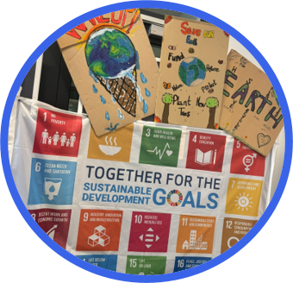
IMPACT
Reduces emissions and promotes active and healthy lifestyles.
Develops sustainability literacy and critical thinking about urban planning and transport systems.
Encourages students to become local mobility leaders, collaborating with municipalities and peers to design safer, greener routes to school.

Slide 13
IMPACT
Promotes safe, fun, active and low-carbon transport habits.
Strengthens community engagement and shared responsibility.
Builds environmental awareness and sustainable lifestyles among students and families.

Slide 14

THEME: CLEAN ENERGY
Inspiring examples and projects across the EU
“Power Savers Club” – student teams monitor classroom and lab energy use and present savings.
CUBE.S – Schools Energy Saving Competition (France) – secondary students compete to reduce energy use through behavior change and design. Cube.S: schools take up the challenge of energy transition! | Cerema (in English); CUBE.S – Le concours énergie pour les établissements scolaires (in French)
Notes:
Explain how students can conduct energy audits, calculate energy savings, and design campaigns to influence peers and school policies. Highlight examples where students present results to the school or wider community, reinforcing leadership and communication skills.

Slide 15
THEME: CLEAN ENERGY
Inspiring examples and projects across the EU
Energy@School: Students become Energy Guardians, conducting audits, proposing efficiency measures, and helping implement smart-school plans.
SAVES2: University and older secondary students act as energy ambassadors in dorms and housing, running peer-to-peer competitions to cut energy use.

Slide 16
IMPACT
Develops leadership, critical thinking, and problem-solving skills.
Encourages participation in measurable, data-driven
sustainability initiatives.
Connects students’ school-level actions to broader Climate Pact goals and local renewable energy transitions.
Promotes practical learning on energy efficiency, innovation,
and responsibility.

Slide 17
Inspiring example by the Climate Pact Ambassador Martin Brocklehurst related to
energy efficiency in schools
Creation of a 206 kW solar power plant at the Faculty of Electrical Engineering, University of Ljubljana, Slovenia, as part of the EU funded AURORA project.
The project involved students, faculty, and technical staff, forming a vibrant university energy community (ŠEK – Student Energy Club).
The plant was designed and built with innovative criteria and is monitored using systems developed in-house, with real-time data accessible via an app.

Slide 18
THEME: WASTE MANAGEMENT AND CIRCULAR ECONOMY
Inspiring examples and projects across the EU
Let’s Fix Fashion: Irish campaign encouraging students to tackle fast fashion.
CicloSchools: Supports teachers and students in integrating circular economy and waste‑as‑resource thinking into science education and school projects
Notes:
Encourage turning waste into a circular economy project; like fashion upcycling or campus reuse hubs. Encourage to use these examples to turn school waste streams into opportunities (e.g., swap markets, up‑cycling clubs, food‑waste audits). Stress that the circular‑economy approach goes beyond recycling: it’s about rethinking design, consumption and waste, and students can support institutions to make this systemic change.

Slide 19
THEME: WASTE MANAGEMENT AND CIRCULAR ECONOMY
Inspiring examples and projects across the EU
Creative Upcycling for Sustainable Art and Design – CREA‑UP:
A higher education/design‑community project creating up‑cycling labs and art‑design interventions from post‑consumer waste
Various schools participate in EU-wide awareness campaigns during the European Week for Waste Reduction - EWWR – students audit and redesign school waste systems.

Slide 20
IMPACT
Fosters creativity, social entrepreneurship and systems thinking.
Encourages students to transform waste into value, shifting mindsets from “throwing away” to “re‑using and redesigning”.
Enables schools to participate in the circular economy transition, connecting classroom action with EU‑scale sustainability goals.

Slide 21
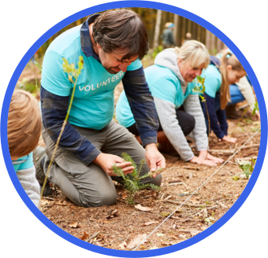
THEME: BIODIVERSITY AND NATURE-BASED SOLUTIONS (NBS)
Inspiring examples and projects across the EU
Blooming School project: Secondary schools create wildlife gardens in their schoolyards and use them as outdoor classrooms to foster green awareness and activism.
The Resource library of Mission Soil Platform: is an online collection of educational materials, scientific publications, policy documents and multimedia resources that support the EU’s Mission Soil – A Soil Deal for Europe.
COOLSCHOOLS: Schools serving as nature‑based climate shelters, implementing NBS (green roofs, shaded schoolyards, biodiversity zones) through co‑creation with students, teachers and local authorities.
Notes:
Explain that biodiversity and Nature‑Based Solutions (NBS) are not just about planting trees: they involve redesigning school environments, mapping living systems, and innovating with nature. Since Nature Based Solutions (NBS) might not be familiar concept, please briefly explain what NBS are. NBS Strategies that protect, restore, or sustainably manage natural ecosystems to address societal challenges such as climate change, biodiversity loss, water management, and human well-being. NBS use nature’s own processes to provide benefits like reducing flood risk, improving air quality, enhancing urban green spaces, and supporting communities. Use the COOLSCHOOLS example to illustrate how schoolyards can become cooler, greener learning spaces co‑designed by students. Highlight how NBS EduWORLD empowers schools across Europe to embed nature‑based solutions into education, bridging science, art and activism. Emphasise that students involved in eNaBlS learn to treat their campuses as living labs, where nature meets pedagogy and climate action. Encourage teachers to facilitate student‑led biodiversity audits, nature mapping, or habitat creation projects.

Slide 22

THEME: BIODIVERSITY AND NATURE-BASED SOLUTIONS (NBS)
Inspiring examples and projects across the EU
NBS EduWORLD: An EU funded project that supports schools in incorporating nature‑based solutions into education, engaging students to explore ecosystem services and biodiversity through hands‑on projects.
ENaBlS: Education and Nature‑Based Solutions – Involves universities and vocational schools across multiple European countries in embedding NBS into curriculum and campus living labs.
Curiosity Kit: is a hands-on collection of activities developed as part of the EU funded CURIOSOIL project that allows learners to explore the hidden world of soil through multisensory learning.

Slide 23
IMPACT
Connects ecology, creativity, and civic engagement in real‑world settings.
Empowers students to understand, design and implement nature‑based solutions for their schools and communities.
Builds awareness of biodiversity, ecosystem services, and how nature‑based solutions contribute to climate adaptation and mitigation.

Slide 24
THEME: SUSTAINABLE AND LOCAL FOOD SYSTEMS
Inspiring examples and projects across the EU
Koninklijk Atheneum UNESCO School, Koekelberg (Belgium) – introduced plant-based menus and waste audits. Case studies on learning environments for sustainability Page 15
SchoolFood4Change: A large‑scale European project that implements a Whole School Food Approach, linking school cuisine, education, and local procurement to promote planetary‑healthy diets and sustainable food cultures.
Notes:
Explain how food systems are deeply linked to climate, biodiversity, waste and health and how schools can act at multiple levels (garden, canteen, procurement, community). Encourage educators to consider activities like: starting a school garden, running a farmers’ market or lunch‑swap event, auditing food waste, switching to more plant‑based menus, and connecting with local farmers or suppliers. Suggest linking these actions to EU strategies such as the “Farm to Fork” strategy and the climate goals of the European Green Deal, so students see the wider system context.

Slide 25
THEME: SUSTAINABLE AND LOCAL FOOD SYSTEMS
Inspiring examples and projects across the EU
Slow Food Youth Network (SFYN): Youth‑led network that works on food waste, sustainable production and cultural food heritage. It is not exclusively school‑based but relevant for student groups and youths.
Edible Connections: Secondary schools students explore local food systems, global connections and ecological impacts through gardening and food culture activities.
Notes:
Slow Food Youth Network (SFYN): https://www.slowfoodyouthnetwork.nl/
Edible Connections: https://www.slowfood.de/was-wir-tun/projekte-aktionen-und-kampagnen/edible-connections/school-project-edible-connections

Slide 26
IMPACT
Encourages students to understand food as part of the climate system (production, consumption, waste).
Builds independent thinking, collaborative initiatives (garden, audit, market), and links food actions to community and planet.
Supports schools in becoming agents of change in sustainable food systems across Europe.

Slide 27
Inspiring example from Pact Ambassador
Morgan Janowicz related to plant-based menus
Plant Based School is an educational and advocacy movement led by the Green REV Institute, aiming to transform school food systems in Poland.
By researching over 1,000 schools, the project highlighted the lack of plant-based meals and nutritional standards.
The initiative brought together institutions, parents, students, and local authorities, organising roundtables, publishing practical guides, and launching awareness campaigns to promote more sustainable and inclusive food policies in schools.

Slide 28
Inspiring example from Pact Ambassador
Morgan Janowicz related to plant-based menus
Students are invited to submit innovative ideas for climate-friendly actions in their schools: from creating school gardens and reducing food waste to raising awareness on renewable energy and circular lifestyles
Winning projects in each age group receive mentoring and support to implement their ideas, turning proposals into real, visible changes on campus and in their communities.
Notes:
Share this inspiring action as part of the Climate Pact Community.

Slide 29

Join the Pact2School campaign!
The Pact2School campaign aims to support children, youths, teachers and the rest of the education community to explore green action and sustainability topics, it also aims to develop meaningful partnerships between the Climate Pact community and schools and universities.
The campaign aims to inspire students and teachers by organising awareness raising sessions on the sustainability and climate action topics as well as to support schools to submit impactful student-led project ideas and get up to 1000 euros in project funding.
Join our new Pact2School campaign - European Union Be part of the European Climate Pact movement empowering students to take climate action.
Notes:
Conclude with a call to action and practical next steps.
Encourage participants to take the next step: turning inspiration into action.
Emphasize that any school can join, whether starting small with a single class activity or launching a full school-wide campaign.
Remind them that the Pact2School toolkit offers ready-to-use materials and examples for different themes: mobility, energy, waste, biodiversity, and food systems.
Pact2School campaign webpage: Conclude by encouraging teachers and other education community members to join the Pact2School campaign. The campaign aims to support children, youths, teachers and the rest of the education community to explore green action and sustainability topics, it also aims to develop meaningful partnerships between the Climate Pact community and schools and universities.
The campaign aims to inspire students and teachers by organising awareness raising sessions on the sustainability and climate action topics as well as to support schools to participate in the Pact2School challenge by submitting impactful student-led project ideas and get up to 1000 euros in project funding.
Webpage link: Join our new Pact2School campaign - European Union

Slide 30

Thank you for
Helping our planet!

Slide 31
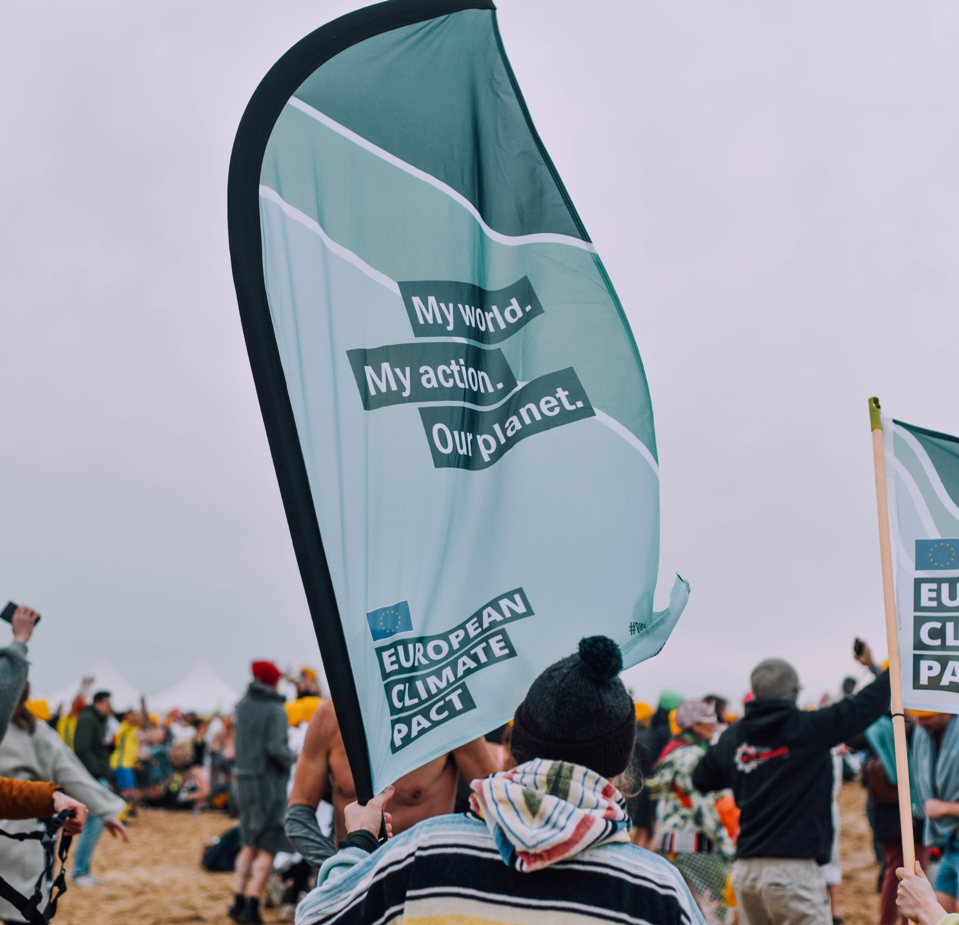
Examples of inspiring actions
XX
XX
Notes:
Feel free to add other examples of inspiring actions that you might know.

