Slide 1
The european
climate pact

Slide 2
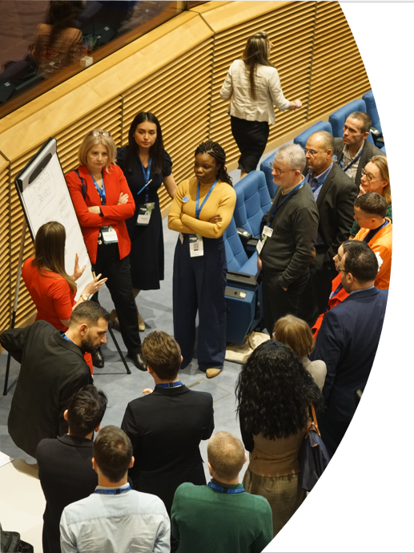
contents
1. About the European Climate Pact
2. The European Climate Pact in action
3. Get involved!

Slide 3
ABOUT the European
1.
Climate pact

Slide 4
What is The EUropean Climate Pact?
20
The European Climate Pact is an initiative launched by the European Commission aiming to create a movement of people united around a common cause: climate action.
As part of the European Green Deal, it is helping the EU meet its goal to become climate-neutral by 2050.
50

Slide 5
objectives
Raise awareness
Encourage
Connect citizens
of climate issues and EU actions
climate action and catalyse engagement
and organisations that act on climate and help them to learn from each other
“
The Pact’s motto is: “My World. My Action. Our Planet.”

Slide 6
priority areas
03
01
02
Economy and just transition
Climate policy and action on the ground
Adaptation to unavoidable climate impacts

Slide 7
Climate Pact community
The Secretariat
CCs and PR
Climate Pact Ambassadors
mobilises the Pact community and coordinates its activities at central level.
Country Coordinators (CCs) and public relations (PR) agencies focus on implementing the Pact’s vision at national level.
inform, inspire and support climate policy and action in their communities.
Climate Pact Partners
Friends of the Pact
are organisations committed to addressing climate change and contributing to a sustainable future.
are supporters interested in becoming active on climate-related topics in their country.

Slide 8
ambassadors
Climate Pact Ambassadors are leaders of organisations, communities, informal groups or movements, local authorities, representatives of cultural institutions, influencers (etc.). Currently more than 800 Ambassadors:
Lead by example and inspire others to take climate action.
Share Pact messages via their networks and communication channels.
Organise and participate in local, national, regional, or European events and activities.

Slide 9
PARTNERs
Climate Pact Partners are organisations committed to addressing climate change and contributing to a sustainable future. As part of the Pact, they:
Increase visibility of the Pact on their websites and showcase achievements through official channels.
Engage in exclusive events with EU policymakers.
Collaborate with Ambassadors at national and regional levels.

Slide 10
THE EUROPEAN CLIMATE
2.
Pact in action

Slide 11
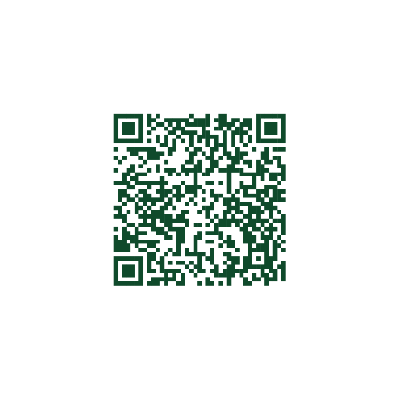
Engaging Citizens in Climate Action
The Climate Pact engages citizens in debates on climate action through activities such as:
Climate walks
Peer parliaments
Local climate action groups
Photo story workshops
Visit the website to find out more

Slide 12
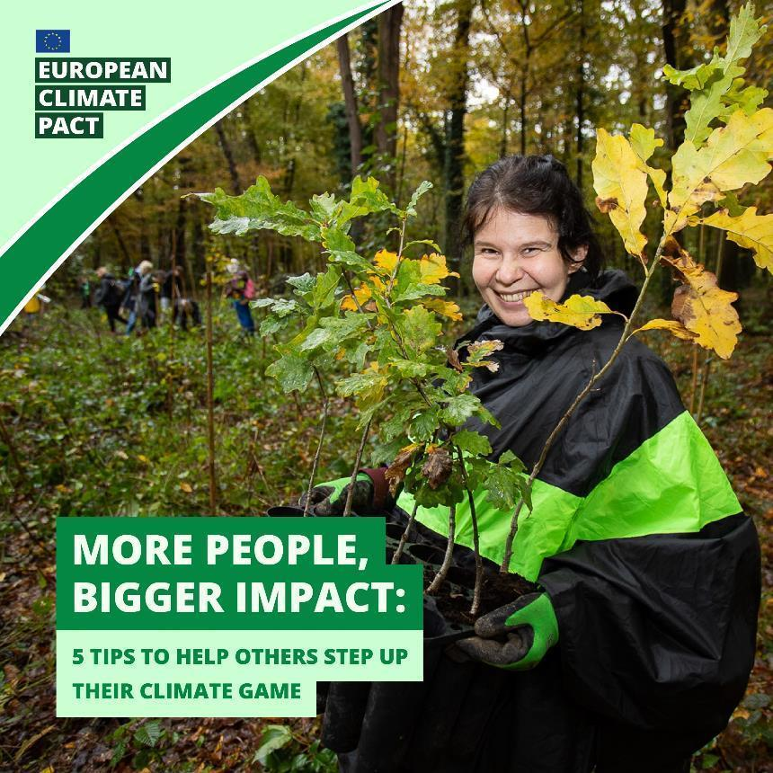
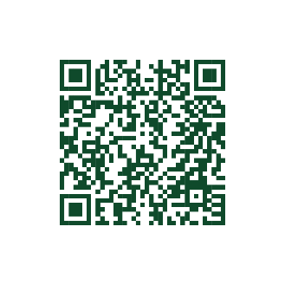
Activities in EU MEMBER STATES
In every Member State, Country Coordinators (CCs) and PR agencies organise and promote events and activities for the local Pact community and the public, such as:
Citizen engagement activities
National events gathering the Pact community
Capacity development workshops
Learn and share sessions
Get in touch with Pact Country coordinators

Slide 13
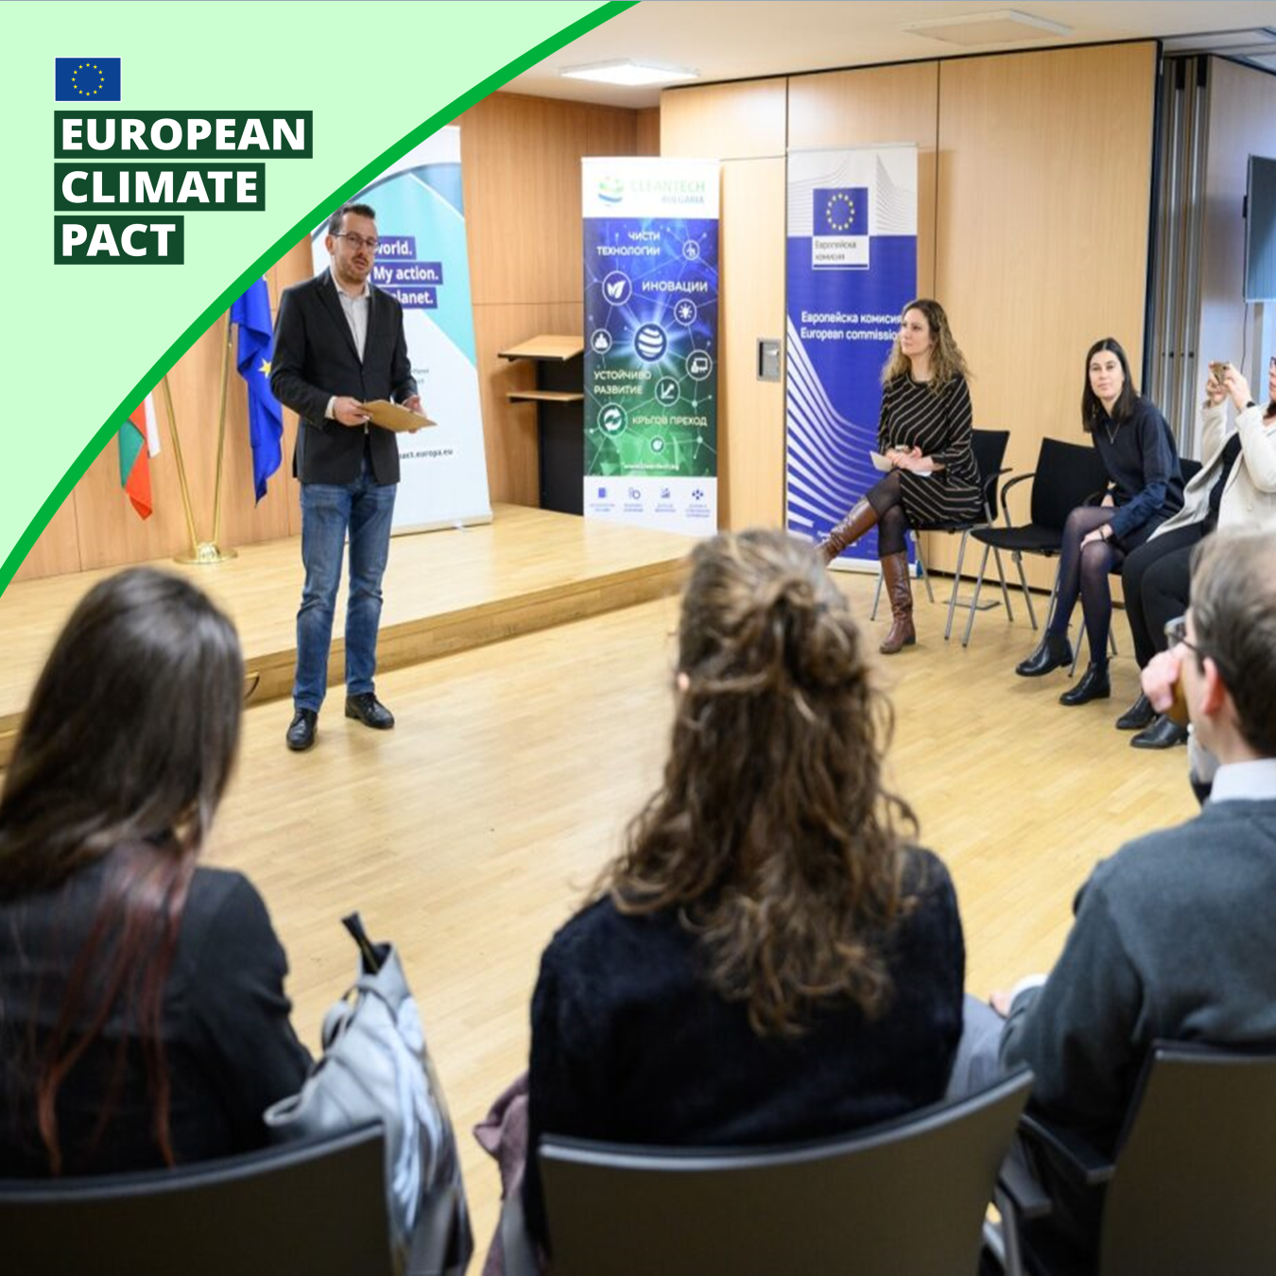
ACTIVITIES in EU countries
Capacity building event in Belgium ​ National event in Bulgaria Citizen engagement event in Estonia​

Slide 14
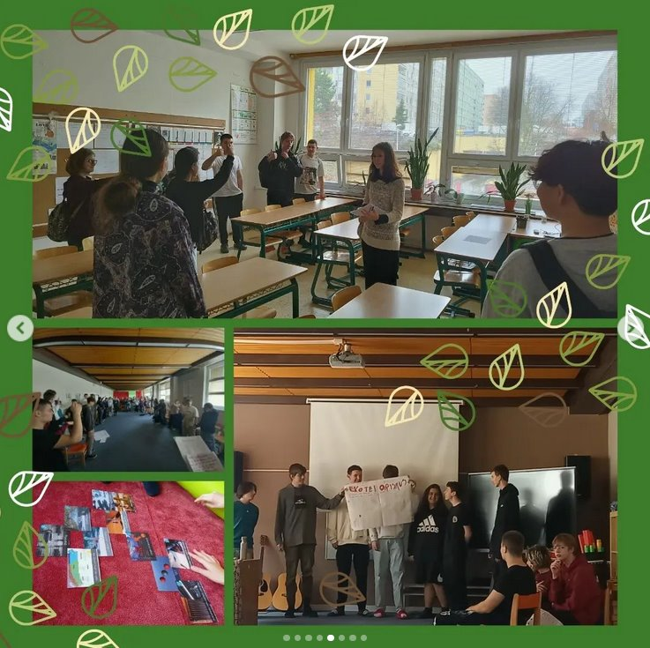
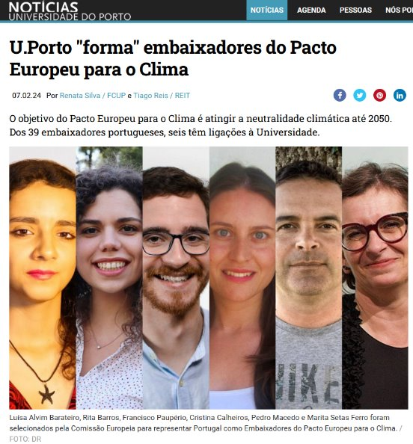
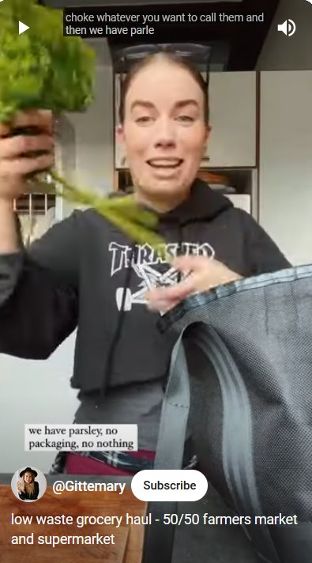
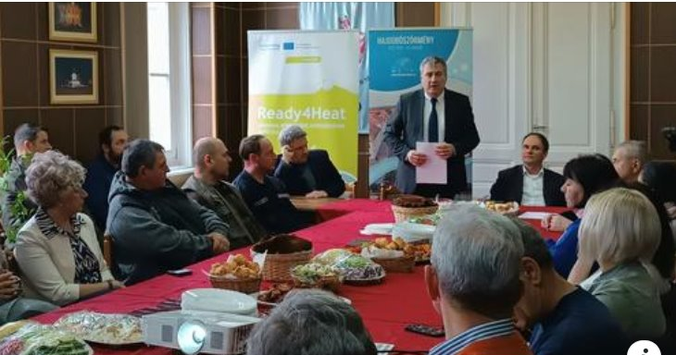
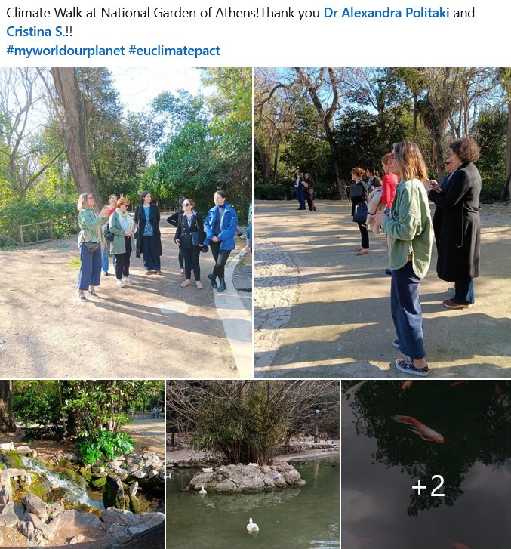
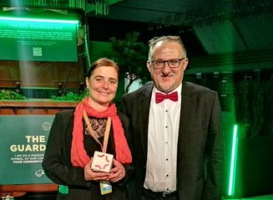
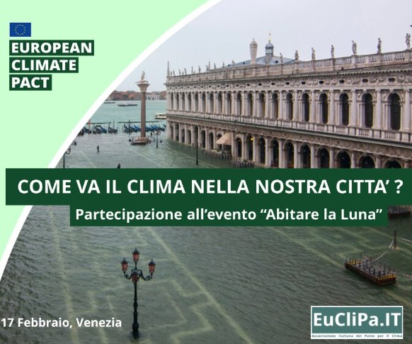
Ambassadors' activities
Pact Ambassadors organise a multitude of activities at the local level to drive change and raise awareness, ranging from workshops, seminars, debates, social media campaigns...

Slide 15
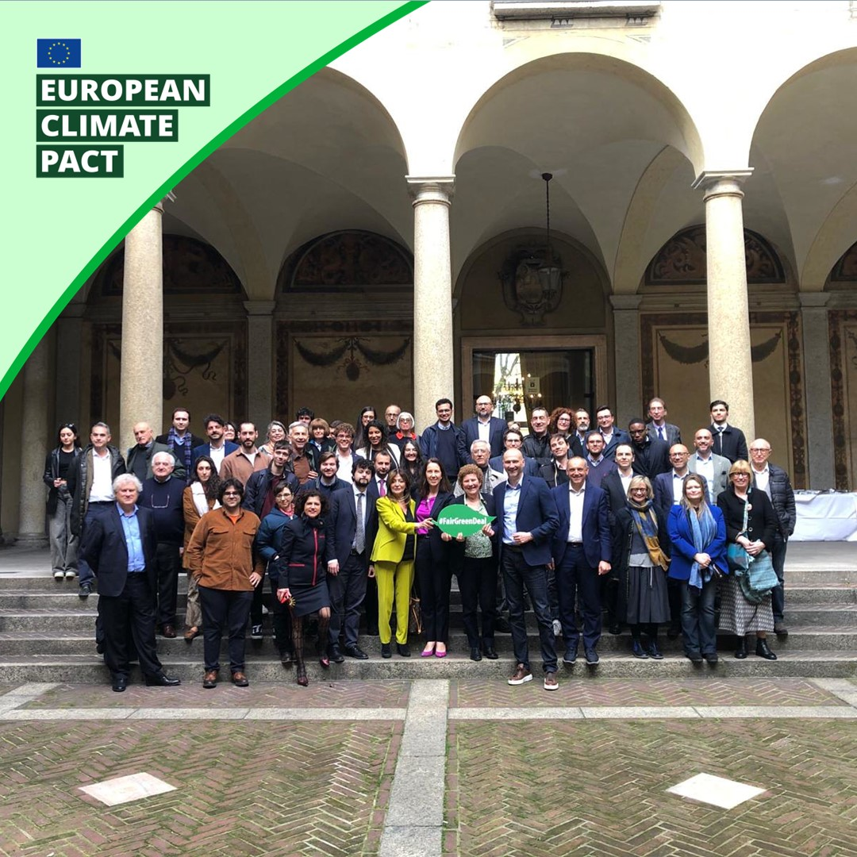
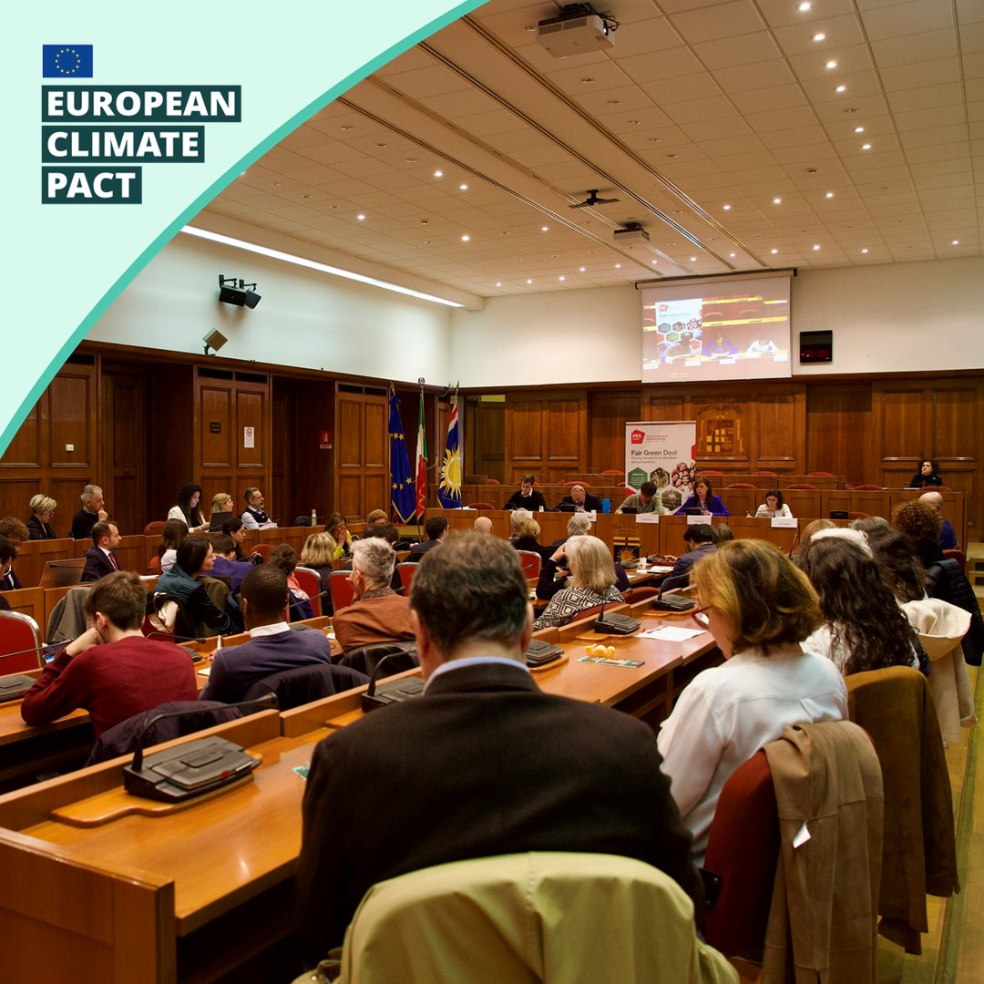
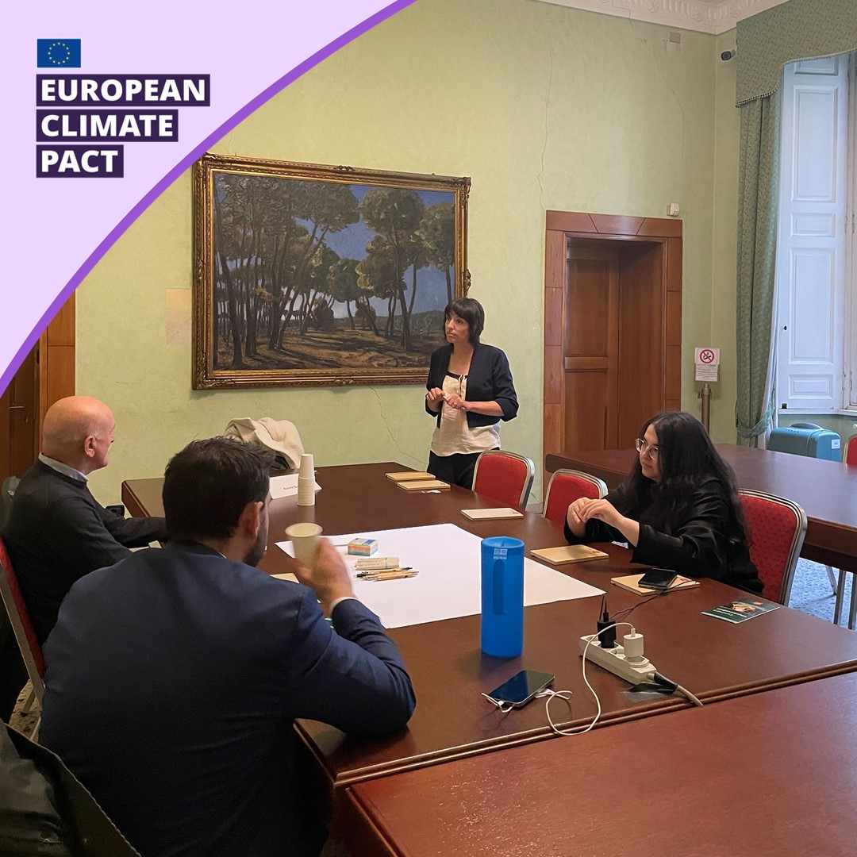
PARTNERS' ACTIVITIES
PARTNERS' ACTIVITIES
Urban mobility and sustainable cities Lombardy-Europe local talk and training for local administrators in Milan, Italy.

Slide 16
cooperation with local authorities
The Climate Pact cooperates with local authorities to promote further visibility of their events, via the:
Committee of the Regions
Climate Pact Going Local Talks
Mission Implementation Platform for Adaptation to Climate Change (MIP4ADAPT)

Slide 17
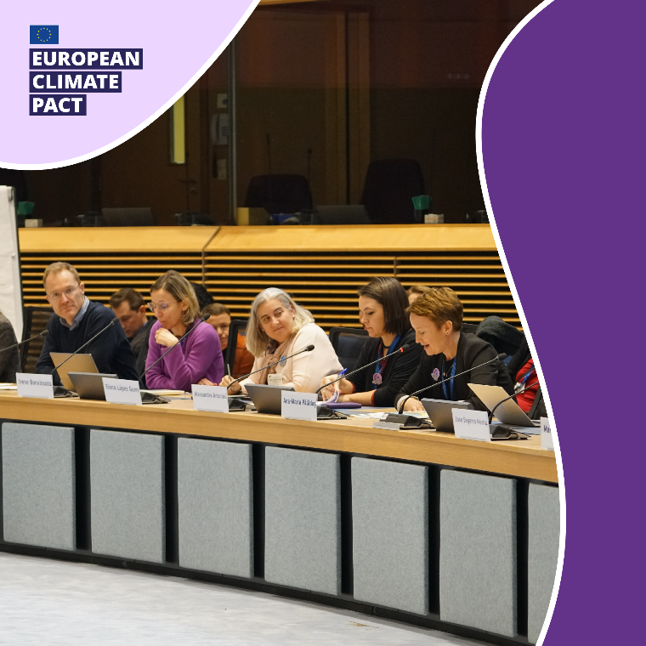
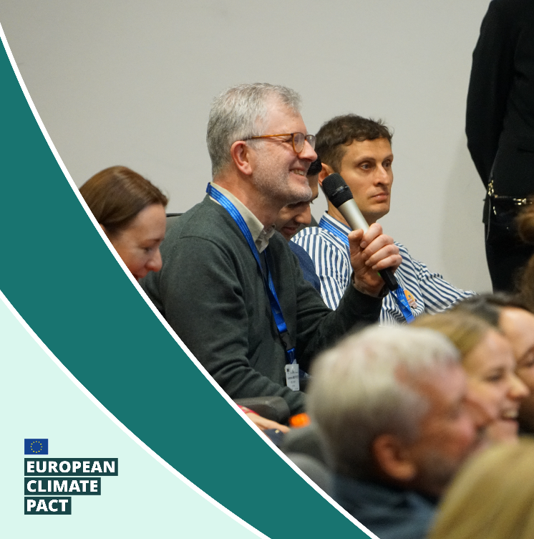
CENTRAL ACTIVITIES
The Pact regularly publishes new resources on the website for those interested in learning more about climate-related issues. You can also stay informed about the Pact’s activities via the news and events sections, subscribe to the Pact newsletter and follow the Pact on Facebook, X, LinkedIn, Instagram.
In addition, community members are invited to join our monthly online Community Talks and our bi-annual Community Forum to get to know other Ambassadors and Partners and learn from each other.
The Pact’s annual event gathers members of the Climate Pact community from across Europe to work together on new ways to spark climate action in their local communities.
Read more about the 2024 event here.

Slide 18
get
3.
involved!

Slide 19
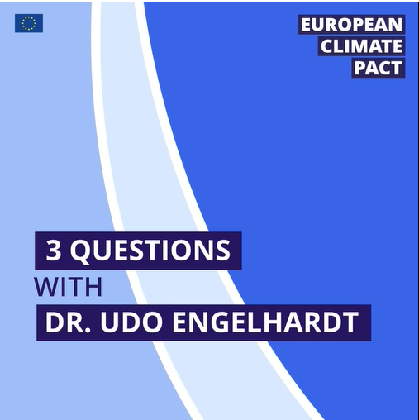
Why join the pact?
As a representative of an organisation, association, region or city:
Access communication tools to help inform, educate and inspire your community.
Benefit from opportunities to network, learn from others and share knowledge.
Demonstrate your commitment to climate action.
Lead by example and inspire others as a Pact partner. Calls for partners are regularly announced.

Slide 20
Why join the pact?
As an individual:
Learn
about climate change and what it means for you.
Join activities and events
or host your own initiatives.
Connect with like-minded people
to push for real change on the ground and find solutions to climate-related challenges.
Lead by example and inspire others
as an Ambassador. Calls for Ambassadors are regularly announced.
Share your views and collaborate
with European, local and regional policymakers.

Slide 21
How can YOU Get involved?
Become a Climate Pact Ambassador and support climate action in your community.
Host your climate action group activity and get inspired by our Quick-start tools for citizen engagement.
Become a Partner of the Pact and increase your organisation’s visibility in taking climate action.
Use our resources to spread clear and accurate information about climate change and climate action.
Become a Friend of the Pact if you're eager to get guidance to on taking more climate action.
Join the Pact team in the UN ActNow campaign via the AWorld app! Reduce your carbon footprint through daily activities and take measurable steps towards the Sustainable Development Goals.
Register your own Climate Pact satellite event to have your event published on the Climate Pact website.

Slide 22
Quick-start tools for citizen engagement
Get inspired by the quick-start tools published on the Pact website
Register the activity you plan to host
Host the activity
Share the results with the European Climate Pact
Disseminate your activity and its results and invite others to host!

Slide 23
Quick-start tools for citizen engagement
Local Climate Action Group
Climate Walk
Photo Story
Peer Parliament
Guided tours in local neighbourhoods to showcase sustainable practices and initiatives supporting the green transition.
Photography workshops where participants capture and reflect on climate issues and solutions. The outputs can influence decision-making and drive change.
A group of people working towards a shared goal, such as creating a communal garden, a repair cafe or a local energy community.
Discussions on how the transition to climate neutrality can work in practice in our everyday lives and what policies should be put in place to encourage us going forward.
Visit the website to find out more

Slide 24
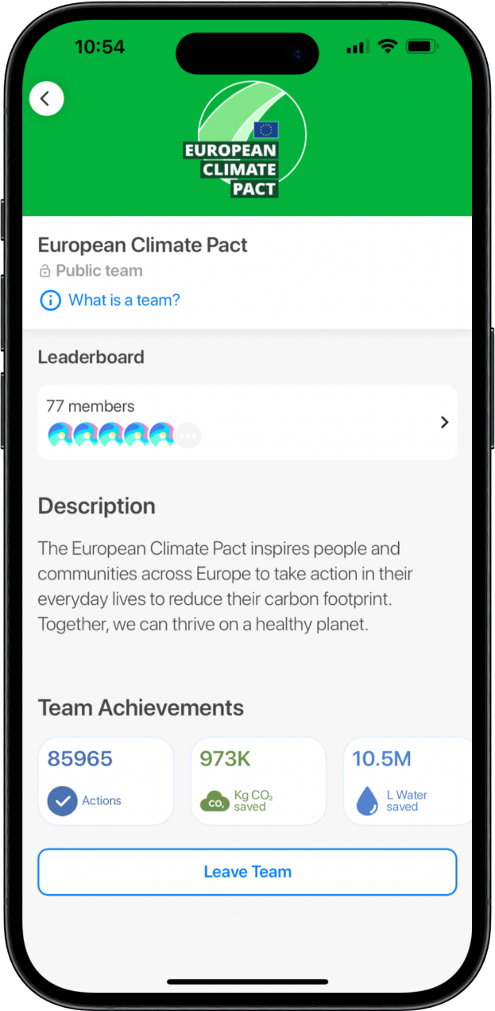
Pact and un act now
The European Climate Pact has joined forces with ActNow, the United Nations campaign, and AWorld, the mobile app for the campaign, which inspires people to take climate action.
More than 900,000 climate actions were reached by users joining the European Climate Pact Team challenge on AWorld.

Slide 25
Share your stories with us!
Each and every one of us can help build a more sustainable future. Sharing inspiring success stories, solutions and actions from the diverse Pact community is at the center of our communications.
Share your stories with us via: stories@euclimatepact.eu.
Include relevant links, attachments, pictures or details that will help us understand and share your story.

Slide 26
For more information
Platform | Tag
Facebook | @EU Climate Action
X | @EUClimateAction
LinkedIn | @EU Environment and Climate
Instagram | @ourplanet_eu
Visit the Climate Pact website to find stories from the Pact community, and useful resources and materials to inspire others to take action.
You can also subscribe to our newsletter and follow us on social media to stay updated on climate action.
Find our content using the hashtags: #EUClimatePact #MyWorldOurPlanet
Any questions? Don’t hesitate to contact the Secretariat at: contact@euclimatepact.eu

Slide 27
Thank you
For your attention!

