Slide 1
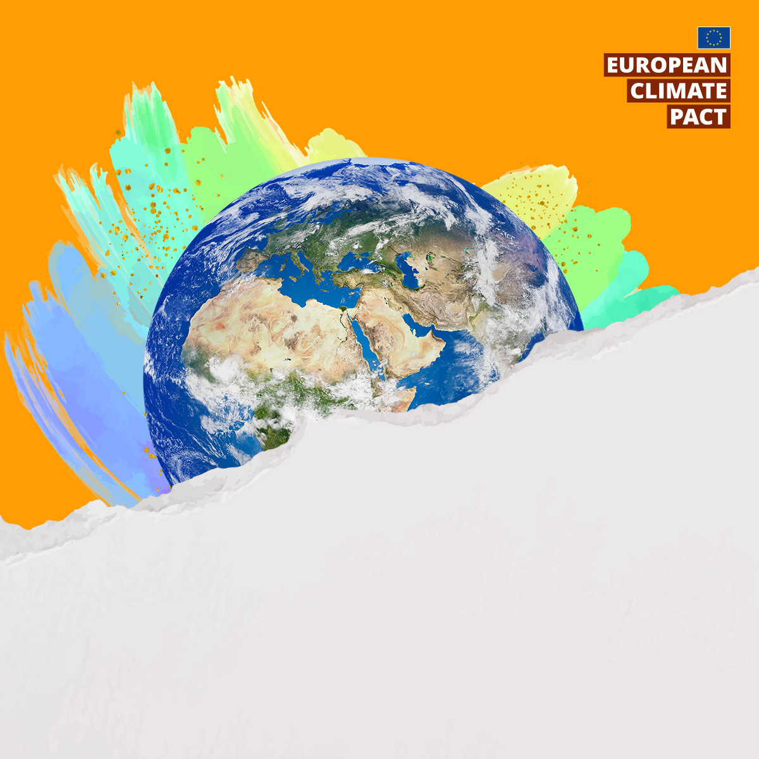

THE EUROPEAN CLIMATE PACT
TOGETHER IN ACTION
2026
#EUClimatePact
#MyWorldOurPlanet
24-25 MARCH | BRUSSELS AND ONLINE
Notes:
Updating the text
When adding new text, adjust the box accordingly to fit in the text and ensure the same difference in space between the text and box is kept.
Adding a new image
Insert your own image, ensuring it is of a high quality and does not overlap the copy.
To do this select the image > Insert > Picture > This Device (or other appropriate option) > Select filename > Once visible on the slide, manually resize and align for best visibility > Once resized, right click > press send to back.
Export
To export: Please choose > File > Save As > Choose your saving location > Change ‘Save As Type’ to PNG (Portable Networks Graphics Format PNG) > Select applicable options from pop up window > Save.
1

Slide 2
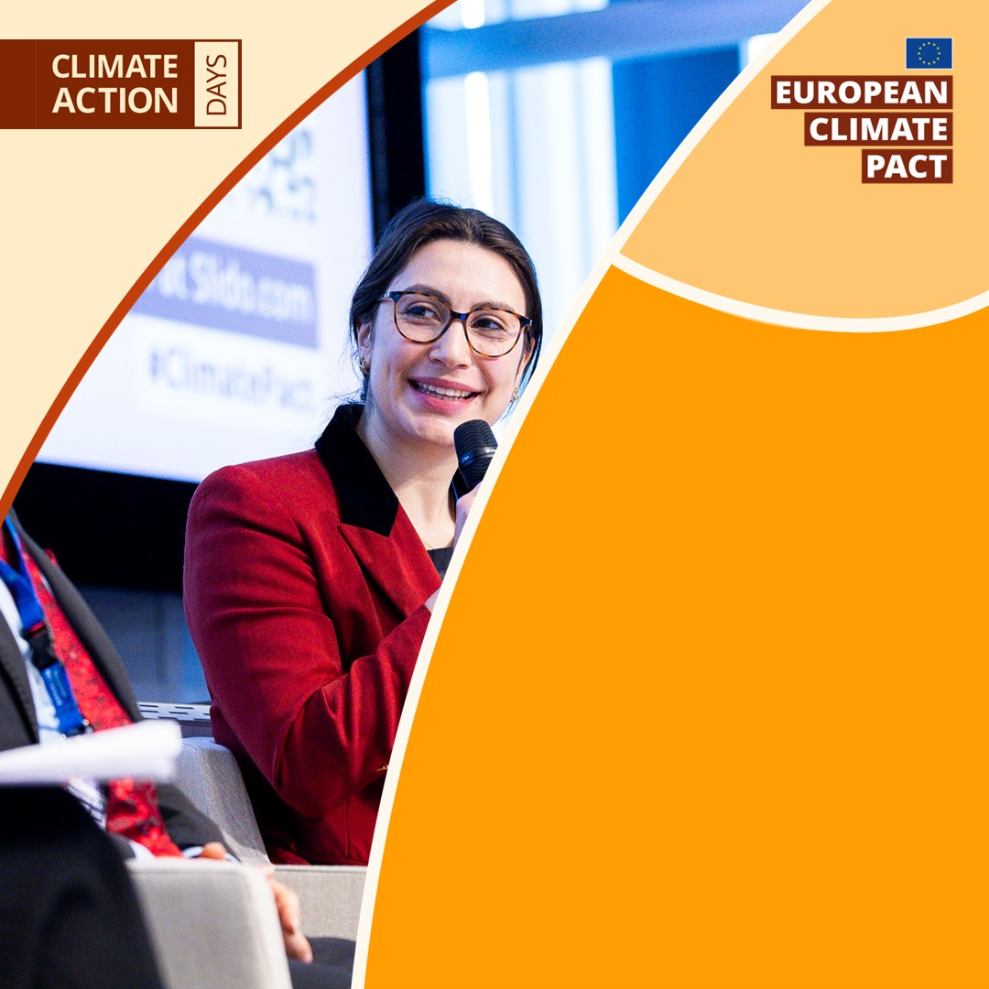
THE EUROPEAN CLIMATE PACT
TOGETHER IN ACTION
2026
#EUClimatePact #MyWorldOurPlanet
24-25 MARCH | BRUSSELS AND ONLINE

Slide 3
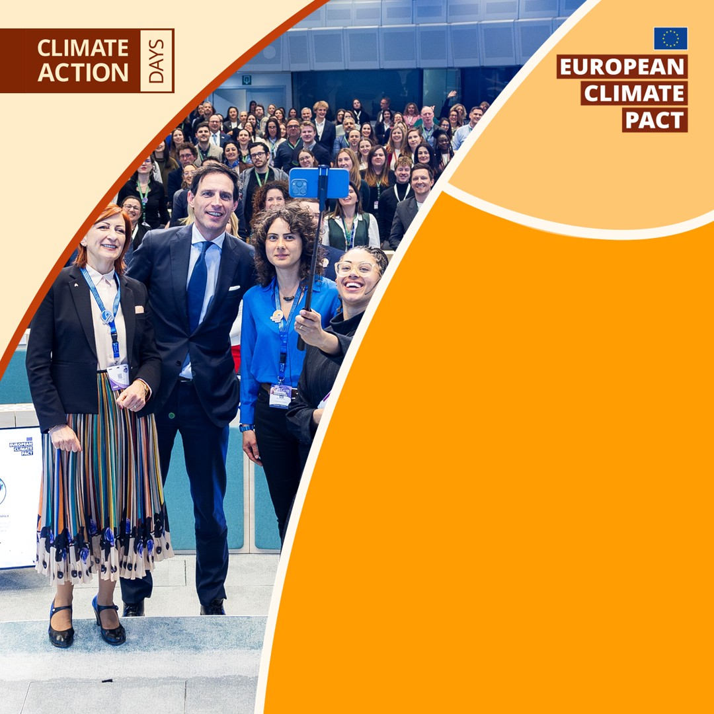
THE EUROPEAN CLIMATE PACT
TOGETHER IN ACTION
2026
#EUClimatePact #MyWorldOurPlanet
24-25 MARCH | BRUSSELS AND ONLINE

Slide 4
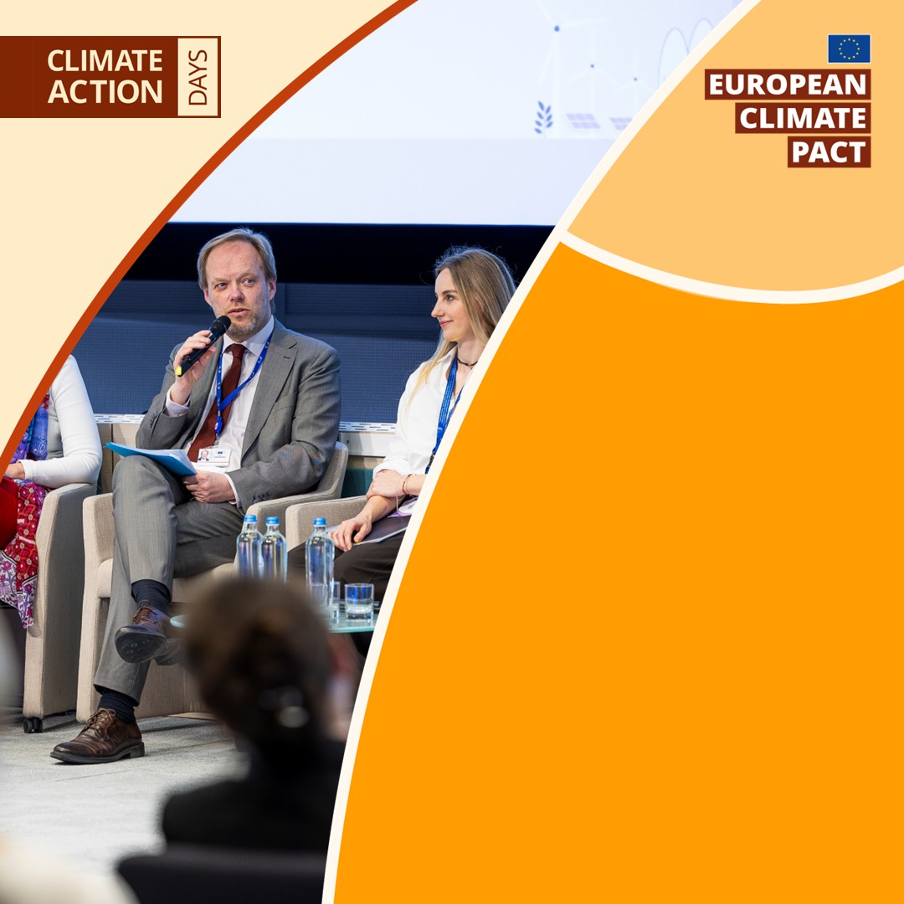
THE EUROPEAN CLIMATE PACT
TOGETHER IN ACTION
2026
#EUClimatePact #MyWorldOurPlanet
24-25 MARCH | BRUSSELS AND ONLINE

