Slide 1

Empowering primary school students:
Climate action in practice
Examples and inspiring stories from
the Climate Pact community and beyond
Notes:
Welcome the audience and introduce the presentation as a showcase of real examples of how primary schools across Europe are engaging children in climate action. Emphasize the power of stories and how small actions can lead to big impact.

Slide 2
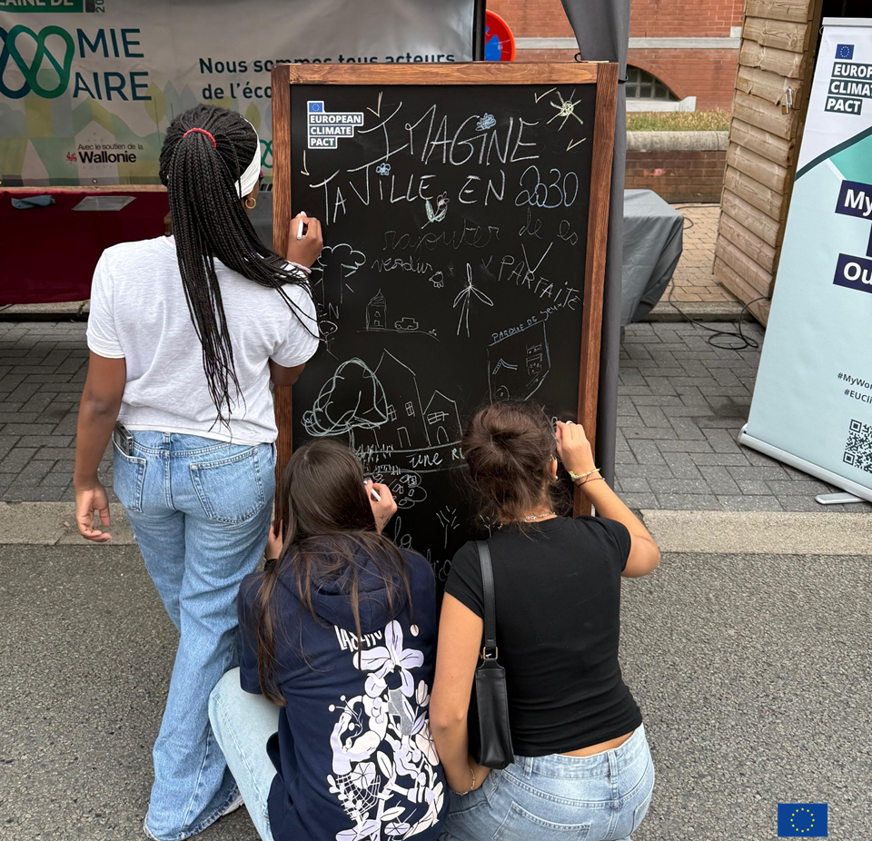
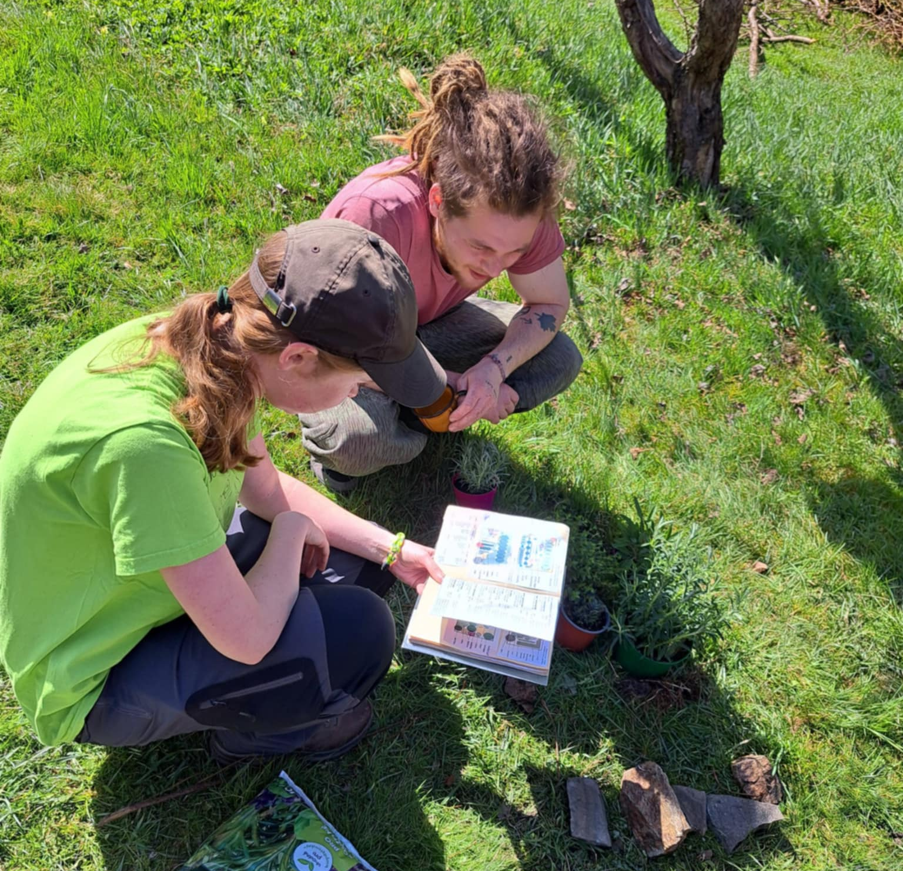
Young students are
powerful changemakers
Early climate action education builds awareness, sustainable habits and creates new communities. Climate Pact supports youth-led action across Europe.
Notes:
Explain why engaging children early matters: they influence peers, families, schools and the surrounding community. Link this to the Climate Pact’s commitment to empower young citizens through education and action.

Slide 3
Six key action areas
for primary schools
Climate awareness
Sustainable mobility
Clean energy
Waste management and circular economy
Biodiversity and Nature-Based Solutions (NBS)
Sustainable and local food systems
Notes:
Introduce the six themes as practical entry points for schools to engage students. Each theme connects global challenges with everyday school life and learning opportunities.

Slide 4
Climate AWARENESS RESOURCES suitable
for primary SCHOOL TEACHERS
EU Learning Corner: European Commission platform offering free, multilingual educational materials to help primary and secondary students learn about climate change, energy and environmental protection. Arts and crafts projects using discarded materials (bottles, cardboard, fabrics) to make useful objects, decorate classrooms, create climate-awareness posters or make some artwork.
GreenComp: consisting in 12 competences organised into key areas: embodying sustainability values, embracing complexity in sustainability, envisioning sustainable futures and acting for sustainability.
Notes:
Highlight examples where students led climate campaigns: from creating climate murals to organising school-wide awareness days. Mention that activities like “EU Learning corner” or "GreenComp" make climate action tangible and fun for primary students, encouraging family participation.
Resources and links:
EU Learning corner: Learning materials - Learning corner - European Union
GreenComp consisting in 12 competences organised into the following key areas:
Embodying sustainability values, including the competences: valuing sustainability, supporting fairness, promoting nature
Embracing complexity in sustainability, including the competences: systems thinking, critical thinking, problem framing
Envisioning sustainable futures, including the competences, futures literacy, adaptability, exploratory thinking
Acting for sustainability, including the competences: political agency, collective action, individual initiative
Full publication: GreenComp, the European sustainability competence framework: https://op.europa.eu/en/publication-detail/-/publication/bc83061d-74ec-11ec-9136-01aa75ed71a1/language-en

Slide 5
IMPACT
Builds leadership, creativity and a sense of responsibility.
Encourages whole-school participation and collaboration.
Helps children feel empowered to take climate action in their daily lives.
Notes:
Emphasise that through these initiatives, children are not just learning about climate action: they are leading it within their schools and communities.

Slide 6
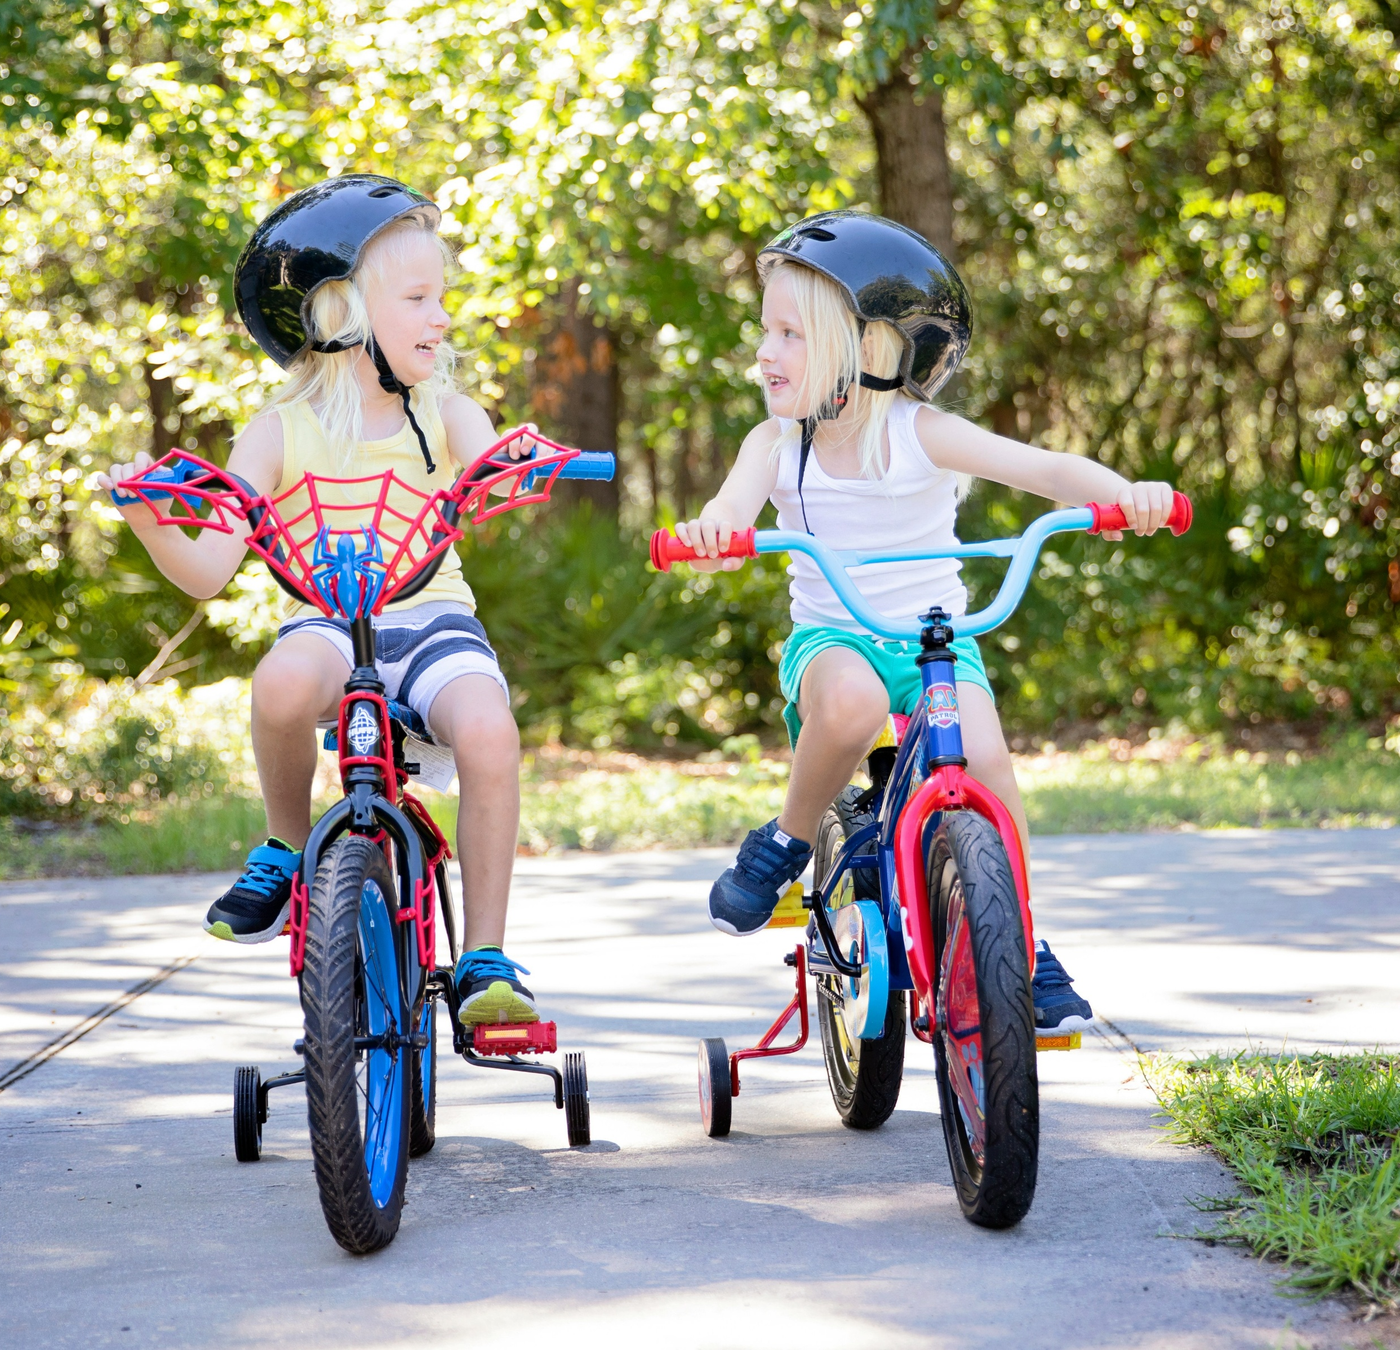
THEME: SUSTAINABLE MOBILITY
Example: Students mapped safe routes to school,
organised car-free days, and tracked emissions saved.
“Safe routes to school': Students, parents, and school co-create safe walking/cycling routes.
“Walk or wheel day”: Weekly challenge encouraging active commuting on one day of the week.
Mobility festival: Celebrates walking, cycling, and public
transport with games and fun activities.
Notes:
Highlight collaboration with parents and teachers to ensure safe participation. Describe how challenges like “Walk or Wheel Wednesday” make sustainable travel a playful habit. Mention how Mobility Festivals can be small events, such as a school walking parade or bike decorating day, to engage children and the community.
Safe routes to school: Safe routes to school | CIVITAS

Slide 7
IMPACT
Reduces carbon footprint in a fun, tangible way.
Encourages physical activity and healthy habits.
Involves families and creates school-wide enthusiasm for sustainable mobility.

Slide 8
THEME: SUSTAINABLE MOBILITY
“Kids on the move!” (Csaba Lajtmann –Hungary)
Theme: Sustainable mobility and collective action
Target group: Primary and secondary school children
Description: Students take part in climate-friendly actions through the Bicibus, cycling to school together on safe routes, and the AWorld app, tracking sustainable actions. The initiative includes creative tasks and community projects, helping students reflect on their role in building greener schools and inspiring climate awareness from an early age.
Impact: Promoted active travel, collective learning, and climate responsibility.
Notes:
Explain how “Kids on the move!” demonstrates practical, collective engagement: promoting safe, sustainable travel while linking digital tools and creativity. Note how it builds habits and community connections.
AWorld app: Engagement and Sustainability for Change - AWorld

Slide 9

THEME: CLEAN ENERGY
Examples: Energy-saving challenges in classrooms
CUBE.Ecoles: Hands-on energy-saving activities introducing renewable energy and responsible consumption.
STEM4Life – Energy and water conservation (eTwinning): Engages primary school pupils in hands-on STEM activities, such as building mini solar ovens or rainwater harvesting models, to learn about energy and water efficiency and sustainable everyday behaviours.
Energy-saving challenges: Posters, classroom pledges,
and friendly competitions to switch off lights and devices.
Notes:
Emphasise simple, tangible actions like turning off lights, unplugging electronics, or tracking energy use with charts. Highlight some examples such as CUBE.Ecoles as an interactive, age-appropriate tool that introduces renewable energy in a playful way. Mention that classroom campaigns and clubs help children understand their personal impact and connect to the broader Climate Pact mission.
Resources and links:
CUBE.Ecoles: CUBE Écoles - Championnat des Economies d'Energie - Accueil
STEM4Life – Energy and water conservation (eTwinning): Energy & Water Conservation | European School Education Platform
Compendium of Good Practices (p.31): https://climate-pact.europa.eu/resources_en

Slide 10
IMPACT
Students learn about energy efficiency, renewable energy and responsible energy consumption.
Encourages teamwork, measurable actions and
fun learning.
Builds awareness of energy use in everyday school life.

Slide 11
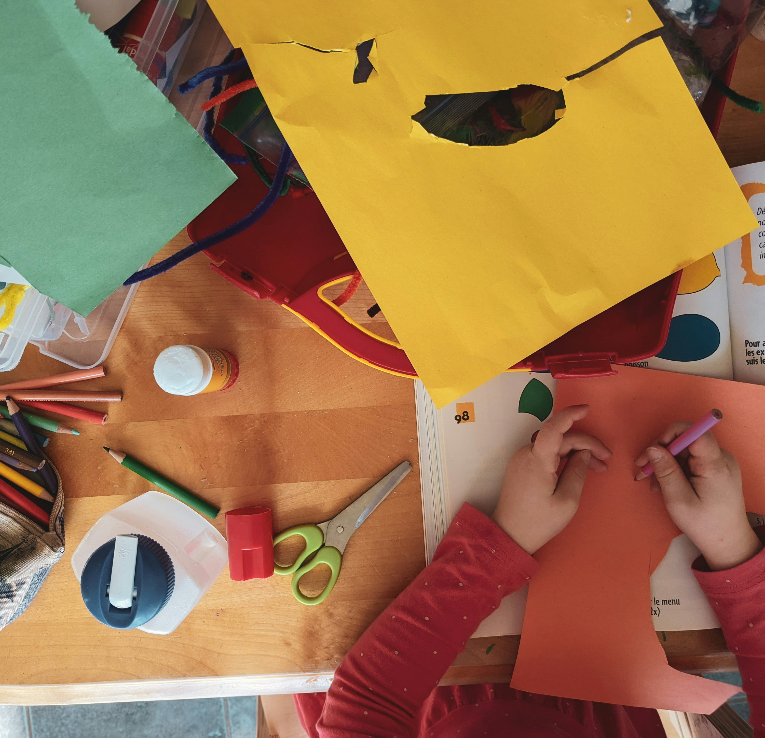
THEME: WASTE MANAGEMENT AND CIRCULAR ECONOMY
Examples of inspiring action
Zero Waste Week: Classroom challenges to reduce landfill waste.
Classroom recycling stations and composting projects.
Swap events for toys, clothes or books.
Upcycle classroom waste into crafts
(e.g., bottle planters, cardboard toys).
Notes:
Highlight interactive activities like a “Recycling Relay” between classes.
Show how small, tangible actions (sorting waste, composting, making crafts) help children understand circular economy principles.
Emphasise teamwork, creativity, and fun — the focus is on learning through doing.
Related resources and links:
Zero‑Waste Toolkit for schools: Complete_Toolkit.pdf
Green-Schools Let’s Fix Fashion (child-friendly version ideas): https://greenschoolsireland.org/lets-fix-fashion/
Food waste monitoring toolkit: https://www.zerowastescotland.org.uk/resources/food-waste-monitoring-toolkit-schools

Slide 12
IMPACT
Builds understanding of materials, reuse and shared responsibility.
Encourages teamwork and creativity.
Introduces the idea of reducing waste in daily life.

Slide 13
THEME: BIODIVERSITY AND NATURE-BASED SOLUTIONS (NBS)
Example: Tree planting days, pollinator gardens,
and citizen-science biodiversity counts
Impact: Fosters connection to nature
and understanding of ecosystems.
Notes:
Tell a story about a school that created a “mini urban forest” or bee-friendly garden. Explain how these activities strengthen emotional bonds with nature, promoting stewardship and curiosity.

Slide 14
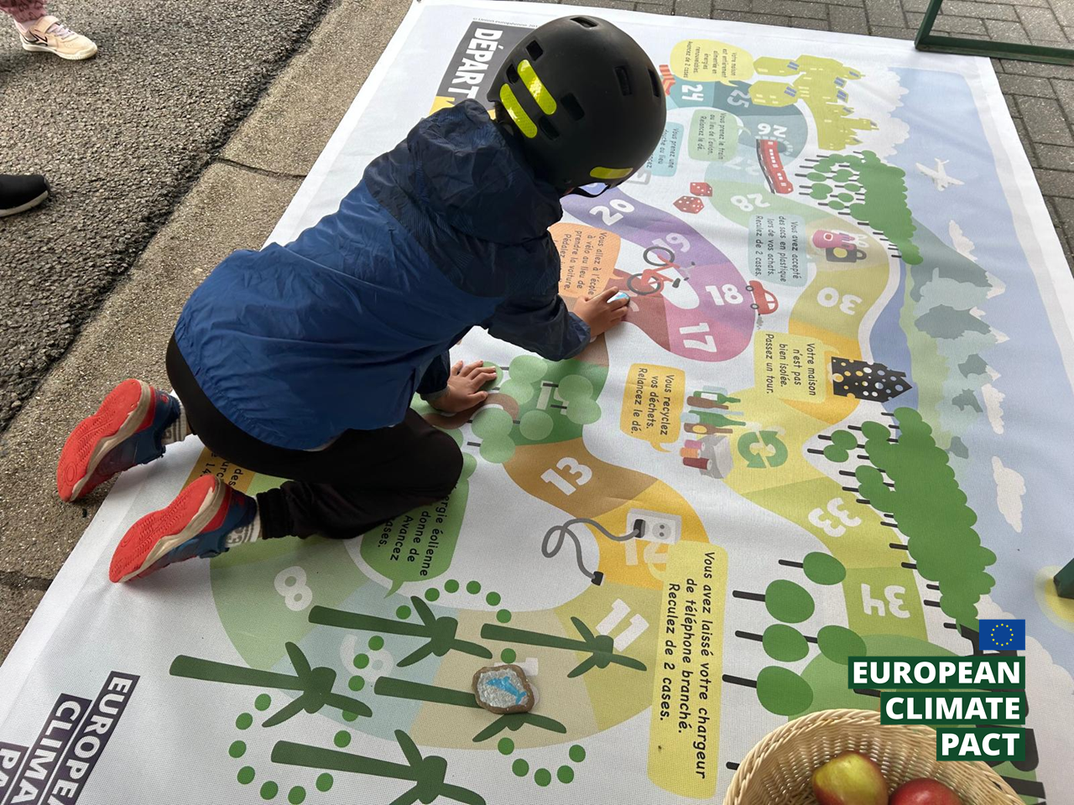
Inspiring Climate
Pact Activity
Notes:
Introduce “My Nature” as a great example of how art and reflection can connect children emotionally to their local environment.

Slide 15
THEME: BIODIVERSITY AND NATURE-BASED SOLUTIONS (NBS)
“My Nature” (Deivi Org – Estonia)
Target group: Primary school children
Description: Children from rural schools explored how climate and nature shape their lives through art. Their work became a public exhibition that inspired conversations across families and communities about caring for local environments and building a climate-aware future.
Impact: Connected creativity, emotion, and environmental awareness.
Notes:
Emphasize how it created intergenerational dialogue and encourage families to think about adaptation and care for nature.

Slide 16
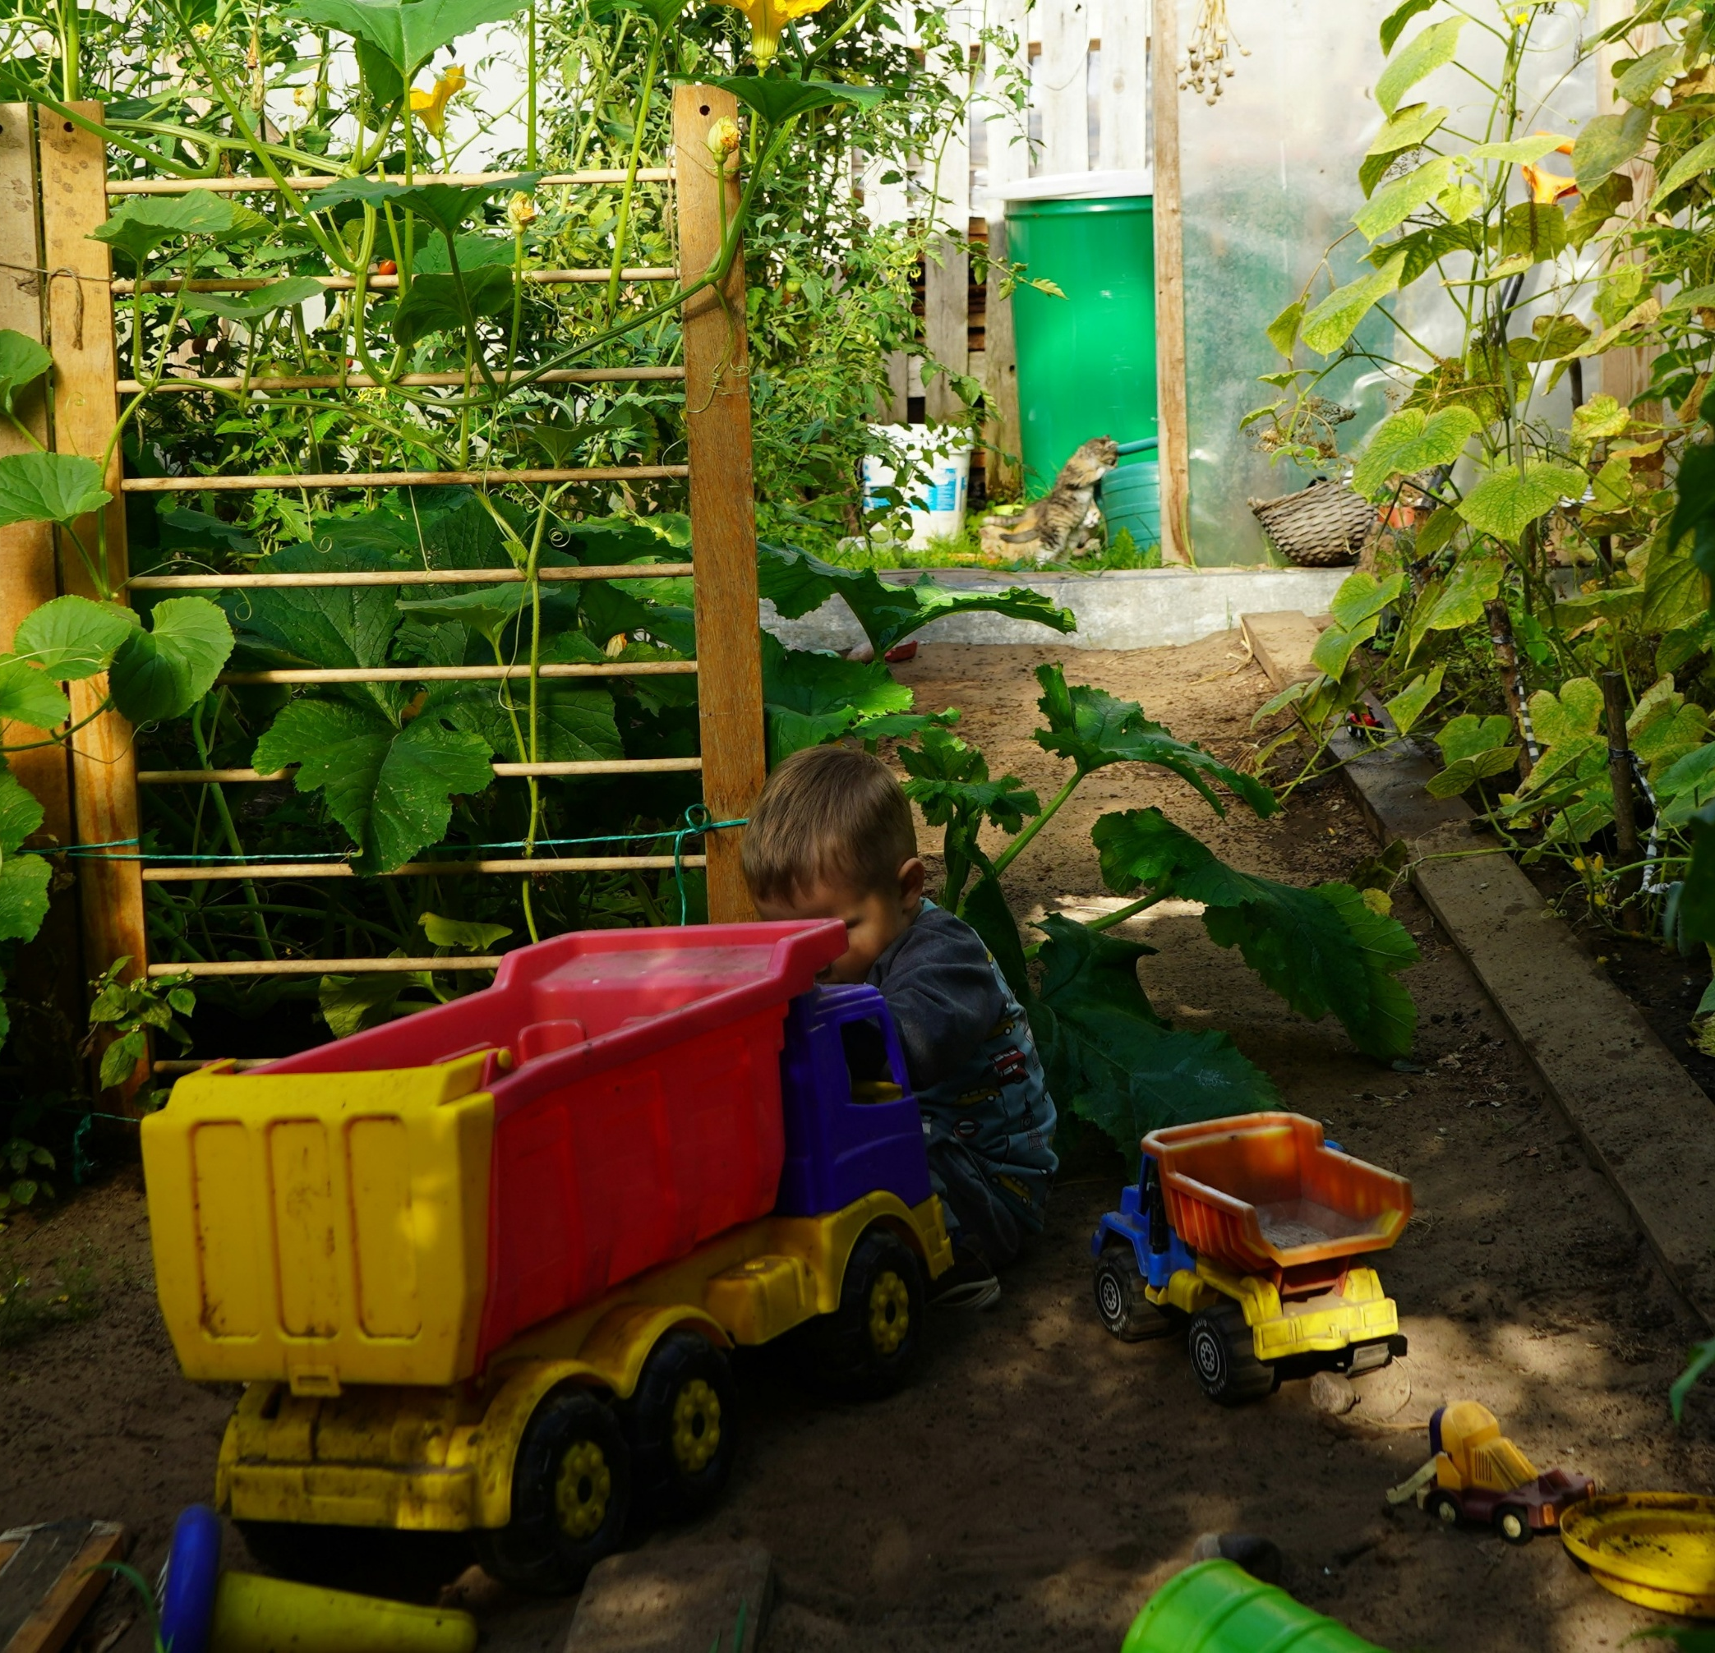
THEME: SUSTAINABLE AND LOCAL FOOD SYSTEMS
Examples of inspiring actions
Start a small vegetable school garden.
Reduce canteen food waste via a no‑waste campaign.
Organise a vegetarian or vegan weekly day at the school canteen.
Notes:
Describe how schools use gardens to teach science (soil, plants, ecosystems), nutrition (fresh‑grown produce) and sustainability (local, seasonal food). You can highlight an example, such as the ''GO! Atheneum Unesco Koekelberg" (page 15 of the Case studies on learning environments for sustainability - Publications Office of the EU): students in the Eco‑Team planted a vegetable garden, rain barrels, hedges and developed biodiversity around the campus, showing how food‑and‑garden systems link to environment. Emphasise how local partnerships (e.g. farmers, community gardens) can enrich the project and connect to climate action.

Slide 17
IMPACT
Encourages healthy eating and awareness of
food’s climate impact.
Builds hands‑on, cross‑curricular learning
(science, nutrition, environment).

Slide 18

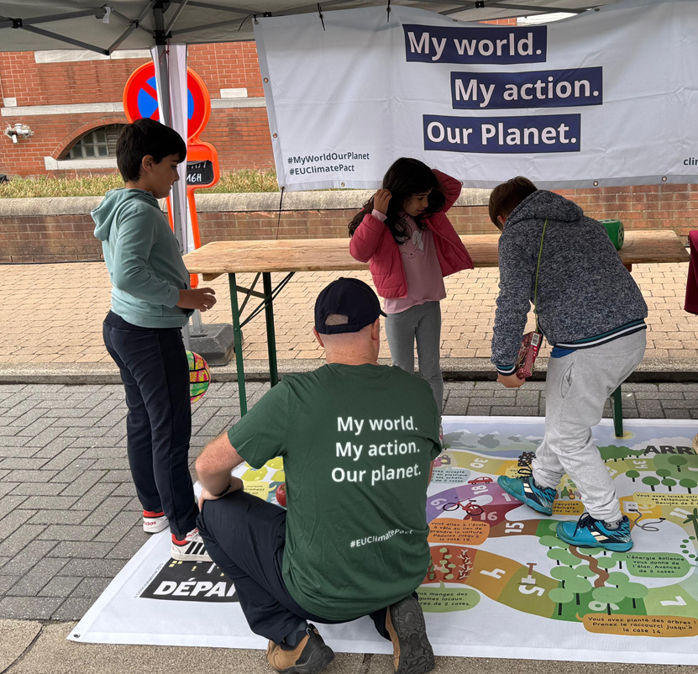

success factors
Student ownership and leadership
Learning by doing
Connection to local context and challenges
Parental and community engagement
What else?
Notes:
Conclude by summarizing what makes these actions effective and sustainable. Encourage educators to see these as inspiration to adapt within their own schools, supported by the Climate Pact community. Encourage teachers and educators to share their own ideas and reflections on what other success factors should be taken into account.

Slide 19
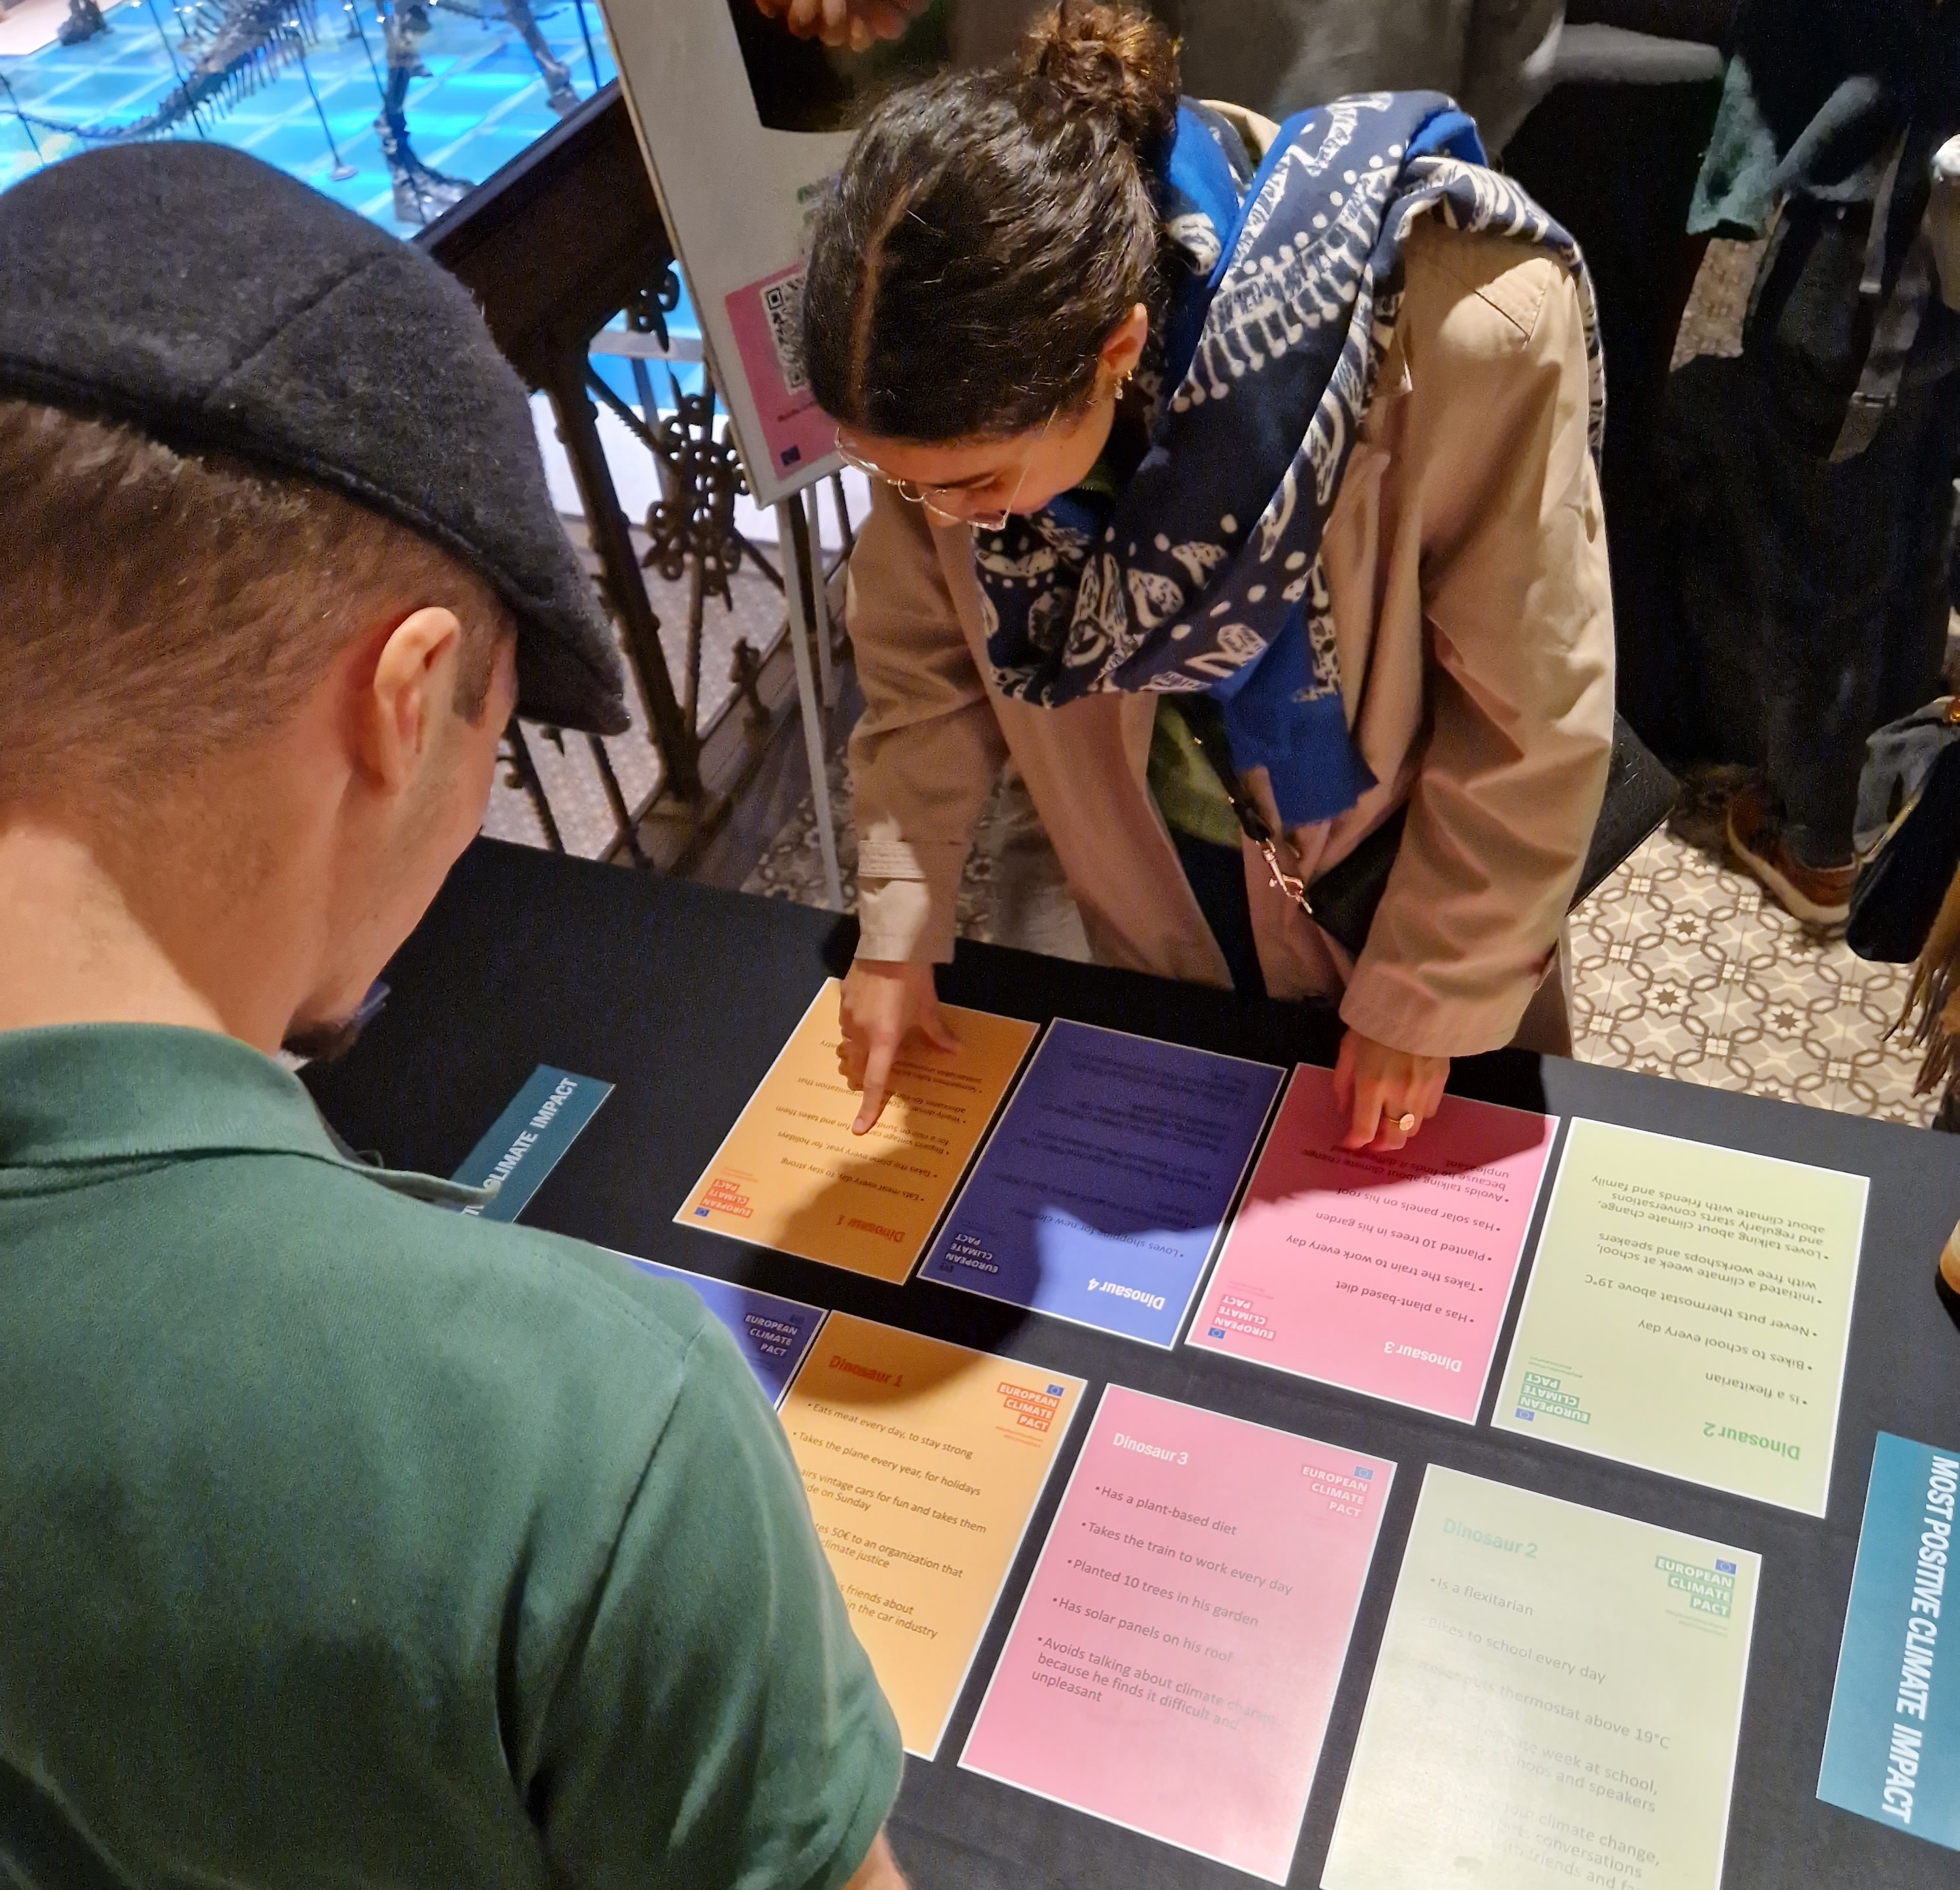
Join the Pact2School campaign
and the Pact2School challenge
Notes:
Conclude by encouraging teachers and other education community members to join the Pact2School campaign. The campaign aims to support children, youths, teachers and the rest of the education community to explore green action and sustainability topics, it also aims to develop meaningful partnerships between the Climate Pact community and schools and universities.
The campaign aims to inspire students and teachers by organising awareness raising sessions on the sustainability and climate action topics as well as to support schools to participate in the Pact2School challenge by submitting impactful student-led project ideas and get up to 1000 euros in project funding.
Webpage link: Join our new Pact2School campaign - European Union

Slide 20

Thank you for
Helping our planet!

Slide 21
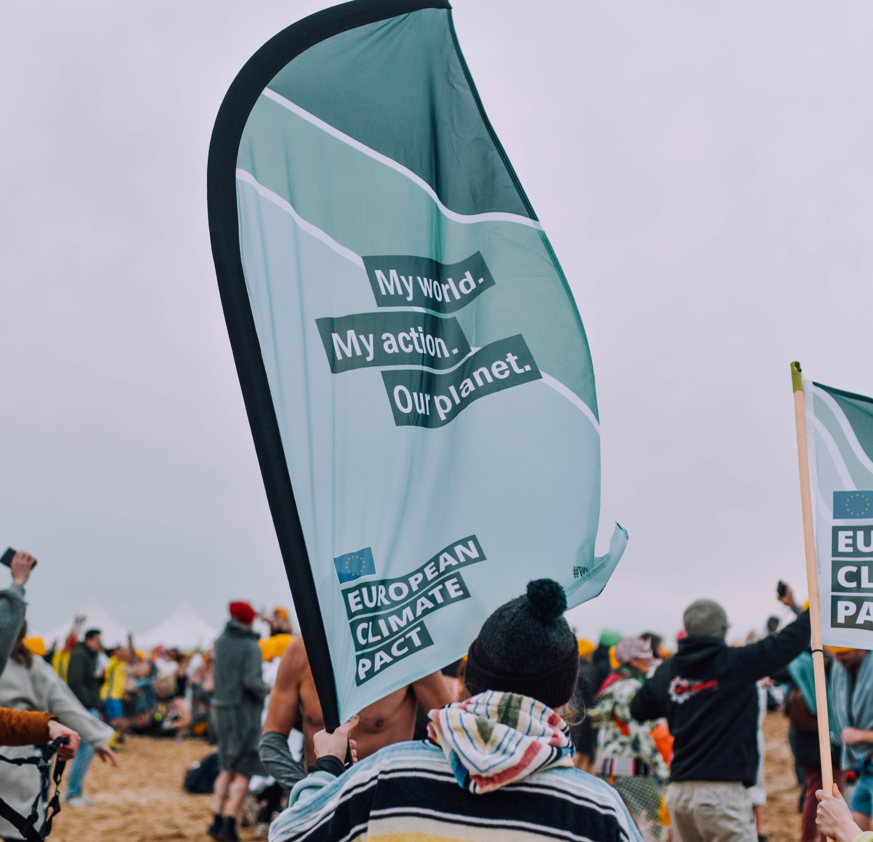
Examples of inspiring actions
XX
XX
Notes:
Feel free to add other examples of inspiring actions that you might know.

Slide 22
Notes:
If you would like you could use this slide to introduce yourself and you can integrate it as part of the presentation

