Slide 1

Together for
Our Planet
Notes:
Warm welcome: Greet the group and thank them for being part of the session.
Introduce yourself: Share your name, your role and briefly why you personally care about climate action or working with young people.
Set the tone: Explain that this session is about exploring what we can do together as individuals, schools, communities and part of a broader European Union initiative.
Introduce the Climate Pact: Mention that the European Climate Pact brings people and organisations across Europe together to learn, take action and support each other in taking climate action.
Highlight inclusiveness: Emphasise that everyone has a part to play, no matter their age or background and that today’s session is meant to be inspiring and interactive and that their reflections and inputs are welcome any time.
Preview the session: Give a quick sense of what’s coming: understanding climate challenges, sharing ideas and discovering fun activities and ways to get involved.

Slide 2
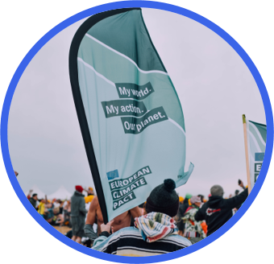
Your Name and SUrNAME
What I care about and why I am here today
My main climate topic(s):
Why the matters to me:
My activities or projects
A short description of any activities or projects that you are engaged with that might be interesting and inspiring for the students
Notes:
If you would like you could use this slide to introduce yourself and what you care about, as well as the activities or projects that you are engaged with. If you would like you could also add a picture of yourself by replacing the photo in the ''circle frame".

Slide 3

Our planet is changing -
but we can help!
Notes:
Begin by engaging students with a few short questions to activate their knowledge:
“What do you think are the main causes of climate change?”
“Have you noticed any climate-related changes where you live?”
“What climate issues worry you the most?”
Use their answers to connect to a brief explanation: climate change happens because greenhouse gases, mainly CO₂ from burning fossil fuels, agriculture and deforestation, are trapping more heat in the atmosphere. This leads to rising temperatures, extreme weather, loss of biodiversity and disruptions to ecosystems and communities.
Acknowledge that most students may already be familiar with these concepts, so the goal is not just to define climate change but to understand its impacts and what actions are possible. End on a hopeful note: the scale of the challenge is big, but collective action, from individuals, communities, and institutions, can make a real difference.

Slide 4
Climate change affects
everything we love.
Notes:
Mention relatable examples: hotter summers, less rain, rubbish in parks, etc. Ask: “Have you ever seen changes like this in your town or school?” Encourage students to share.
If you are speaking with older students (for example, high school or university level), you can introduce a broader discussion about climate action at the societal level. Encourage reflection by asking questions such as:
Where do planet-warming emissions come from?
Where and how have we managed to reduce them so far?
Why is it difficult to cut emissions quickly?
What do we know about future climate changes, and how can we prepare for them?
Who is already taking action, and who still needs to act?
Use these questions to spark a conversation about the wider challenges we face and explore how they can be addressed more systemically through the combined efforts of governments, businesses, universities and schools, NGOs, community organisations, and citizens. This helps students understand that climate action requires multiple societal actors working together, not just individual lifestyle changes. You could also use and share data, resources and studies that clearly show the causes and impact of climate change to further motivate students and gather their attention.

Slide 5
Climate action =
taking care of our home.
Notes:
Define climate action in simple words: anything that helps protect nature, reduce emissions and make our communities and planet healthier. It happens at many levels: families, schools, cities, companies, governments, and communities.
Share relatable examples: school recycling projects, planting community trees, cycling streets, local clean-up events.
Ask students questions to engage them:
“What climate actions have you seen in your school or community?”
“Who do you think is taking action in your town, city, or country?”
“What could we do together to make a bigger impact?”
“Why is it important to work together rather than alone?”
Emphasize that while individual choices matter, real change comes from collective efforts and collaboration among multiple societal actors. You can mention that progress on cutting CO2 emissions is already happening, and the European Union has cut its CO2 emissions by 37%.

Slide 6
People all over Europe are
taking action – together!
Notes:
Explain that the European Climate Pact is an initiative of the European Union encouraging people and communities to contribute to a sustainable future. Ambassadors and partners are part of this movement. Explain your experience being part of this community.

Slide 7
My World. My Action.
Our Planet.
Notes:
Start introducing the Climate Pact and link to your experience as part of it

Slide 8
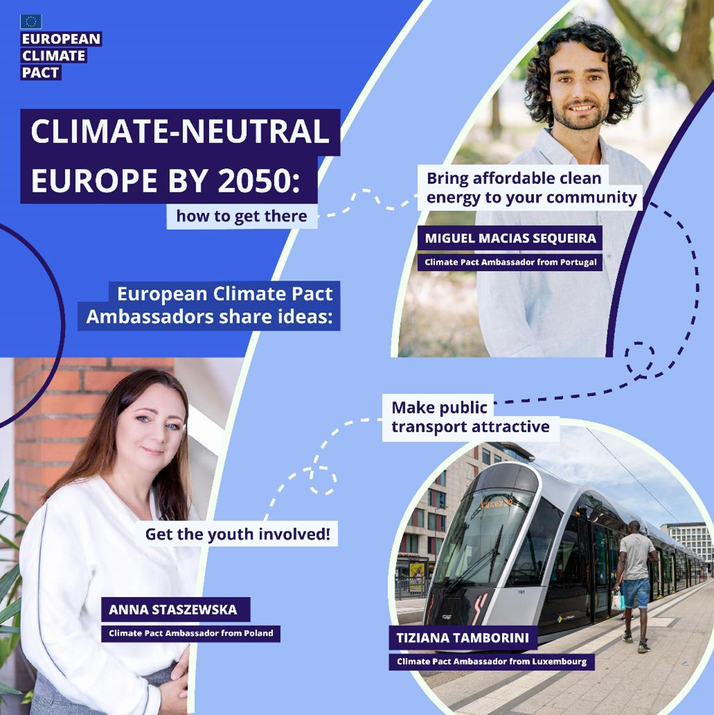
EUROPEAN CLIMATE PACT
Main objectives:
Raise awareness of climate issues and EU action
Encourage climate action and catalyse engagement
Connect citizens and organisations that act on climate and help them to learn from each other
“My World. My Action. Our Planet.”
Notes:
Share that the Climate Pact has three main objectives:
Raise awareness – understand climate change and its impacts.
Encourage action – inspire individuals, schools, and communities to take practical steps.
Connect citizens – share ideas and support each other across Europe.
Emphasize that collective action matters most, even though everyone can contribute individually.
Ask students: “Which objective do you find most important?” or “How could your community get involved?”
Share the key message: Learning, collaborating, and taking action together helps protect our planet.

Slide 9
Ambassadors, Partners,
Friends of the Pact
Notes:
Describe the roles in the Pact Community:
Ambassadors: Inspire and guide communities, host events, and promote climate action.
Partners: Organisations that implement projects, share best practices, and collaborate across networks.
Friends: Individuals or groups who support the Pact, stay informed, and participate flexibly.
You can engage students by asking questions like: “If you were part of the Climate Pact, which role would you choose and why?”; “Can you think of a school or community that could join as a Partner or Friend?”
If they are interested in becoming Friends of the Pact, here is the link EUSurvey - Survey
You can also share that if they would like to explore the Climate Pact more they can check the Interactive Pact Map: Discover climate action near you to explore the Ambassadors, Partners and different initiatives organised as part of the Climate Pact.
You can also introduce the students to the EU Climate Action Academy where they can explore multiple resources related to climate action and they can take free self-led online courses: EU Climate Action Academy
You could also share the following link to subscribe to the Climate Pact newsletter: CLIMA - Newsroom Subscription Form

Slide 10
Energy, transport, nature,
food, waste, water, communities
Notes:
Introduce the slide by explaining that climate action happens in different areas of our daily lives and society.
Explain each area briefly:
Energy: Using clean energy, improving efficiency, and supporting renewable sources.
Transport: Walking, cycling, using public transport, and reducing emissions from vehicles.
Nature: Protecting forests, planting trees, restoring habitats, and caring for biodiversity.
Food: Reducing food waste, eating seasonal/local products, and supporting sustainable farming.
Waste: Reusing, recycling, and reducing single-use plastics.
Water: Conserving water, protecting rivers, lakes, and other water sources.
Communities: Working together on local projects, awareness campaigns, or school sustainability initiatives.
Engage students by asking engaging questions such as:
“Which of these areas have you seen action in your school or community?”
“Can you think of new ideas for projects or actions we could take together?”
Highlight that collective effort amplifies impact: it’s not just about individual choices but about working together as a community.
Share the following key message: Climate action happens everywhere, in many areas of life, and everyone can contribute to creating a healthier, more sustainable planet.

Slide 11
Local and European
activities for change
Notes:
Explain that young people across Europe are leading concrete climate actions in schools and communities.
Share examples of youth-led climate action, such as: climate walks, workshops to design solutions, peer parliaments to discuss actions, photo story workshops, tree planting, clean-ups, cycling events, and energy-saving initiatives.
Ask questions to engage students, such as: “Which of these climate actions could you try at your school?”; “Which activity would you like to try at your school?”

Slide 12
Practical activities
for climate action
Notes:
Suggest simple and engaging activities for climate action that students and schools can implement, such as a climate walk, creating a photo story, forming a student action group or running a peer parliament. Another option is to divide students into smaller groups and invite them to develop their own ideas in a mini-hackathon format. Each group can brainstorm a concrete climate action or engagement project and then briefly present their idea to the class. This approach helps generate multiple ideas quickly and encourages creativity and collaboration. With older or university-level students, you might also build on existing structures, such as student associations, sustainability clubs, innovation labs, or civic engagement programs, which can support and scale the ideas developed during the session. Finally, invite the group to plan one simple activity together, choosing something feasible and exciting that they can start right away.

Slide 13
Thank you
For helping our planet!

Slide 14
Notes:
You could use the following slides templates in case you would like to add any content to the presentation adapting to the school context and students' needs and interests

