Slide 1
DEEP DIVE
ABC OF EU CLIMATE POLICY:
INSIDE POLICYMAKING
Thursday 12 March 2026
12:15 – 13:00 CET

Slide 2




Introduction of the speaker
Alexandre Mabille
Belgian EU Climate Pact Ambassador, Working with En‑ROADS and Climate Interactive to link climate science, education, and action. Focused on empowering students and communities through STEAM, systems thinking, and real-world collaboration.
CLIMATE INTERACTIVE
Nonprofit organisation that creates science-based, easy-to-use simulation tools that make complex climate dynamics understandable and actionable.

Slide 3
En-roads simulator
test climate and energy policy choices in real time
Alexandre Mabille
EU CLIMATE PACT AMBASSADOR

Slide 4
The climate policy paradox
Climate change is mainly a challenge of transforming the entire energy-economy system.
Despite decades of negotiations and technological progress,
Global emissions remain near records high
The energy system is deeply interconnected
Single policies rarely produce systemic change

Slide 5
Why systems thinking matters
Climate outcomes emerge from interacting systems
Energy ; Economy; Technology ; Land use and Behaviour
Golden rules: climate policy is a system problem
Interdependence: Energy, industry, transport and land systems are deeply interconnected.
Feedback and delays: Changes in the energy system unfold over decades (infrastucture, investments and technology adoption create time delays.
Non-linear effects: policy impacts are rarely proportional. Small interventions may have limited impact, while coordinated policies can produce systemic change.
-> Understanding the interactions between policies, technologies and markets is precisely where simulation tools like En-ROADS become valuable.

Slide 6
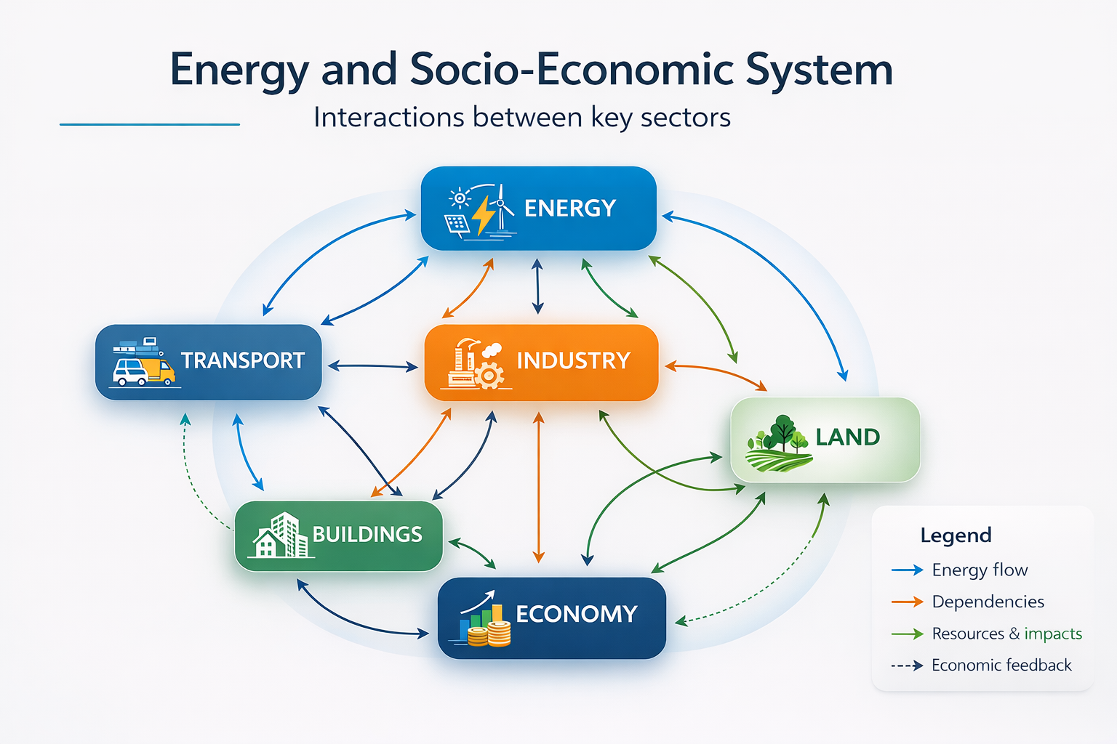

Slide 7
What is en-roads
The En-ROADS Climate Simulator is a system dynamics model developed by Climate Interative with the MIT Sloan School of Management
It allows users to explore:
Interactions between climate policies
Long-term energy transitions
System-level impacts of policy portfolios
How these principles translate into real policy outcomes.

Slide 8
Climate policy as a system
6 core concepts
Climate governance requires coordinated policy portfolios
Systems Thinking: climate outcomes emerge from the interaction of energy, economic and
technological systems.
Policy Coherence: effective climate action requires aligned portfolios across sectors.
System Interdependence: changes in one sector influences the entire energy-economy system.
Path Dependency: infrastructure, investment cycles and technology lock-in shape the pace of transition.
Policy Trade-offs: climate strategies require balancing environmental, economic and social considerations.
Strategic foresight: enhance public policy through anticipatory governance, enabling governments to better prepare for future challenges and opportunities

Slide 9
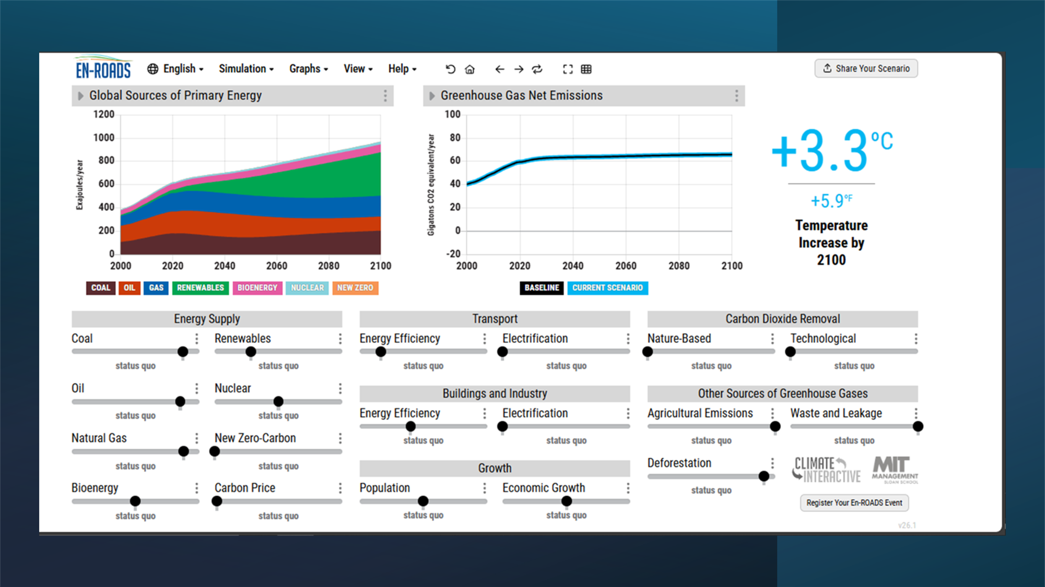
Baseline scenario
Current policies are not yet aligned with the Paris goal
Emissions trajectory
Temperature outcome

Slide 10
The En-Roads policy dashboard
A few levers
Energy supply
Transport
Buildings
Carbon pricing
Land use
Methane

Slide 11
Policy priority
Which policy should we strengthen first in the simulation?
Carbon pricing
Renewable energy
Energy efficiency
Electrification
Methane reduction
Which policy should we strengthen next in the simulation?

Slide 12
A few lessons from en-roads
Climate policy requires policy portfolios
System impacts differ from political attractiveness
High-leverage interventions matter
Climate governance is a coordination challenge

Slide 13
Reflection
What surprised you most in the simulation?
Methane
Limited impact of single policies
System inertia

Slide 14
Strategic takeaway
What is the most important insight for climate policy design?

Slide 15
Even with ambitious portfolios,
reaching 1.5°C remains extremely difficult
Because systems contain inertia and transitions take time
Capital stock turnover
Industrial lock-in
Political constraints
Infrastructure lifespan
Question for the Pact:
How should EU policy account for system inertia when designing long-term targets?

Slide 16
The limits
3 common critiques
It is a implified model: its value lies in revealing system interactions
It ignores political feasability: the model assesses physical and systemic consequences. Feasibility remains a governance decision.
It cannot moel adaptation: adaptation does not change the global temperature trajectory. But it reduces exposure and vulnerability.

Slide 17
Conclusion
Climate policy is not only solved by identifying technologies but also by designing coordinated policy systems
Technology matters
Economics matters
But policy alignment across sectors matters even more.
Climate change is fundamentally a systems challenge.
And systems require integrated governance, strategic foresight, continuous learning and coordinated policy portfolios.

Slide 18
FINAL REMARKS

Slide 19

climate pact activities
Together in Action 2026
📅 24-25 March (Community Day: 23 March)
🌍 Join online from anywhere
📍 Or attend in person in Brussels
Join 1500+ others already registered – places are booking up fast.
Highlights from the agenda
📝 EU policy insights
Hear directly from with Commissioner Wopke Hoekstra and Director-General for Climate Action, Kurt Vandenberghe.
🌱 Local community
Get practical ideas and approaches, from community engagement to flood adaptation.
📈 Business, innovation and industry
Explore future‑focused sessions on aviation, energy, and carbon removals.
Scan the QR code

Slide 20
climate pact activities
📘 Next EUCAA series
Next, in May and June, we invite you to join the following series:
Disinformation and social media.
A series exploring how disinformation shapes public attitudes toward climate action — and how to take action.
👉 Stay tuned!

Slide 21

climate pact activities
⭐ Making an ImPact Campaign
Discover new inspiring stories from the Climate Pact community and celebrate everyday climate action across Europe.
👉 Read the latest stories:
Making an ImPact - your climate stories
Scan the QR code

Slide 22

climate pact activities
Visit the Climate Pact website to:
Build your climate knowledge with the EU Climate Action Academy’s resources
🤝 Connect with Climate Pact Ambassadors, Partners and Country Coordinators
🔦 Get inspired by our Making an ImPact stories
🛠️ Check out our tools for citizen engagement
🗓️ Discover Climate Pact satellite events near you
📰 Subscribe to the newsletter!
Scan the QR code

