Slide 1

Pact2School Activity Guide
Engaging primary school students in
climate action through fun, creative
and collaborative activities
Notes:
Welcome to the Pact2School Activity Guide! This toolkit is designed to support Climate Pact Ambassadors and primary school educators to engage children in fun, creative, and hands-on climate activities. These activities are meant to spark curiosity, creativity, and a sense of responsibility for young learners. Use this guide to inspire action in the classroom or outdoors and connect your school to the wider Climate Pact community.

Slide 2
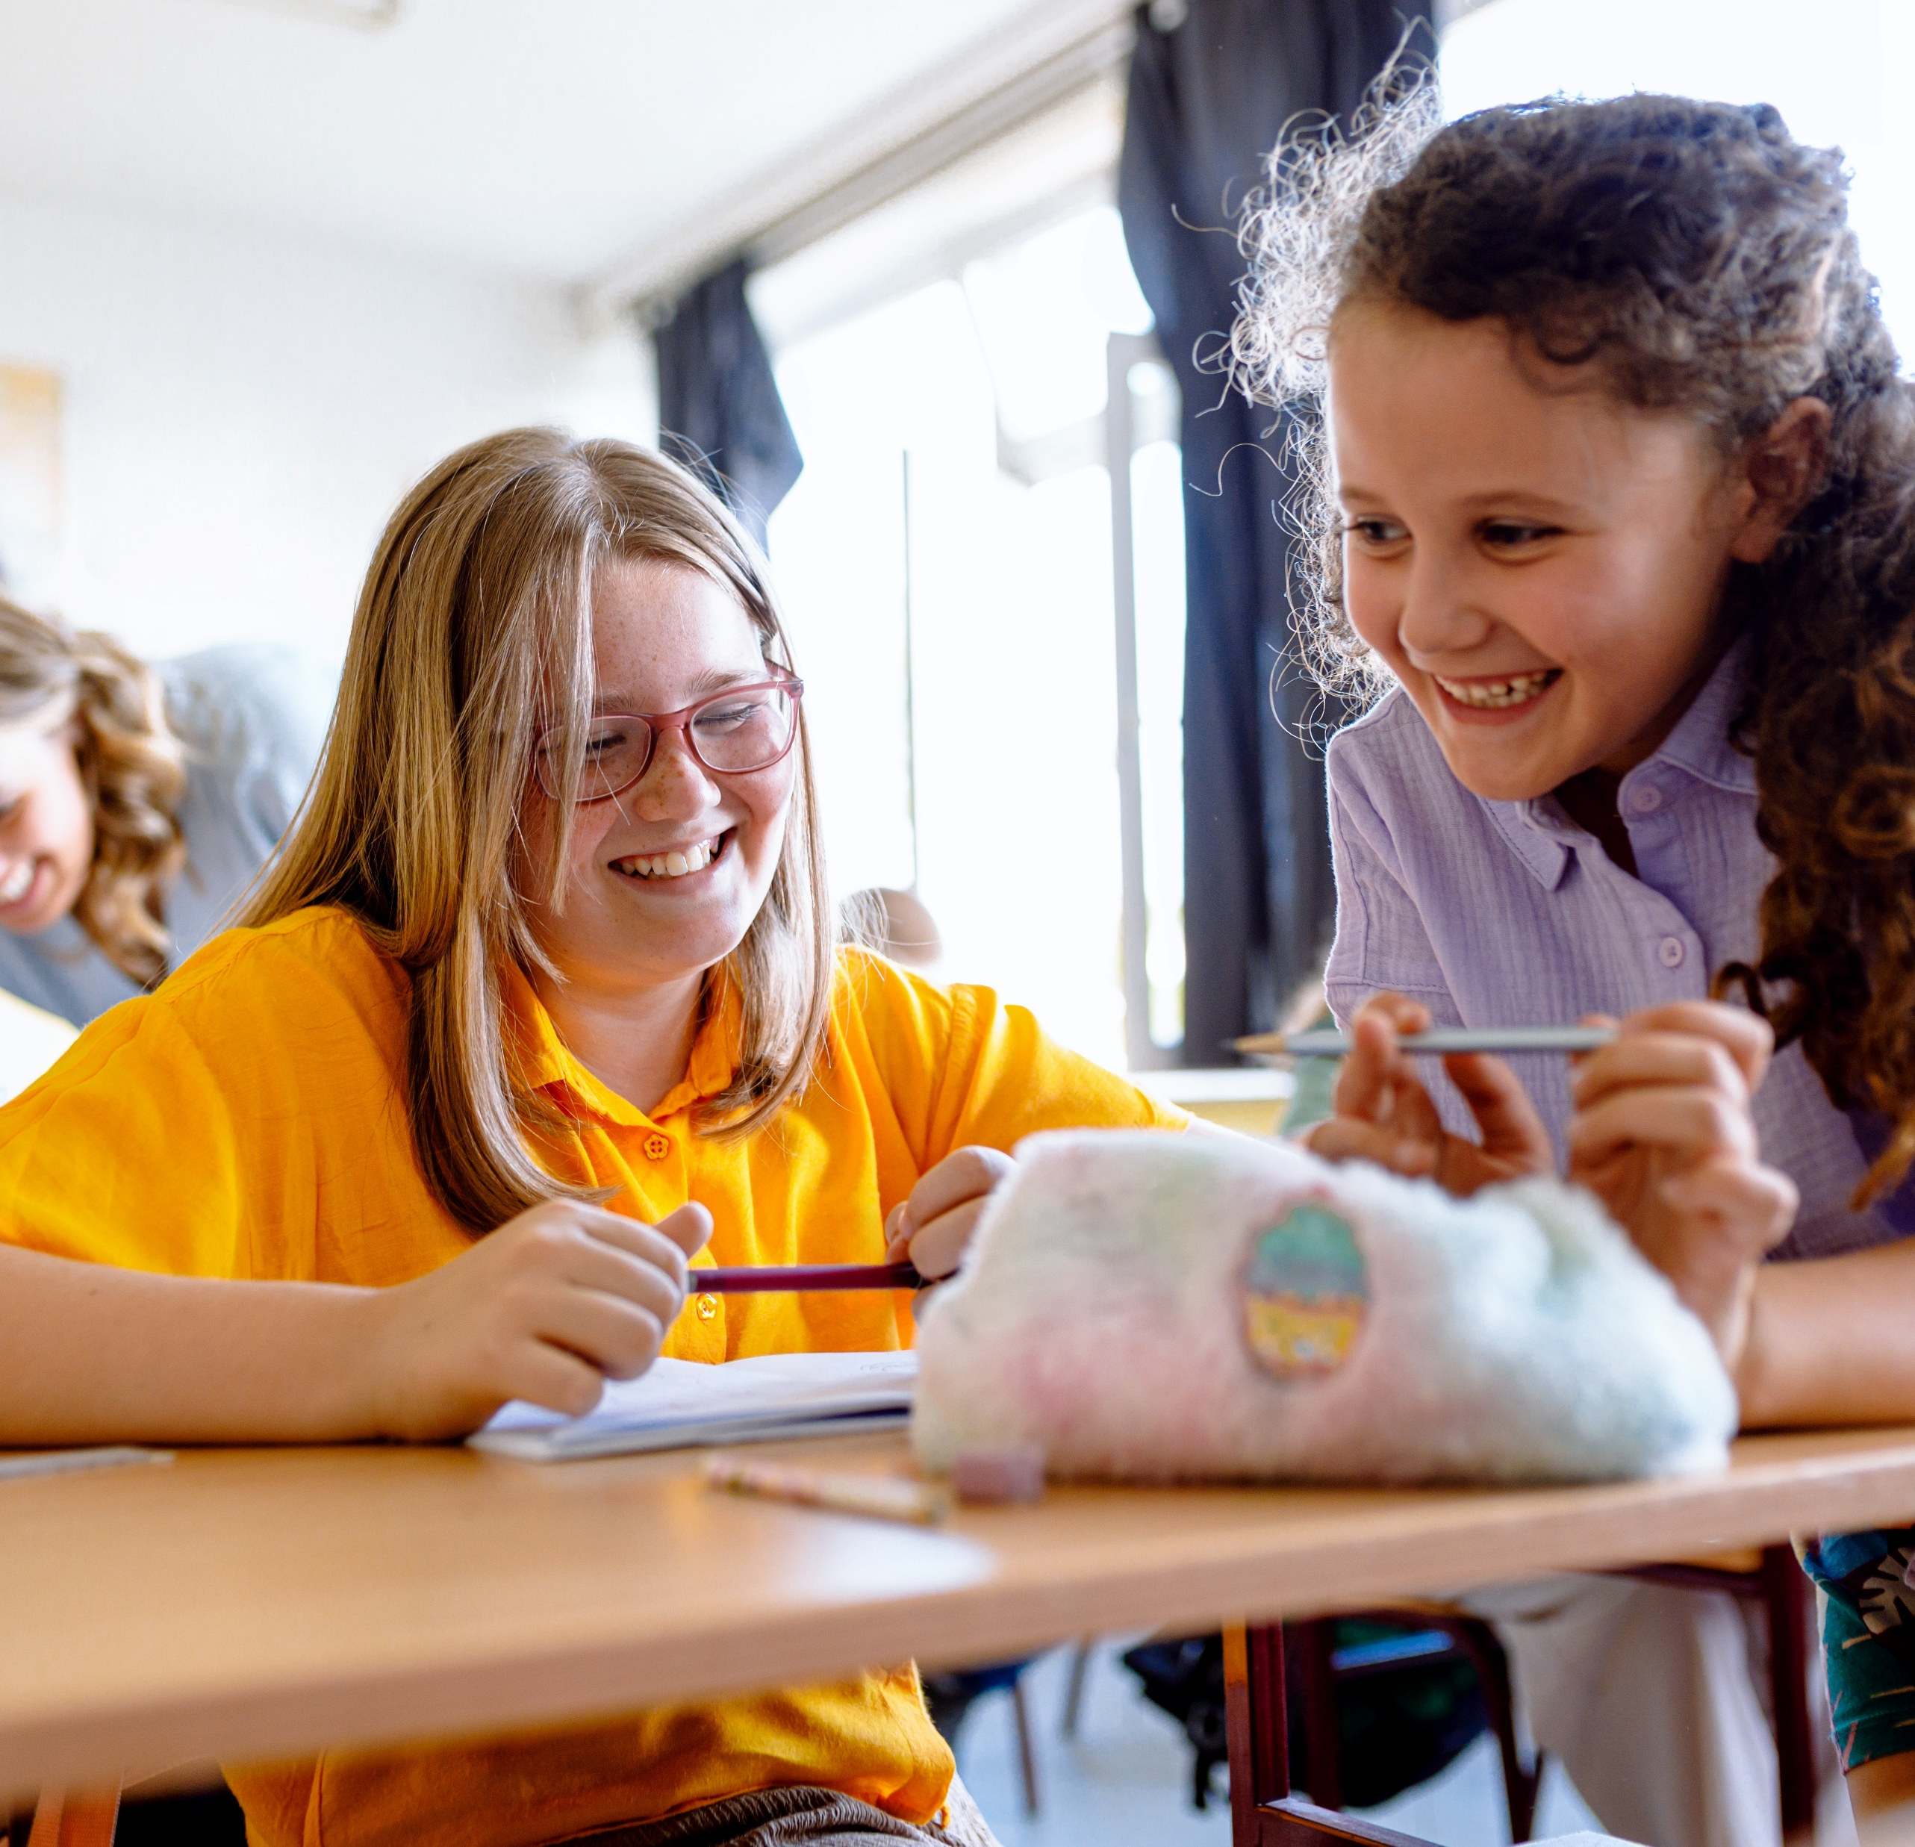
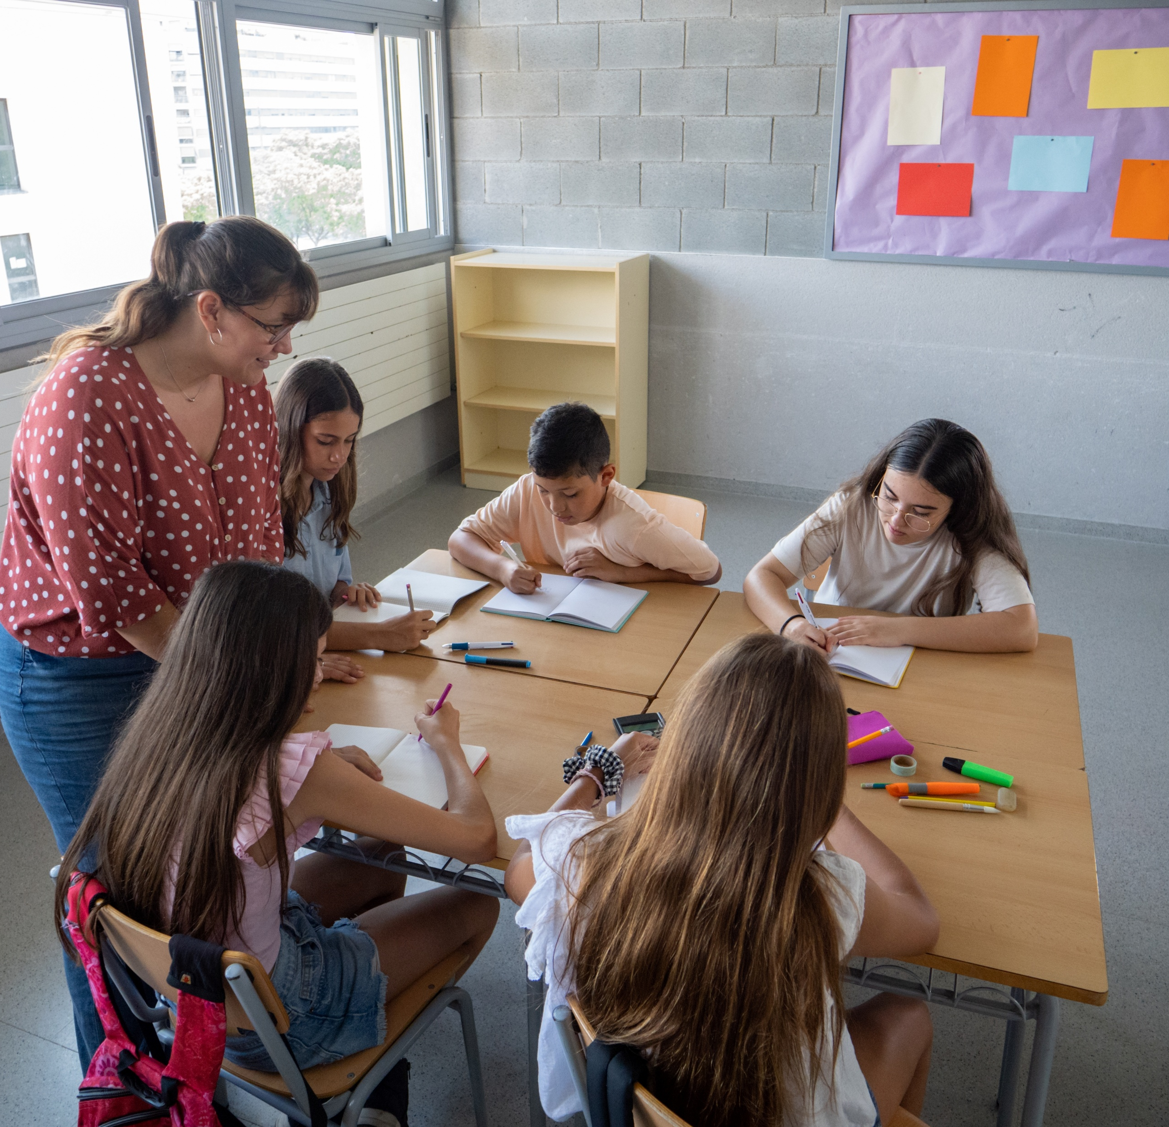
Purpose
Support Ambassadors, teachers and educators of primary school students in leading fun, creative and hands-on activities about climate and sustainability.
Build awareness and responsibility through creative play, dialogue and exploration.
Strengthen school participation in the European Climate Pact community and in overall Climate Action.

Slide 3
The six key climate action themes
for primary schools’ students
Climate awareness
Sustainable mobility
Clean energy
Waste management and circular economy
Biodiversity and Nature-Based Solutions (NBS)
Sustainable and local food systems
Notes:
Introduce the six key themes that structure the activities in this guide. These themes help children explore climate action in a playful and age-appropriate way. You can choose one or more themes depending on your school’s interests or current projects. Each theme connects everyday experiences to broader climate challenges and solutions.

Slide 4
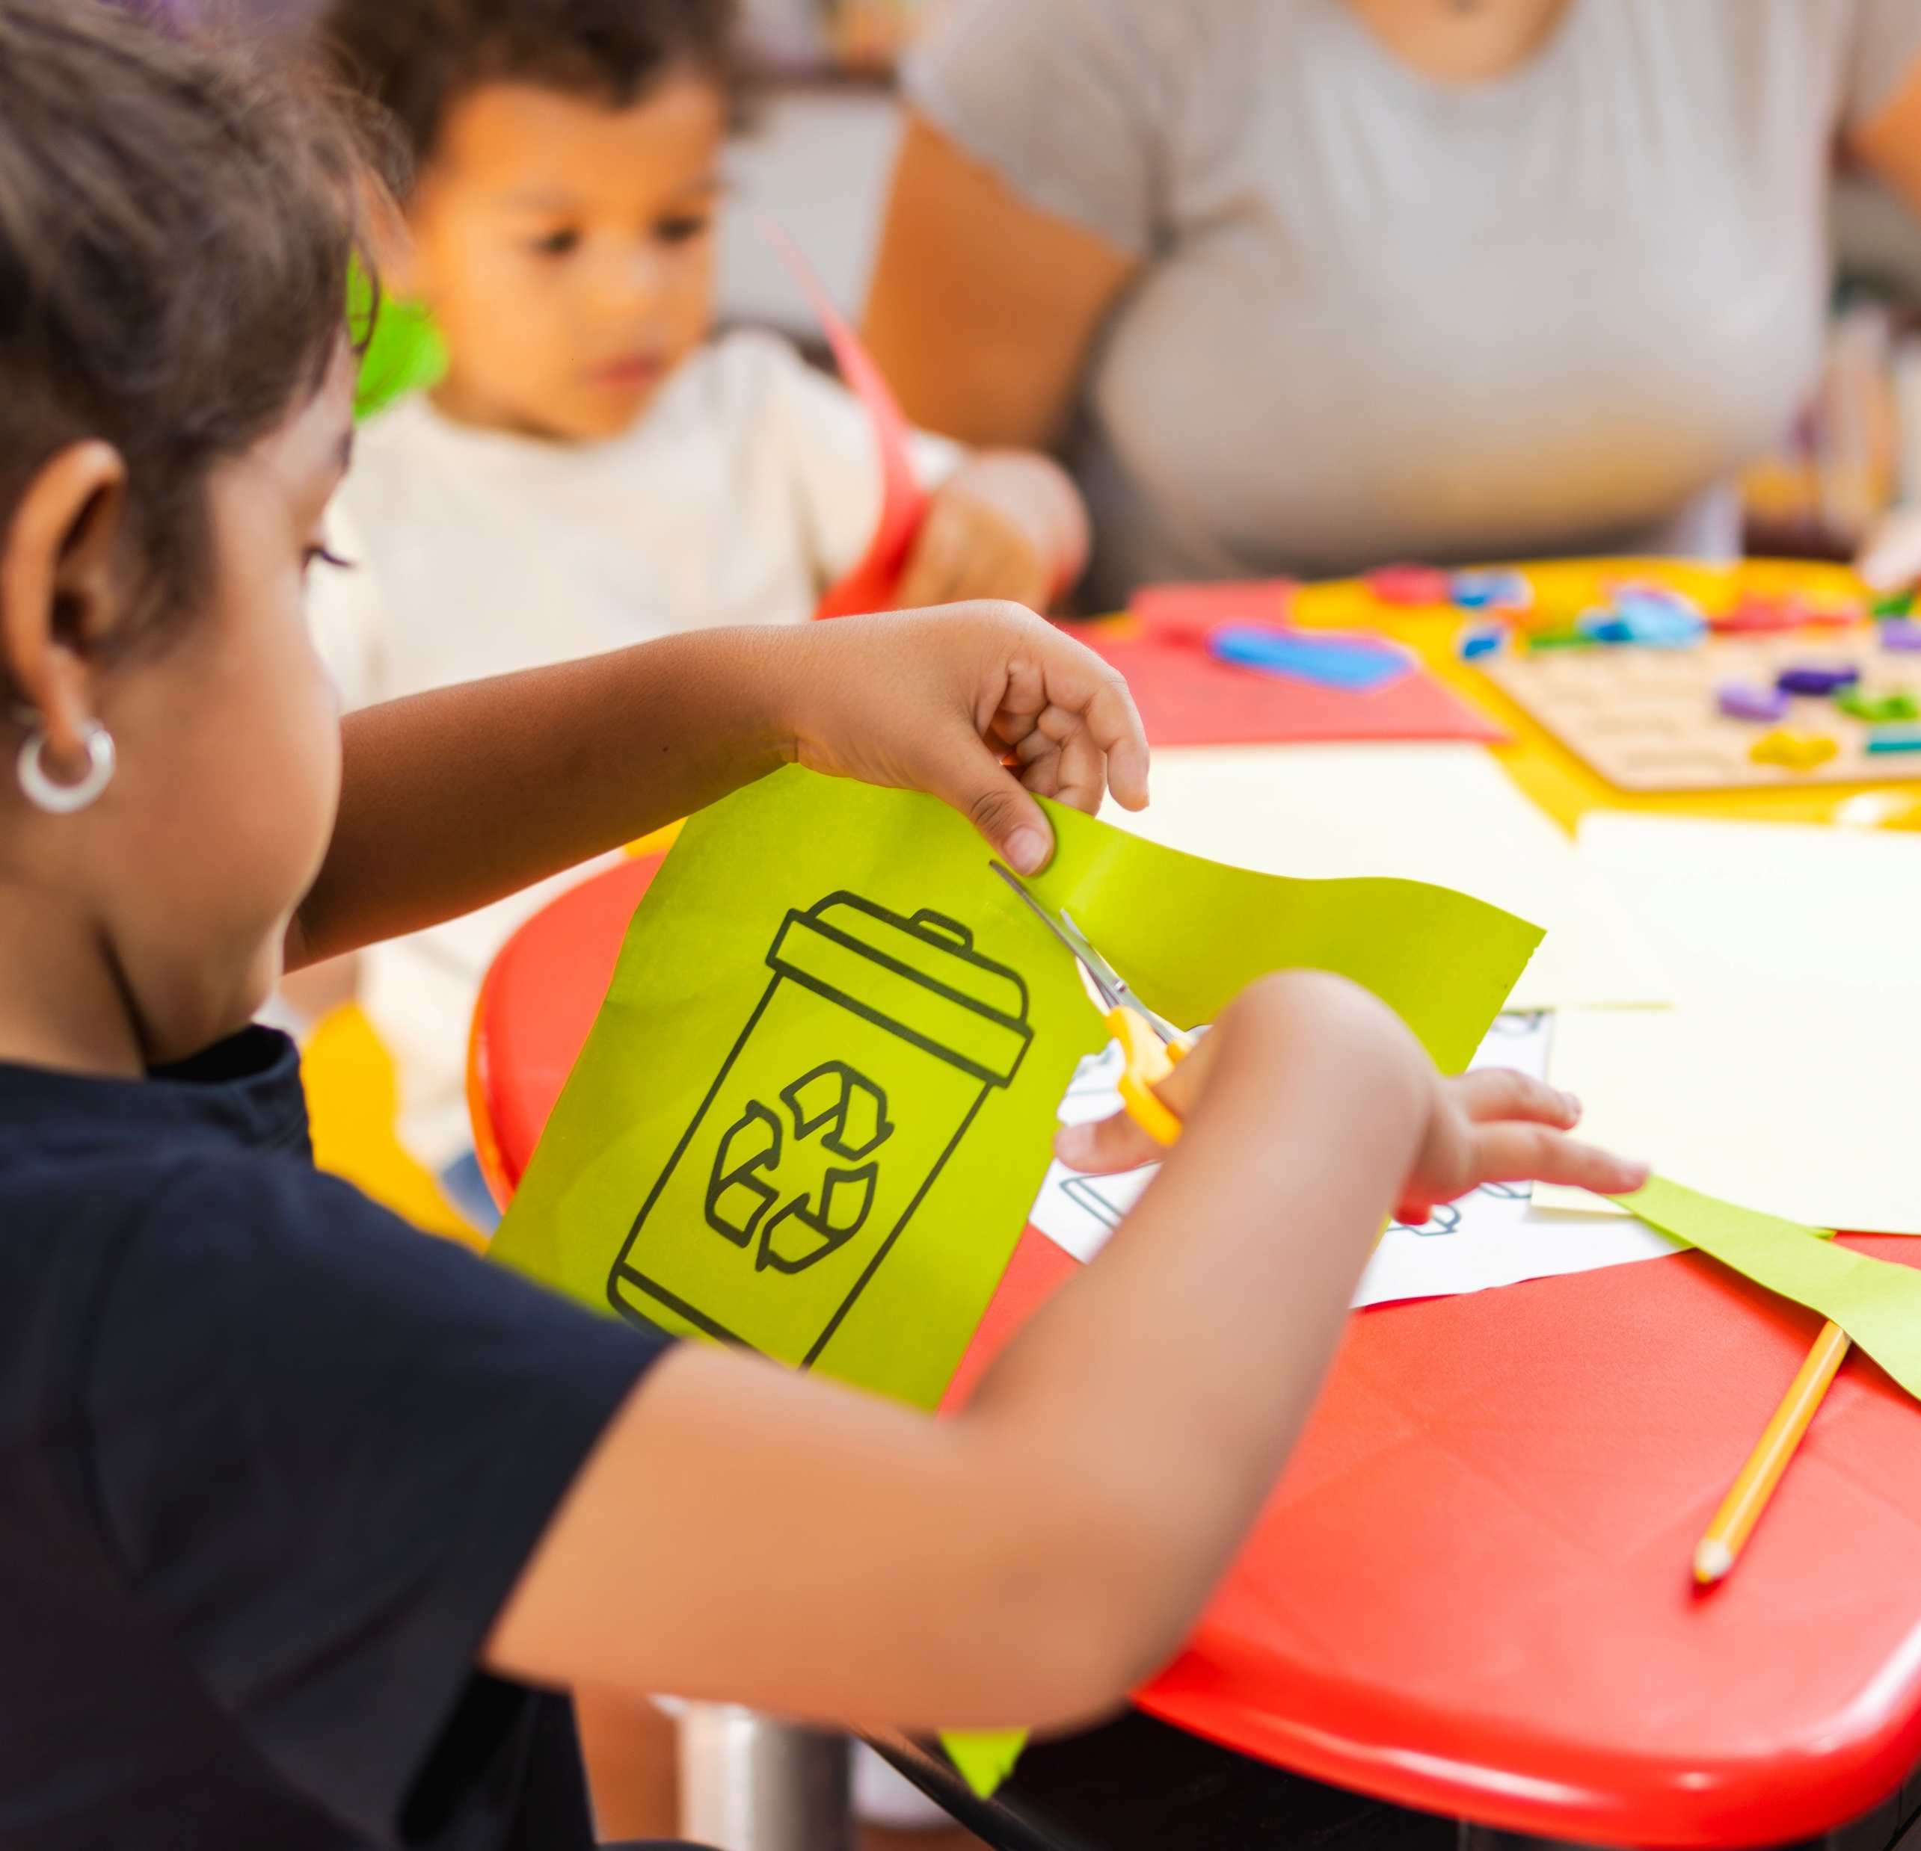
THEME: CLIMATE AWARENESS
Activity: Climate action circle
Duration: 30–45 minutes
Step-by-Step:
Each student receives a card with an image (tree, car, bike, lightbulb, plastic bottle, etc.).
They group similar cards (e.g., “good for the planet” vs. “bad for the planet”).
Discuss why and brainstorm how to make more actions planet-friendly.
Create a classroom poster titled “our climate promises.”
Learning goal: Understanding everyday actions and climate impact.
Notes:
This activity helps children understand the impact of everyday actions on the planet. Use the cards to spark discussion and group work. Encourage students to reflect on their choices and create a visual reminder of their climate promises. The poster can be displayed in the classroom to reinforce their commitment.

Slide 5

THEME: CLIMATE AWARENESS
Activity: Climate superheroes
Duration: 1 hour
Step-by-Step:
Students invent a Climate Superhero
(e.g., captain compost, super healthy food, etc.)
Draw their superhero and describe their powers.
Display drawings around the classroom.
Discuss: “What power can we use every day to
protect the planet?”
Learning goal: Building identity and motivation for action.
Notes:
This 1-hour activity invites students to invent a Climate Superhero to explore how individual actions can help the planet.
Start by giving a few fun examples, then ask students to draw their superhero and describe their powers.
Display the drawings around the classroom and end with a group discussion:
“What power can we use every day to protect the planet?”
The aim is to build students’ sense of identity, agency, and motivation for climate action through creativity.
Related resources:
UNICEF Toolkit for young climate activists: Toolkit for young climate activists | UNICEF

Slide 6
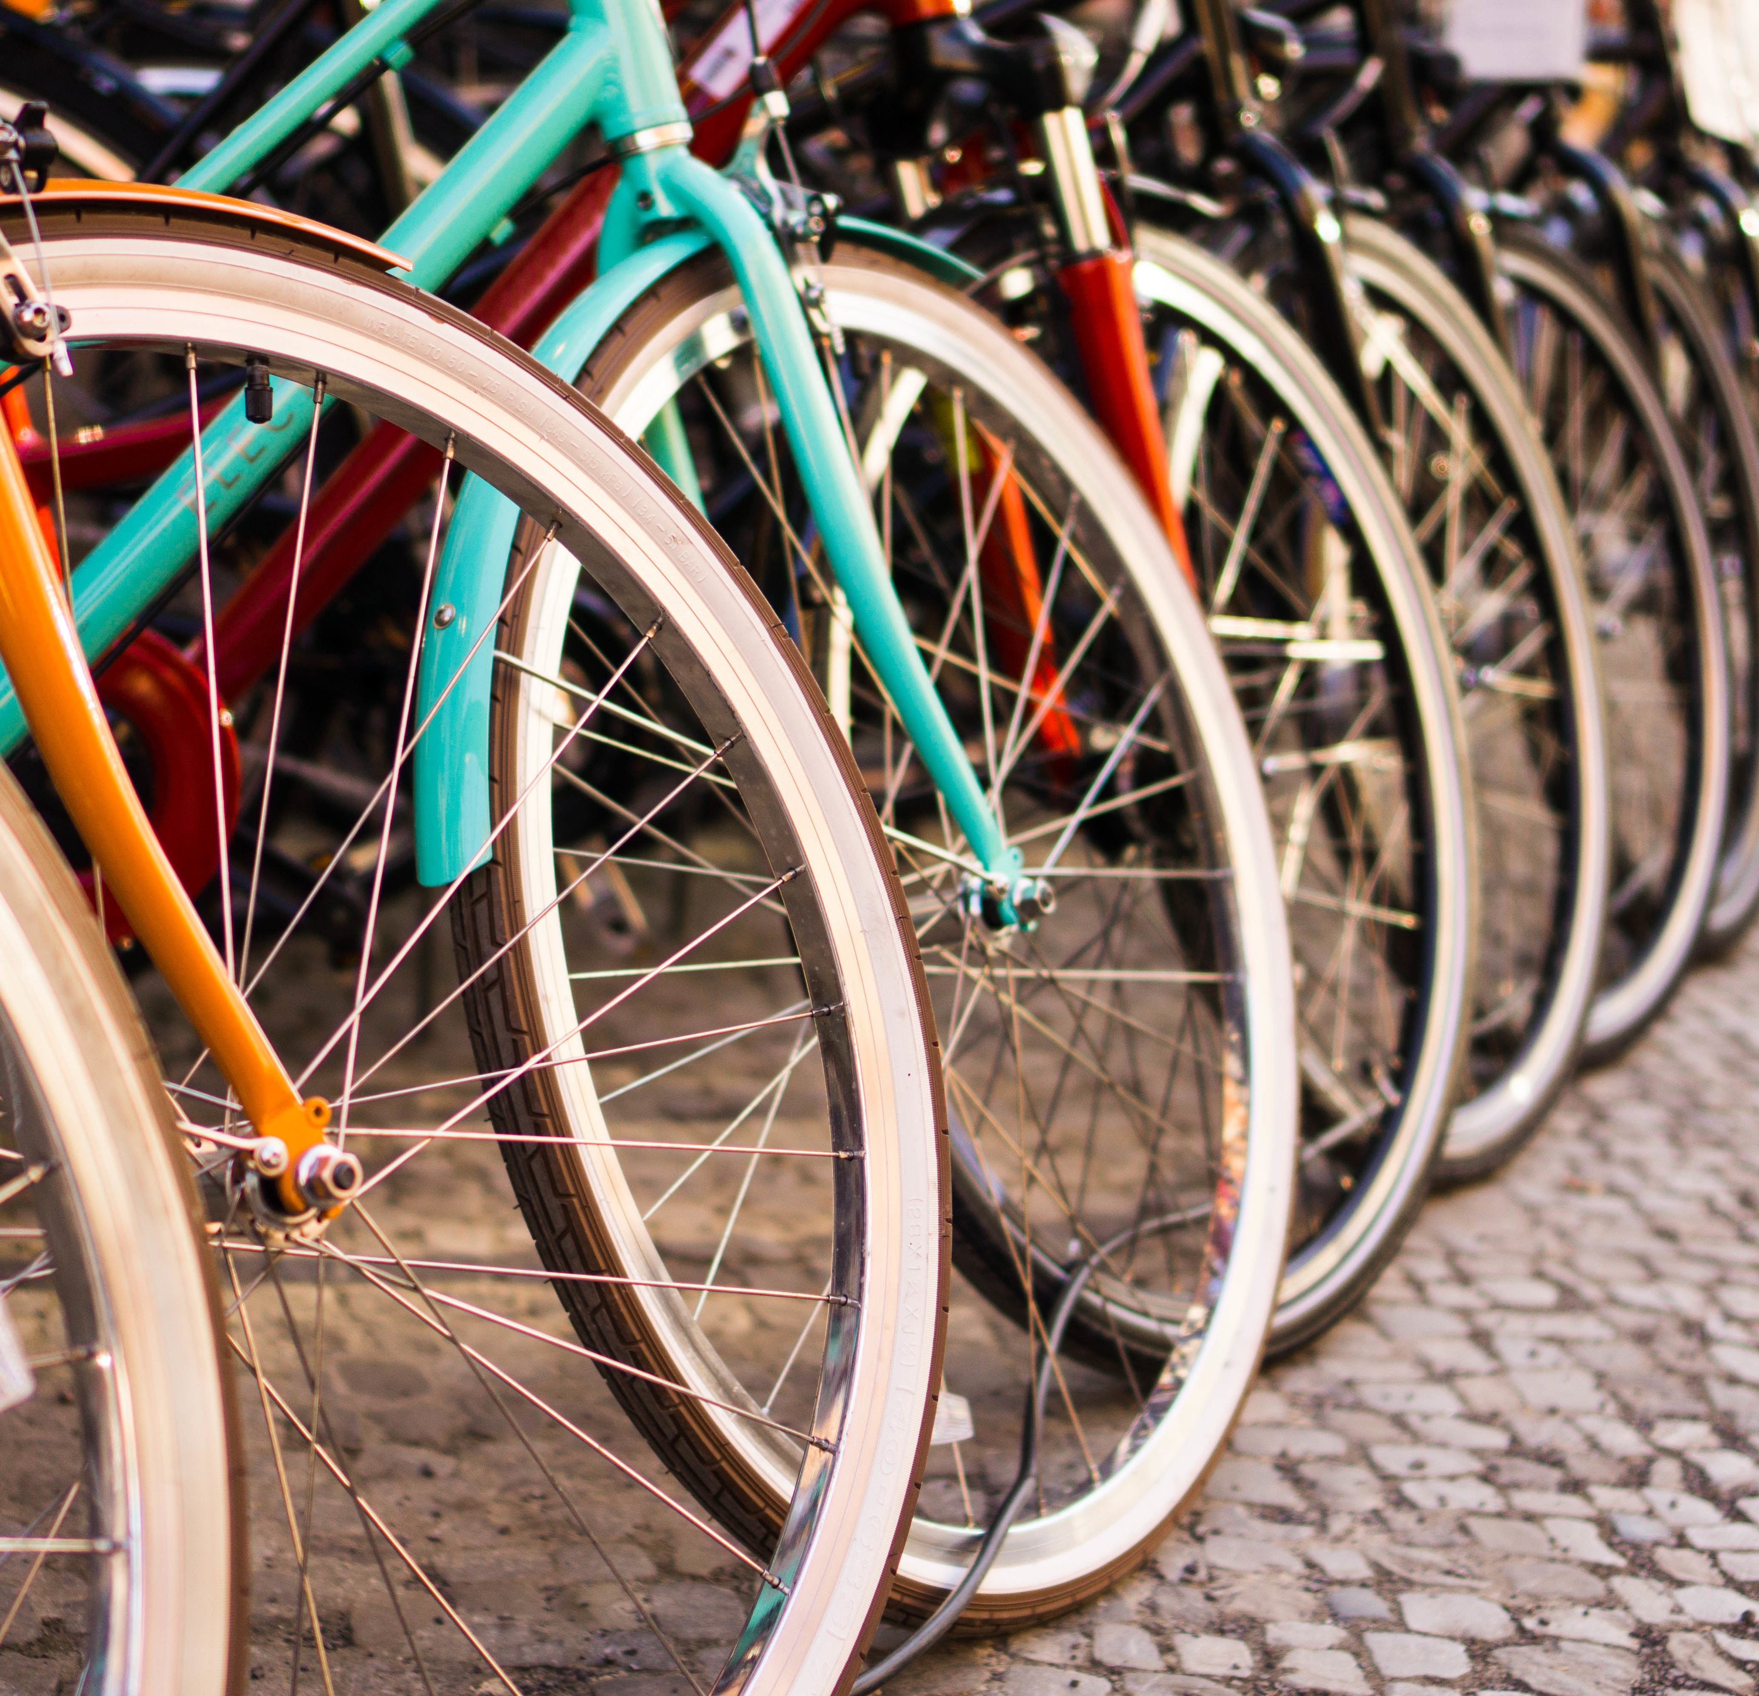
THEME: SUSTAINABLE MOBILITY
Activity: Car-free city
Duration: 1 hour
Step-by-Step:
Begin by raising awareness on more sustainable mobility systems (walking, biking, using public transport, car sharing, etc.)
Ask simple questions such as: “What makes a city safe and clean for walking and cycling?” ''Why walking and cycling are good for the planet?”
Give each group paper, cardboard, markers, and small objects (toy cars, LEGO, etc.).
Ask them to build or draw their own “car-free city”, including: bike lanes, pedestrian streets, safe school routes, green spaces, bus stops
Once finished, each group presents their city and explains how people move around.
End with a class reflection: “Which ideas could we use in our
school or neighbourhood?”
Learning goal: Imagining cities designed for people and understanding how mobility shapes healthier, safer communities.
Notes:
This 1-hour activity helps students imagine a city designed for people instead of cars.
Start by asking: “What makes a city safe and clean for walking and cycling?”
Then divide students into groups and give them materials to draw or build a ‘car-free city’, including bike lanes, pedestrian zones, safe school routes, green areas, and public transport.
Afterward, each group presents how people move around their city.
Finish with a reflection: “Which ideas could we use in our school or neighbourhood?”
The goal is to encourage students to think about people-centred, sustainable urban design. This activity can also be adapted to broader themes, such as green, inclusive, or climate-friendly cities, depending on the learning objectives.

Slide 7
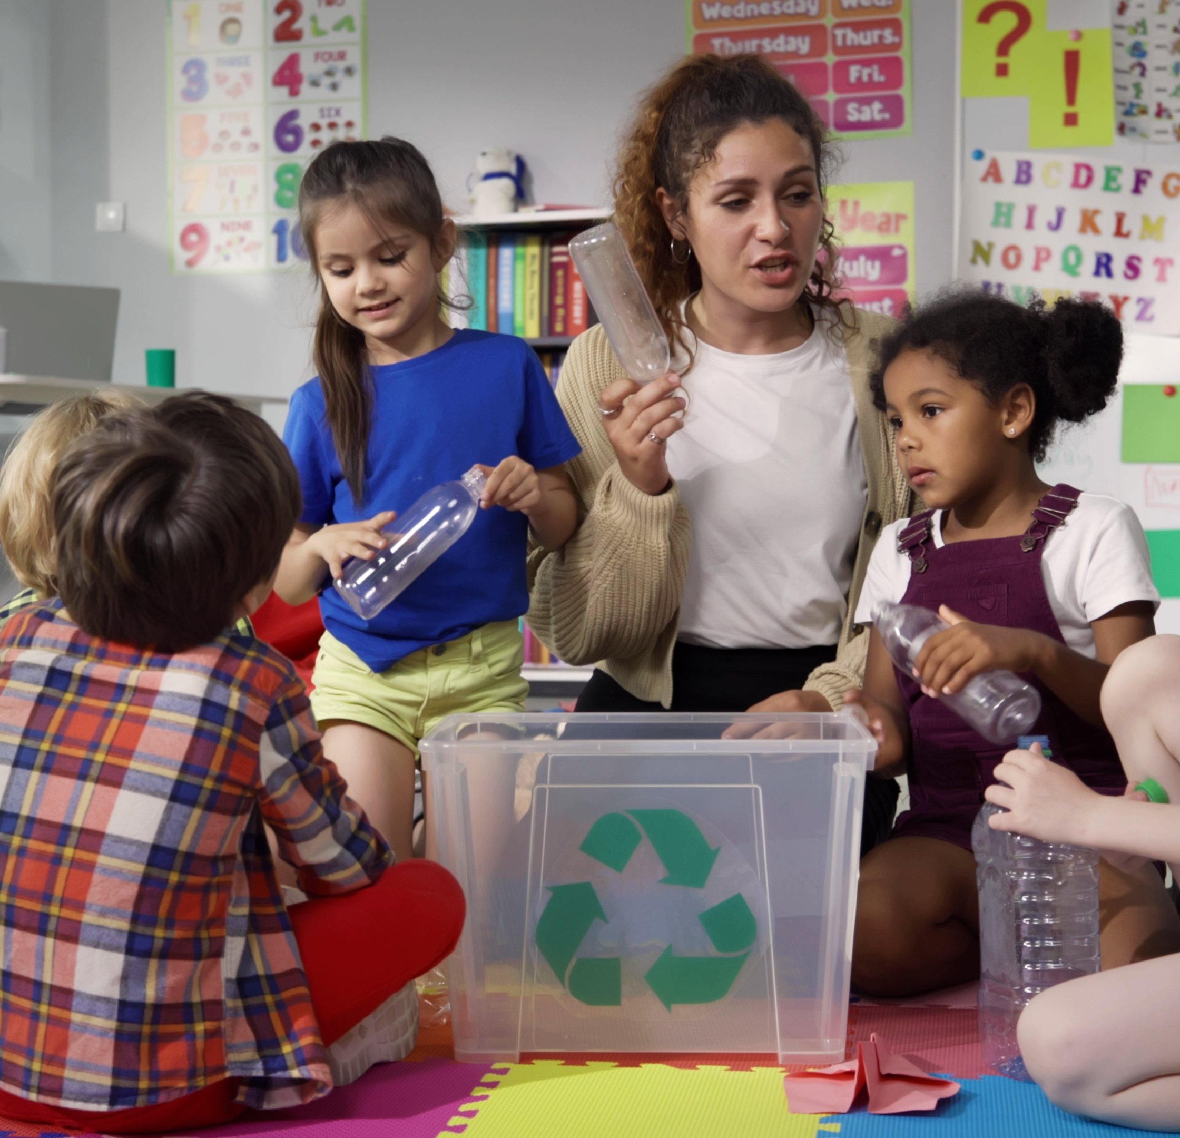
THEME: WASTE MANAGEMENT AND CIRCULAR ECONOMY
Activity: Waste race
Duration: 30 minutes
Step-by-Step:
Set up bins or boxes with labels.
Give each team a pile of waste items (drawings or clean examples).
Teams race to sort correctly.
End with a reflection: “Where does our waste go?”
Optional: Create an “upcycled art corner” or a ''upcycled art workshop” with leftover materials, showing them examples of art that can be created with waste.
Learning goal: Learn to sort waste and understand the value of recycling.
Notes:
This is a game that teaches children how to sort waste correctly. It’s a great way to introduce the concept of circular economy. Use the reflection moment to talk about where waste goes and how we can reduce it. The art corner adds a creative twist and helps reinforce the idea of reuse.

Slide 8

THEME: CLEAN ENERGY
Activity: Climate detectives
Duration: 45 minutes
Step-by-Step:
Divide the class into small “detective teams.”
Search classrooms for lights left on, open windows, or devices plugged in unnecessarily.
Note findings on a checklist.
Create a “Power Savers” poster and nominate classroom Energy Ambassadors.
Learning goal: Discovering how small actions reduce energy waste.
Notes:
This activity turns students into energy detectives! Guide them through the school to identify energy waste and empower them to take action. The goal is to make energy saving fun and visible, and to promote responsibility through the role of Energy Ambassadors. Celebrate their findings and encourage them to share tips with their families and become energy detectives at home.

Slide 9
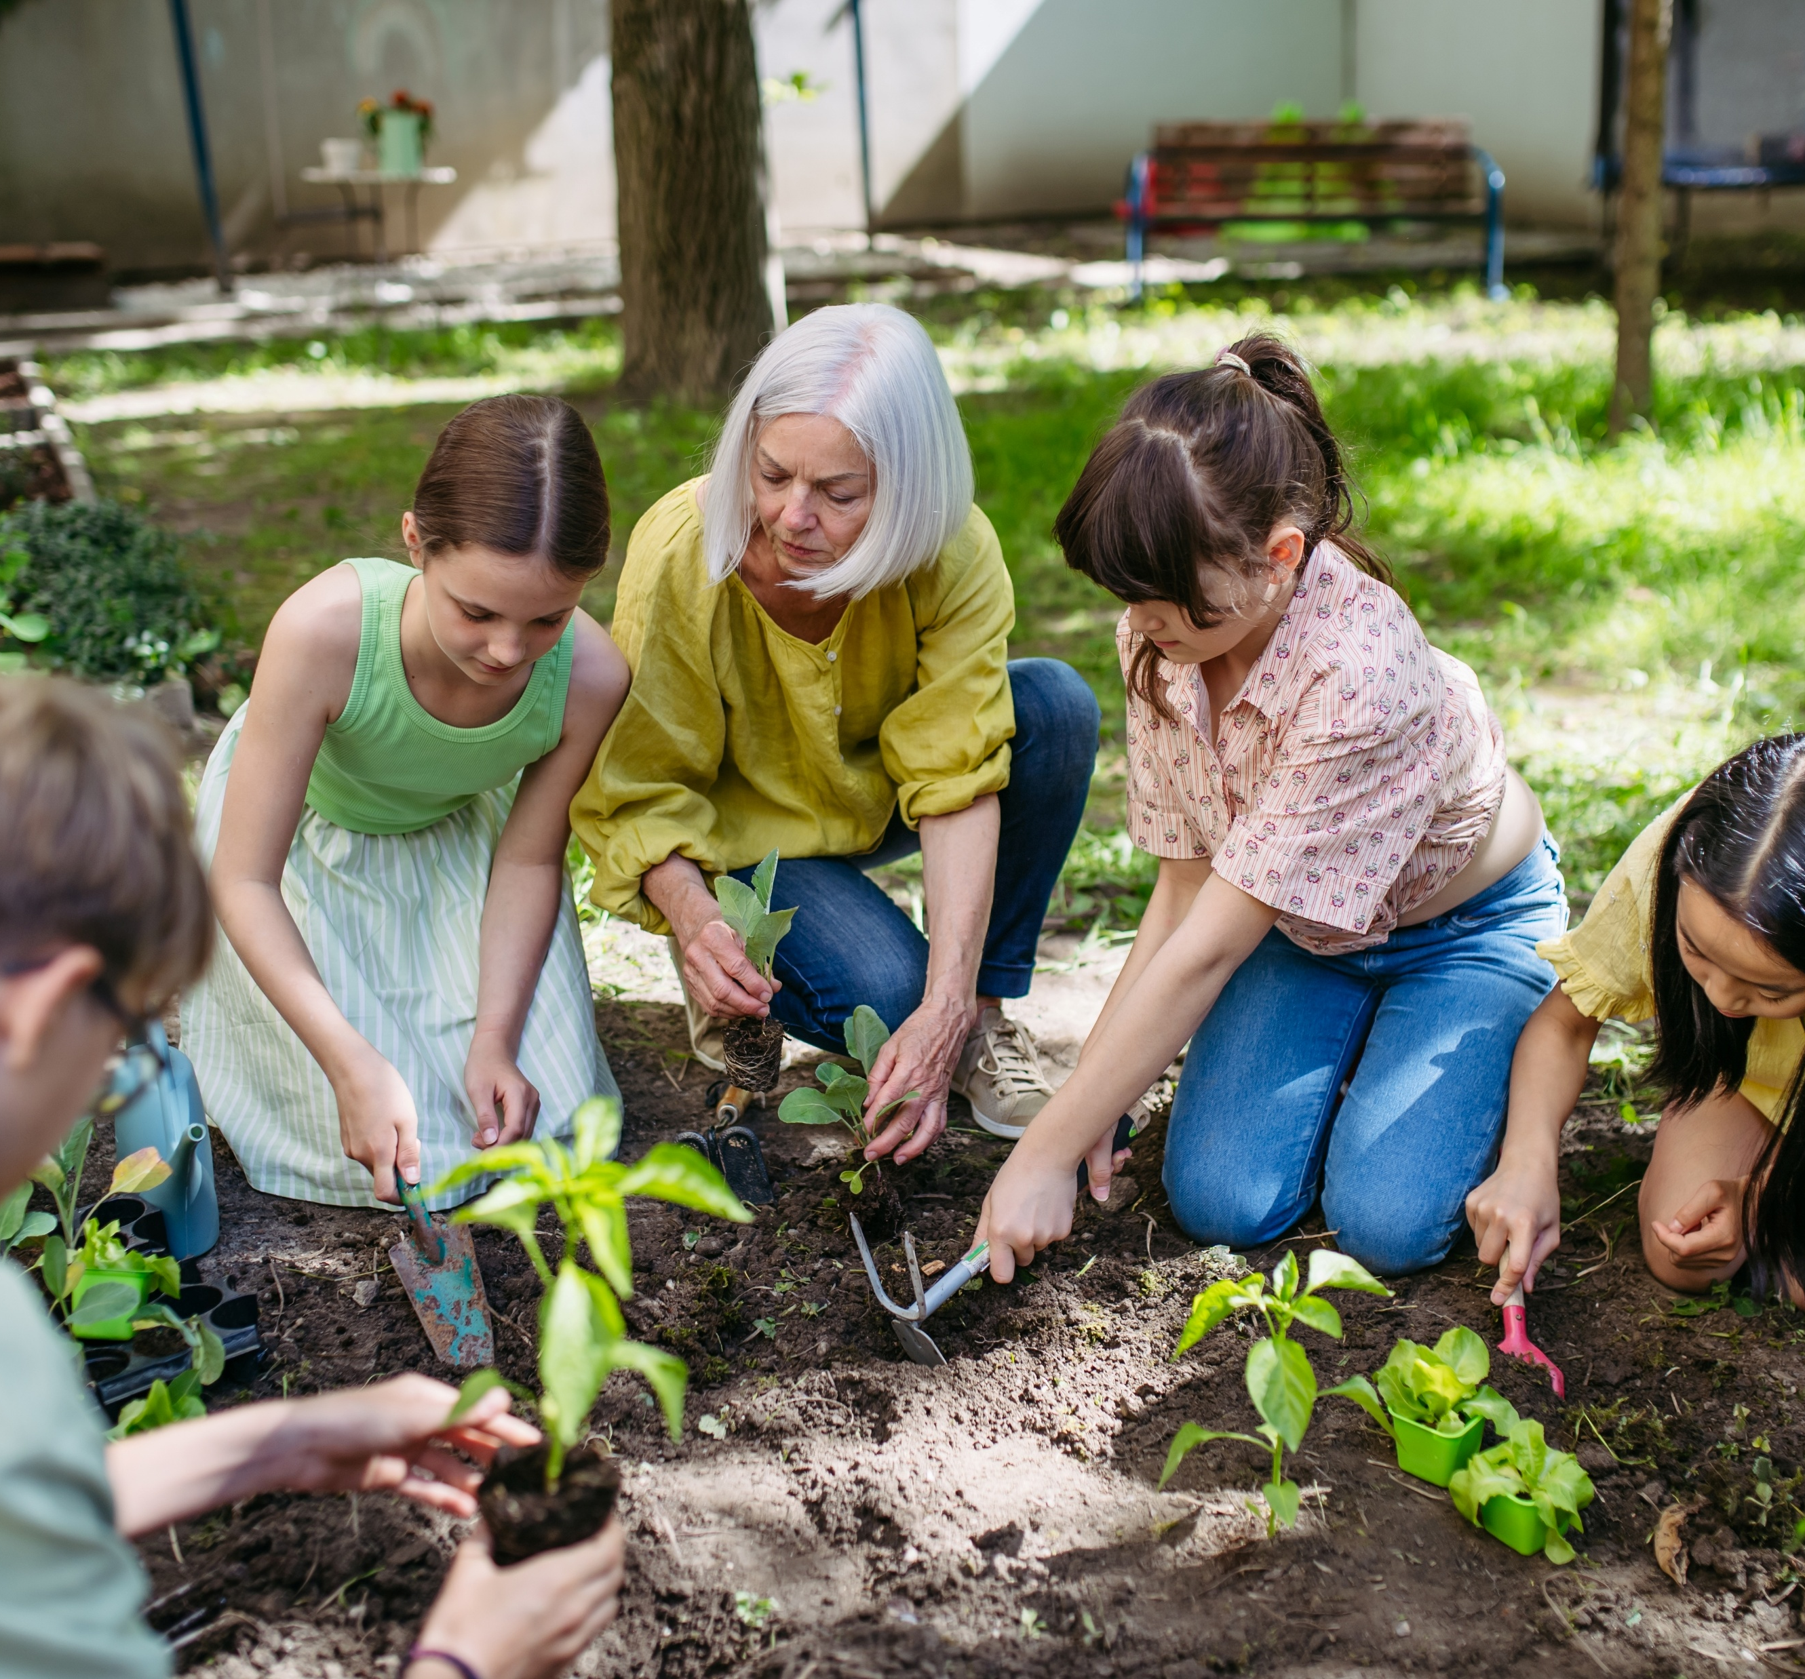
THEME: BIODIVERSITY AND NATURE-BASED SOLUTIONS (NBS)
Activity: Mini garden builders
Duration: 1 hour (plus short follow-ups over the next weeks)
Step-by-Step:
Set the scene: Talk briefly about plants and why they’re important for people and the planet (food, air, pollinators, cooling cities).
Prepare materials: Gather small pots, yogurt cups, or upcycled containers, soil, and easy-to-grow seeds (herbs, beans, sunflowers, etc.).
Planting time: Let each student fill their pot, plant a seed, and label it with their name and plant type.
Notes:
Encourage the educators to connect to local nature and biodiversity (e.g. local park or school garden). You can invite a local gardener, parent, or community volunteer to share planting tips, or encourage educators to highlight the importance of a local natural area. Link the discussion to broader Climate Pact themes: caring for nature, reducing emissions, and creating greener, healthier communities.

Slide 10
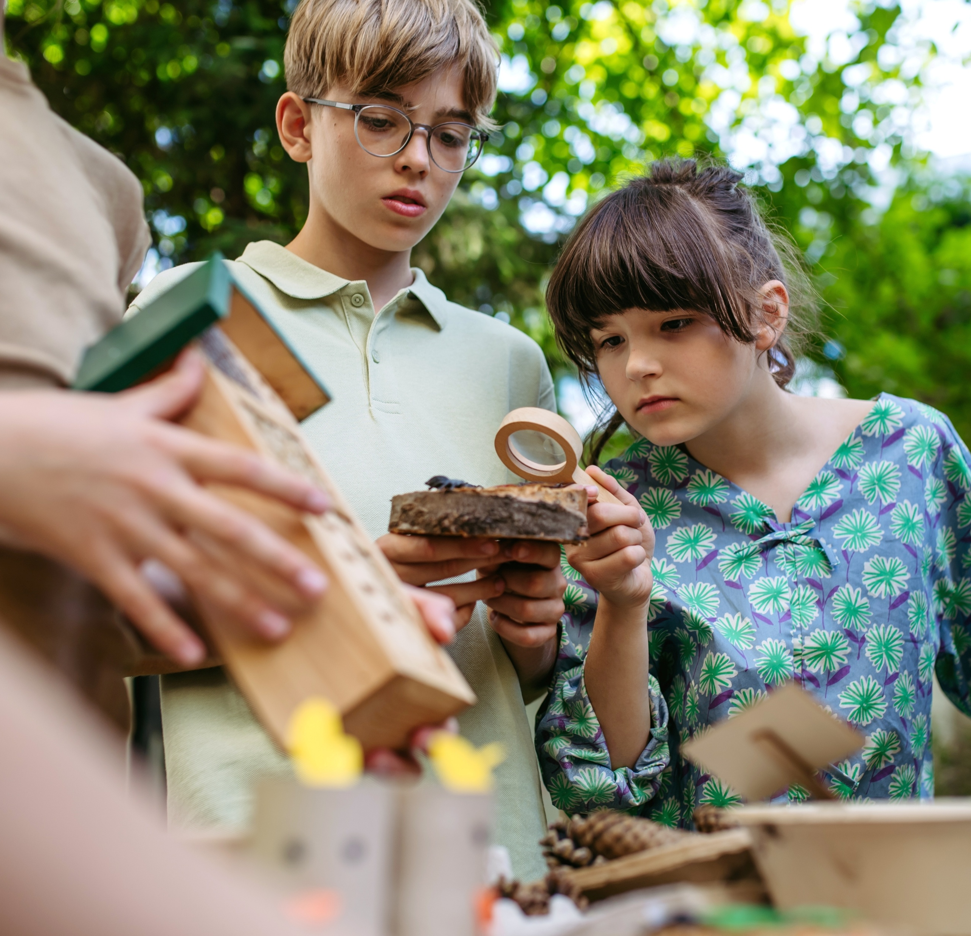
THEME: SUSTAINABLE AND LOCAL FOOD
Activity: Mini garden builders
Step-by-Step:
Learn through care: Discuss what plants need to grow (sunlight, water, air, care).
Ongoing observation: Water weekly and keep a “plant growth diary” with drawings or photos.
Reflection: Ask: “What do plants teach us about taking care of the Earth?”
Learning goal: Children learn about biodiversity, ecosystems and responsibility through hands-on experience with nature. They also see how small individual actions contribute to a healthier environment.

Slide 11
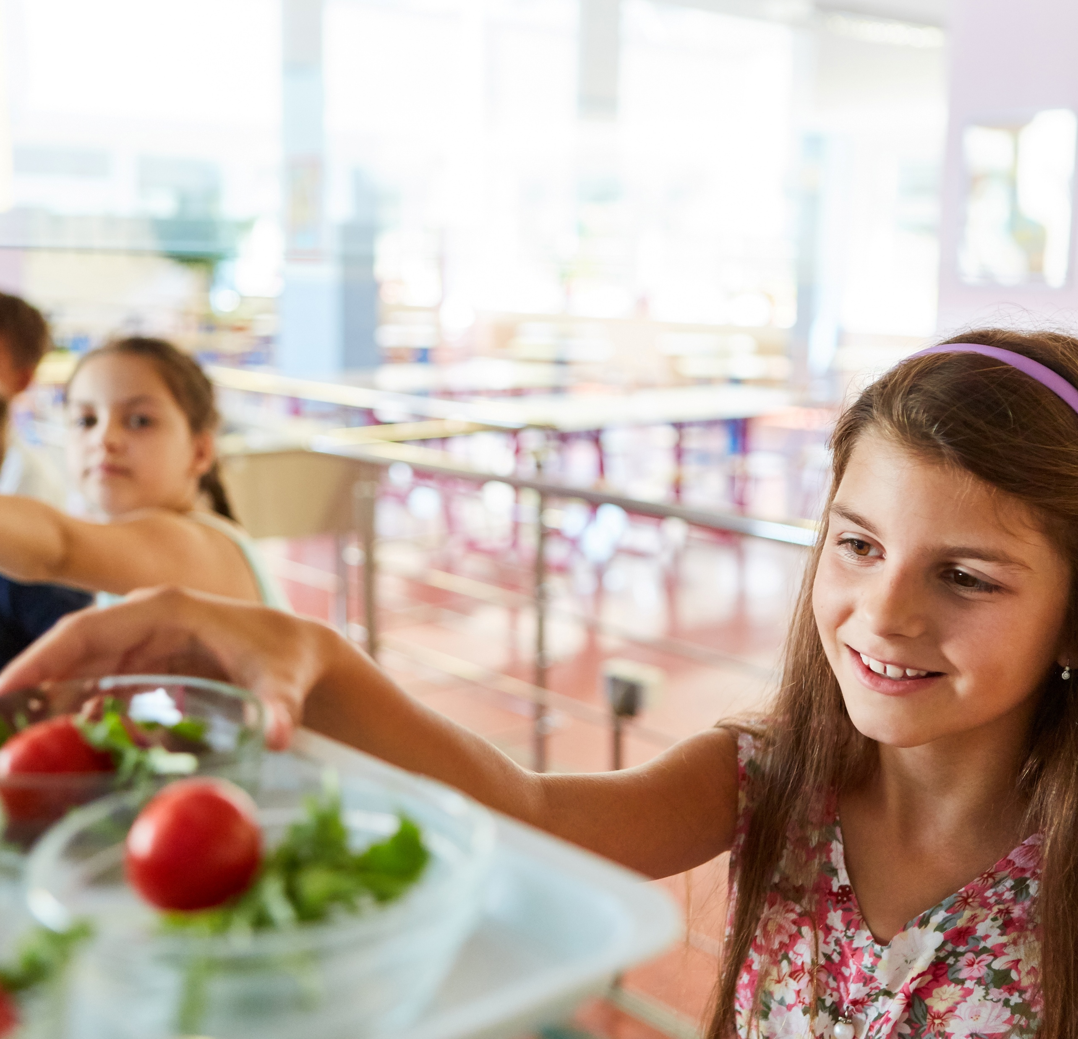
THEME: SUSTAINABLE AND LOCAL FOOD
Activity: From the garden to the plate
Duration: 1 hour (plus short follow-ups over the next weeks)
Step-by-Step:
Discuss “Where does our food come from?”
Visit the garden (if you have one in your school) or a park or natural area that has edible plants or fruit trees close to your school, or invite a local farmer/chef.
Prepare a small “local snack” (fruit, bread, veggies).
Reflect on how eating locally helps the planet.
Learning goal: Connecting food, climate, and local communities.
Notes:
This activity connects food, climate, and local communities. Encourage children to think about where their food comes from and how it’s grown. If possible, involve local farmers or chefs to make it more engaging. The goal is to build appreciation for local, seasonal food and reduce food waste. Link the discussion to climate-friendly choices and healthy eating.

Slide 12

Join the Pact2School campaign
and the Climate2School challenge!
Pact2School webpage: Join our new Pact2School campaign - European Union
Notes:
End by encouraging teachers and ambassadors to use these activities as starting points: small steps that build a shared culture of climate action in schools across Europe. Please also encorage teachers and other education community members to join the Pact2School campaign. The campaign aims to support children, youths, teachers and the rest of the education community to explore green action and sustainability topics, it also aims to develop meaningful partnerships between the Climate Pact community and schools and universities.
The campaign aims to inspire students and teachers by organising awareness raising sessions on the sustainability and climate action topics as well as to support schools to participate in the Pact2School challenge by submitting impactful student-led project ideas and get up to 1000 euros in project funding.
Pact2School campaign webpage: Join our new Pact2School campaign - European Union

Slide 13

Thank you for
helping our planet!

Slide 14
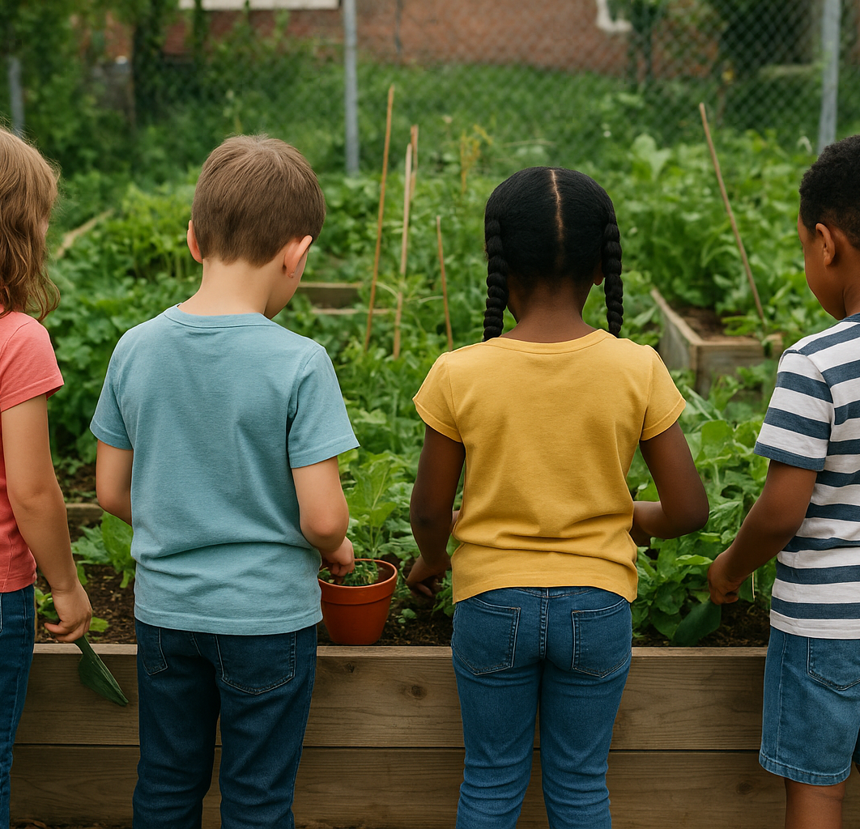
THEME:
Activity:
Duration: XX
Step-by-Step:
XX
XX
Learning goal:
Notes:
Feel free to add any activity that you might know and that you would like to share with teachers or other members of the education community.

Slide 15
Notes:
If you would like you could use this slide to introduce yourself and you can integrate it as part of the presentation

